Slide 1
BEGIN
Consists of trace data and markers involved in the model.
1
The setting winner of the second tournament selection will be updated by the process
recombination or mutation
I
READING
DATA
This operator allows the generation of new individuals before the combination of two or more individuals, and it supports the intuitive idea of information exchange between different candidate solutions. In classical genetic algorithm, a probability of recombination is assigned to the pairs of positions of the population.
GENERATION
OF U[0,1]
Function that adjusts the pair of positions
Method as to be considered
(SSE, BIC or AIC).
U[0,1]:0.6
>
2
II
OBJECTIVE FUNCTION FOR EVALUATION
Makes for each model test to verify the hypothesis Interaction effect for complete model formed by additive effects and interaction for two loci.
<=
RECOMBINATION
BLX-α
Stop 3.2
QUANTITY OF
GENERATIONS AND SOLUTIONS
GENERATION OF U[0,1]
pos1’ e pos2’: par de
posições obtidas
após a atualização
por recombinação ou
mutação e avaliados
(ajustados) pela
função objetiva
The best solution is stored elapse after each generation
SOLUTION<-1
Stop 1
If you have reached the amount of solutions generations / solution set for model simulation.
The algorithm stops after a certain number of generations and fixed solutions.
ATUALIZATIONS
GENERATION OF U[-α,1+α]
3
SHOW SOLUTION
YES
CONVERGE?
POS1’<-POS1+U[-α,α+1](POS2-POS1)
POS2’<-POS1+U[-α,α+1](POS2-POS1)
Stop 6
END
Stop 5
NO
Se atende as restrições, ou seja,
1 ≤pos1,pos2≤ tamanho do
Genoma (compgenoma) e
abs(pos1-pos2) ≥ 10
INICIALIZATION
MEET CONVERGENCY?
If it was not satisfied the stop condition, the algorithm returns to the step 2, heading for the next generation of the genetic algorithm, to to complete a certain number of generations
EVALUATION
NO
Stop 2
YES
Nesta etapa, o ajuste
contido em AVALIAÇÃO
é comparado com o
ajuste contido em
ATUALIZAÇÃO e caso o
ajuste de AVALIAÇÃO
seja menor, substituirá
o ajuste contido em
ATUALIZAÇÃO
Stop 3
GENERATION<-1
EVALUATION
Is the randomization of the four pairs of positions with their respective settings matched pairs, the winners of which will be the pairs of positions that have better fit than their respective competitive, according to the second contest of the tournament the two winners of their respective clashes .
SELECTION
ATUALIZATION
TOUENAMENT SELECTION I
Também compara com o
pior ajuste contido em
INICIALIZAÇÃO, e se for
melhor, o ajuste em
AVALIAÇAO será
inserido em seu lugar.
SOLUTION<-SOLUTION+1
TOUENAMENT SELECTION II
Stop 3.1
Choose the setting winner between the two settings I tournament winners
O ajuste de AVALIAÇÃO substituirá o menor entre os ajustes de
INICIALIZAÇÃO caso este seja maior que o ajuste contido em AVALIAÇÃO
1

Slide 2
2
The proposal in this case is to consider the use of mutation limit, where the operator replaces the value of a decision variable randomly selected by someone randomly whose value is also obtained. Another alternative is uniform method of mutation, which changes the position whose value is closest rounding uniformly between 0.51 and genome size more 0.49. For this work were considered mutation probabilities 0.1 and 0.4.
Stop 3.3
MUTATION
GENERATION
OF U[0,1]
PML: random variable that assumes discrete uniform distribution ranging from 1 to the size of the genome (compgenoma)
LIMIT MUTATION
<=
U[0,1]:0,5
>
UNIFORM
MUTATION
GENERATION OF U[0,1]
GENERATION OF PML~U[1,COMPGENOMA]
U[0,1]:0,5
>
UPPER
LIMIT
<=
ABS(PML-POS1):
ABS(PML-POS2}
LOWER LIMIT
<
>=
POS1’<-PML
POS2’<-PML
pos1’ e pos2’:pair of positions obtained after the upgrade by recombination or mutation and reviews
(adjusted) for the objective function
MEET CONVERGENGY?
NO
YES
EVALUATION
Stop 4
In the Startup matrix excludes the pair of positions of the population unless it worse adjustment (SSE residue or AIC or BIC) that the fit obtained by the pair of positions after the steps of recombination or mutation. This pair, after having passed through recombination or mutation process, will be inserted in the update if the setting it is less than the setting of the pair already inserted in the update.
ATUALIZATION
SOLUTION<-SOLUTION+1
3

Slide 3
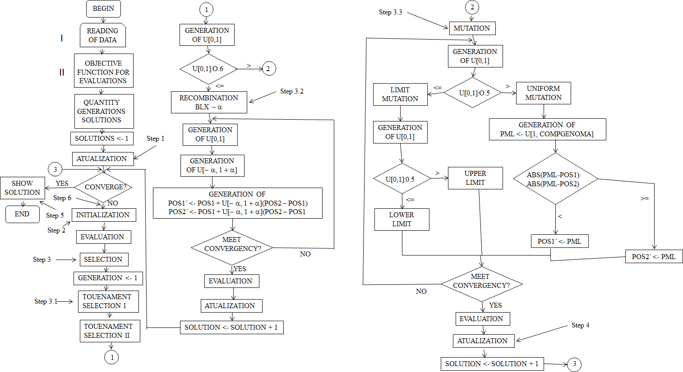
Function that adjusts the pair of positions Method as to be considered (SSE, BIC or AIC).

