Slide 1
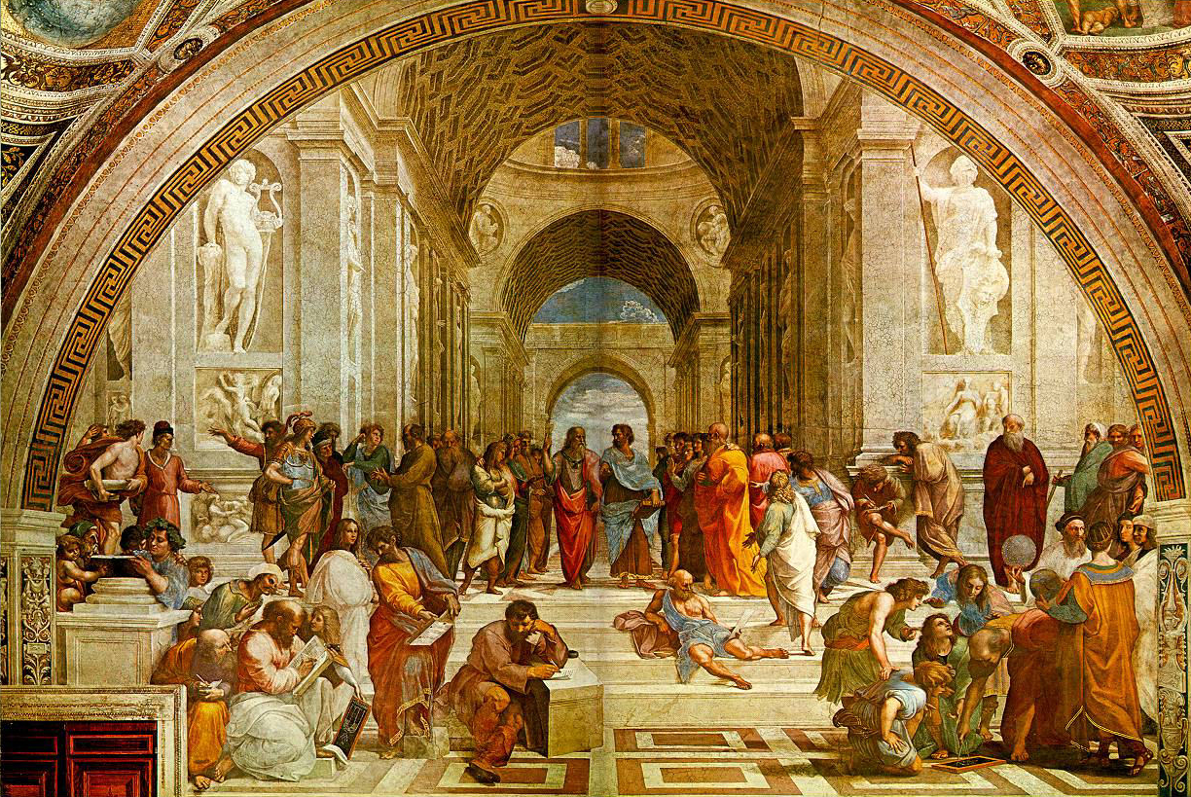
Open Problems
Modern Trends in Differential Geometry Sao Paulo
July 26, 2018
Possible basis for article in special issue SPJM.
, Pierre.PANSU@math.u-psud.fr
Notes:
<number>

Slide 2
Joaquín Pérez, Granada
Do CMC spheres about a point x form a foliation of X−{x}?
Could this be a way of proving embeddedness of CMC spheres in general?
Here X is a 3D, simply-connected, noncompact homogeneous manifold diffeomorphic to R³.
It is well known [MMPR] that CMC spheres in X exist exactly for values of the mean curvature H lying in an interval of the form (H(X),∞) where H(X) is the critical mean curvature of X. Furthermore, spheres of CMC H are unique up to congruencies, when they exist. This uniqueness leads to a well-defined notion of center of symmetry for CMC spheres. Finally, it is also known that if we take any point x in X, the class of CMC spheres with center x is a real analytic 1-parameter manifold. It is not known (but expected) if CMC spheres are embedded in general (they are known to be Alexandrov embedded).
[MMPR] William H. Meeks III, Pablo Mira, Joaquín Pérez, & Antonio Ros, CONSTANT MEAN CURVATURE SPHERES IN HOMOGENEOUS THREE-MANIFOLDS, https://arxiv.org/pdf/1706.09394.pdf

Slide 3
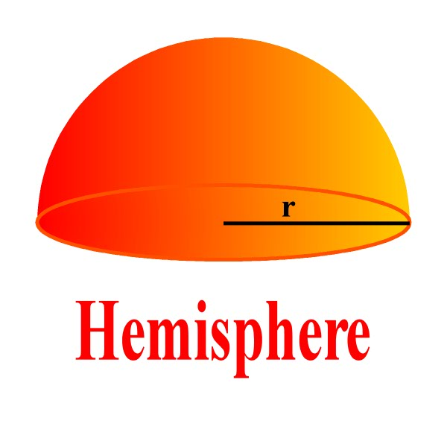
Olga Gil-Medrano, Valencia
In Berger-sphere projective spaces, is an equatorial projective space minimal? uniquely area minimizing in its homology class? (Known in 3D [G-M] and in round-sphere projective spaces RP^{n}.)

Slide 4
Lashi Bandara, Potsdam
Can a (noncompact) manifold with Ricci curvature bounded below be C⁰-approximated by one with Ricci curvature also bounded above?
(We restrict to manifolds with injectivity radius bounded below.)
During my thesis, my supervisor Alan McIntosh and I studied the Kato square root problem on manifolds. This problem is invariant under C⁰ or L∞ perturbations of metrics.

Slide 5
Renato Bettiol, CUNY
1. Give an alternative, geometric proof that the holonomy representation of a closed flat manifold is reducible.
2. Does S²xT² admit a Riemannian metric with positive biorthogonal curvature?
The biorthogonal curvature of a 4-manifold is defined, for each tangent plane σ, as the average of the sectional curvature of σ and σ⏊. Positive biorthogonal curvature is an intermediate condition between positive sectional curvature and positive scalar curvature. Clearly, S²xT² admits metrics with nonnegative biorthogonal curvature, but it is unknown if it can be deformed into a metric with (strictly) positive biorthogonal curvature. Settling this matter would be a crucial step in classifying non-simply connected closed 4-manifolds with positive biorthogonal curvature (the simply-connected classification, up to homeomorphisms, was obtained in [1]).
1. Bettiol, R. G.: Four-dimensional manifolds with positive biorthogonal curvature
Asian J. Math 21 (2017), no. 2, 391 - 396
2. Bettiol, R. G.: Positive biorthogonal curvature on S²xS². Proc. Amer. Math. Soc. 142 (2014), no. 12, 4341 - 4353.

Slide 6
Ian Adelstein, Yale
Can you hear an orbifold singularity?
Mark Kac in the American Mathematical Monthly in 1966 famously ask if one can hear the shape of a drum, by which he meant whether the Laplace spectrum of a manifold determines its isometry class. John Milnor quickly answered this question in the negative, by producing a pair of isospectral yet non-isometric 16 dimensional tori.
An important open question is whether one can hear the presence of an orbifold singularity, i.e. whether or not there exists a pair of isospectral orbifolds, one of which has singular points whereas the other does not and is therefore a manifold [2].
Recent work has shown that non-orbifold singularities are inaudible to the G-invariant spectrum. In [1] the authors construct a pair of orbit spaces with equivalent G-invariant spectra, yet where one space is isometric to an orbifold whereas the other admits a non-orbifold singularity.
1. IM Adelstein and MR Sandoval, The G-invariant spectrum and non-orbifold singularities, Arch. Math., 109 (2017), 563-573.
2. C Sutton, Equivariant isospectrality and Sunada's method, Arch. Math., 95 (2010), 75-85.

Slide 7
Claudio Gorodski, IME-USP
For a bi-invariant metric on a compact connected Lie group, the index of any geodesic is even (Bott).
Does this property characterize bi-invariant metrics among left-invariant ones?

Slide 8
Joaquin Pérez, Granada
Calabi-Yau problem. For an embedded minimal surface in R³, does complete imply proper ?
Hoffman-Meeks conjecture. For a complete embedded minimal surface of genus g and k ends and finite total curv, k ≤ g + 2.
Davi Maximo, UPenn
Do there exist embedded minimal surfaces with finite genus and Morse index 3? or 4?
More focused : in the 1-parameter deformation of Costa's surface, does the index stay constant?

Slide 9
Ruy Loja Fernandes, IST Lisbon
Understand the role of Poisson structures in the explicit integration of certain examples (Bochner-Kähler, connections with special holonomy).
Jorge Lauret, Córdoba
For amenable Lie groups G, show that semi-algebraic solitons are the only maxima of the functional
g → F(g) = Scal(g)²/|Ric(g)|²
on G-invariant Riemannian metrics on G/K.

Slide 10
Pierre Pansu, Paris-Sud
Find more numerical invariants of metric spaces that are nondecreasing under coarse/uniform embeddings.
Dominique Hulin
Find applications of the harmonic map approximation of coarse/uniform embeddings.

Slide 11
Elisha Falbel, Paris VI
Which manifolds can be modeled on an orbit of a real form in a space of flags?
What is the homotopy classification of totally real immersions of real 3-manifolds in the complex full flag manifold F₁₂?
Gormov's H-principle applies here, so the problem should belong to homotopy theory.

Slide 12
Camillo de Lellis, Zürich
1. Prove that an area-minimizing oriented surface is regular at almost all boundary points.
2. Is there an area-minimizing oriented 2D surface with infinitely many branch points (converging to a boundary point)? (We have an example with infinitely many crossings.)
3. Is every area-minimizing 2D surface bounded by a smooth curve of finite topological type?

Slide 13
Bernard Henke, Augsburg
Conj (Gromov-Lawson 1980, Rosenberg 1986).
A closed connected manifold of dimension at least 5 admits a positive scalar curvature metric if and only if a generalized index invariant vanishes.
Holds in simply connected case (Gromov-Lawson 1980, Stolz 1992).
False in general for infinite fundamental groups (Schick 1998).

Slide 14
Wolfgang Ziller, UPenn
Does Frankel's theorem on the intersection of totally geodesic submanifolds hold for symmetric Finsler metrics?
Frankel’s theorem says that in a complete connected Riemannian n-manifold of positive sectional curvature two closed totally geodesic submanifolds of dimension n₁ and n₂ must intersect provided n₁ + n₂ ≥ n.
Miguel Angel Javaloyes (at Ziller talk).
Find an example of a Finsler 2-sphere with n simple closed geodesics with 2 < n < ∞.

Slide 15
Carlos Olmos, Córdoba
Conj 1. If the normal holonomy group of an irreducible and full homogeneous submanifold M^{n} of the sphere with n ≥ 2 does not act transitively, then M is the orbit of an s-representation.
Conj 2. The index of an irreducible symmetric space which is different from G₂/SO(4) (or its symmetric dual) coincides with its reflective index.
Open Questions about homogeneous Riemannian manifolds with nontrivial nullity.
Are there examples which are not topologically trivial?
Are there examples M = G/H, with G non-solvable?
Are there Kähler examples?
Are there examples in any dimension d ≥ 5?

Slide 16
Roberto Miatello, Córdoba
“On the Hodge spectra of lens spaces”
How to construct L and L’ ||₁- and ||₁*-isospectral in all dimensions?
Are there families with more than two elements?
Is there a procedure to go from mD to (m+1)D?
What is connection with toric geometry (see Mohades-Honari)?

Slide 17
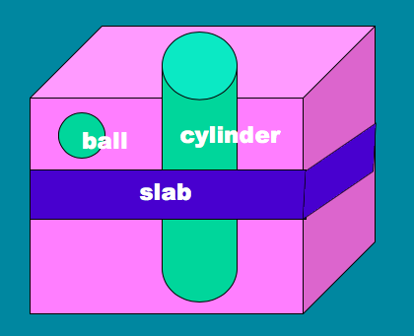
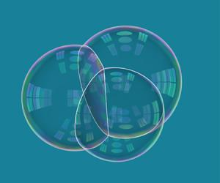
Frank Morgan, Williams College
Isoperimetric Problem in CP². Prove that geodesic spheres provide the least-perimeter way to enclose prescribed volume in CP².
Isoperimetric Problem in Cubic Torus (Ritoré and Ros). Prove spheres, cylinders, and slabs best.
Triple Bubble in R³. Prove that the pictured standard triple soap bubble is the least-perimeter way to enclose and separate three given volumes in R³.

