Slide 1
Convex sets in modules over semifields
Karl-Ernst Biebler
Institute for Biometry and Medical Informatics
Ernst-Moritz-Arndt-University Greifswald
Greifswald, Germany
Email: biebler@biometrie.uni-greifswald.de

Slide 2
Outline
Vector lattices and semifields
Modules over semifields
S-convex sets in modules over semifields
S-norm and S-convexity
S-normability and inner product
S-lineartopological S-module and S-norm
Extension theorems in S-modules
References

Slide 3
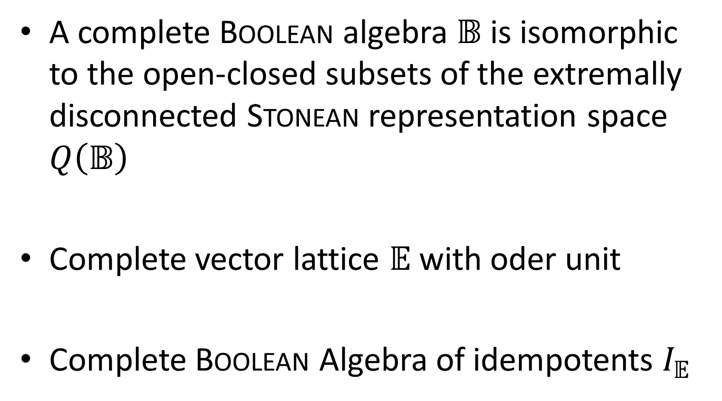
1. Vector lattices
A complete Boolean algebra $𝔹$ is isomorphic to the open-closed subsets of the extremally disconnected Stonean representation space $Q\left(𝔹\right)$
Complete vector lattice $𝔼$with oder unit
Complete Boolean Algebra of idempotents $I_{𝔼}$

Slide 4
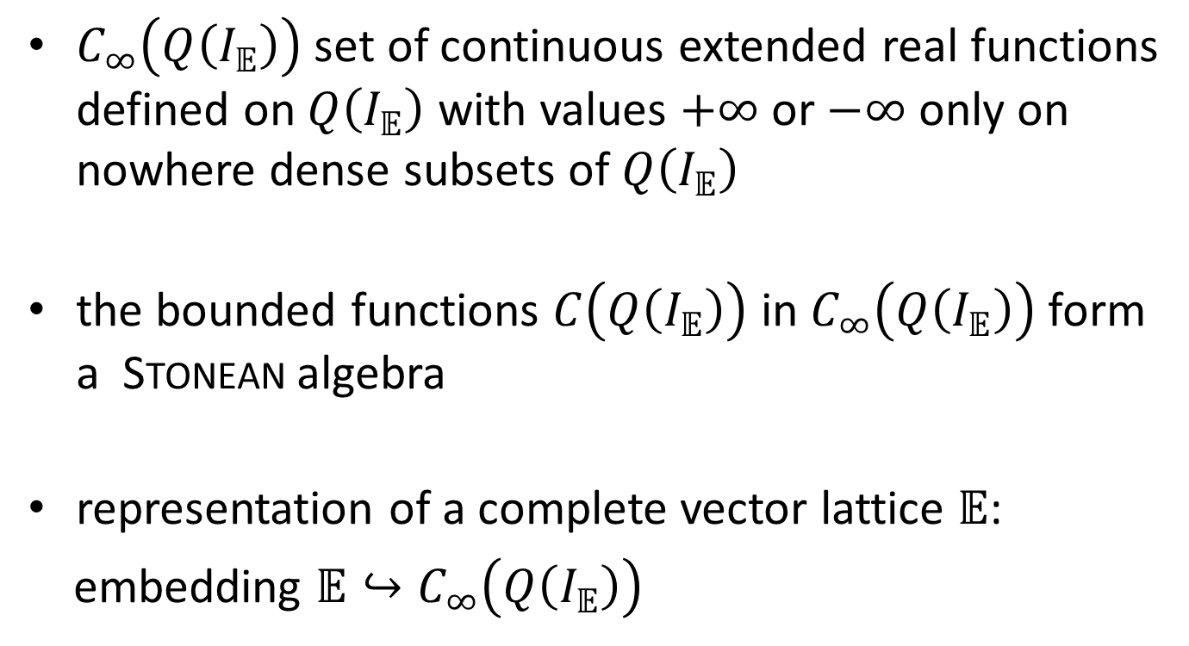
1. Vector lattices
$C_{∞}\left(Q\left(I_{𝔼}\right)\right)$ set of continuous extended real functions defined on $Q\left(I_{𝔼}\right)$ with values $+∞$ or $−∞$ only on nowhere dense subsets of $Q\left(I_{𝔼}\right)$
the bounded functions $C\left(Q\left(I_{𝔼}\right)\right)$ in $C_{∞}\left(Q\left(I_{𝔼}\right)\right)$ form a Stonean algebra
representation of a complete vector lattice $𝔼$:
embedding $𝔼↪C_{∞}\left(Q\left(I_{𝔼}\right)\right)$

Slide 5
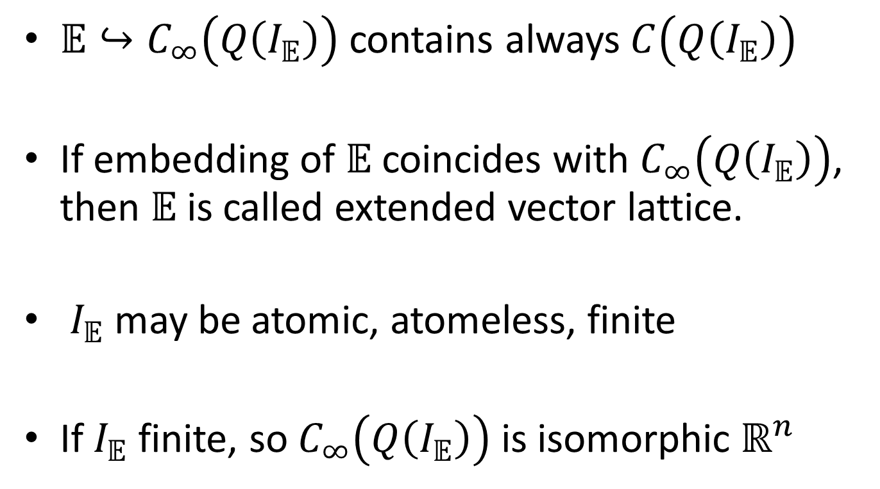
1. Vector lattices
$𝔼↪C_{∞}\left(Q\left(I_{𝔼}\right)\right)$ contains always $C\left(Q\left(I_{𝔼}\right)\right)$
If embedding of $𝔼$ coincides with $C_{∞}\left(Q\left(I_{𝔼}\right)\right)$, then $𝔼$ is called extended vector lattice.
$I_{𝔼}$ may be atomic, atomeless, finite
If $I_{𝔼}$ finite, so $C_{∞}\left(Q\left(I_{𝔼}\right)\right)$ is isomorphic $ℝ^{n}$

Slide 6
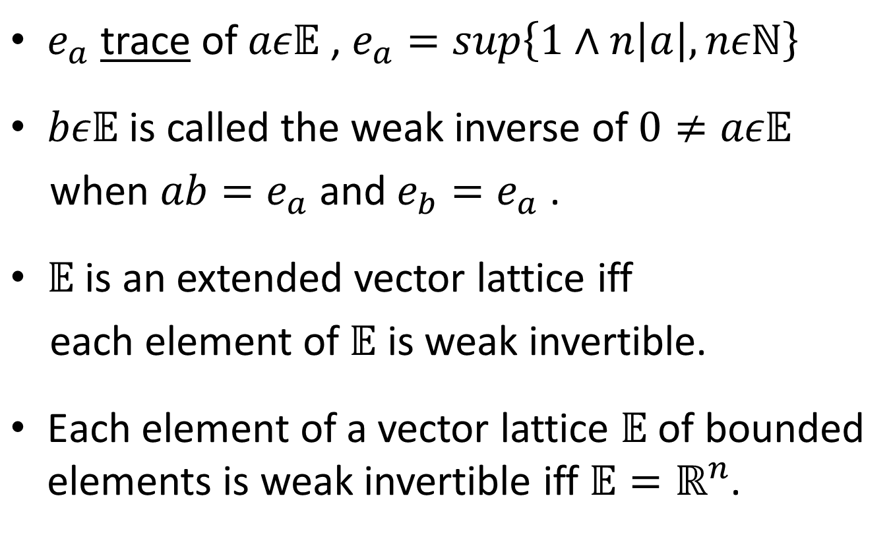
1. Vector lattices
$e_{a}$ trace of $aε𝔼$ , $e_{a}=sup\left\{1∧n\left|a\right|, nεℕ\right\}$
$bε𝔼$ is called the weak inverse of $0≠aε𝔼$
when $ab=e_{a}$ and $e_{b}=e_{a}$ .
$𝔼$ is an extended vector lattice iff
each element of $𝔼$ is weak invertible.
$\text{Each} \text{element} \text{of} \text{a}$ vector lattice $𝔼$ of bounded elements is weak invertible iff $𝔼=ℝ^{n}$.

Slide 7
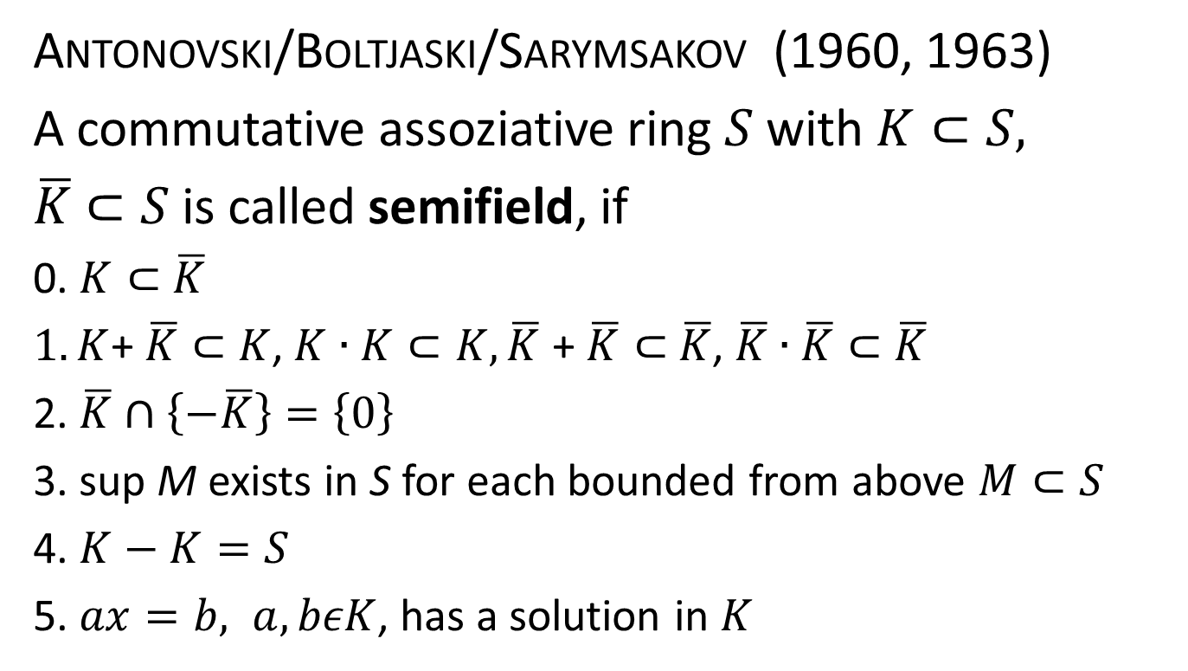
1. Semifields
Antonovski/Boltjaski/Sarymsakov (1960, 1963)
A commutative assoziative ring $S$ with $K⊂S,$
$\overline{K}$ $⊂S$ is called semifield, if
0. $K⊂$ $\overline{K}$
$1.K$+ $\overline{K}⊂$ $K$, $K∙K⊂K, \overline{K}$ + $\overline{K}⊂$ $\overline{K}$, $\overline{K}$ $∙$ $\overline{K}⊂$ $\overline{K}$
2. $\overline{K}$ $∩$ $\left\{−\overline{K}\right\}=\left\{0\right\}$
3. sup M exists in S for each bounded from above $M⊂S$
4. $K−K=S$
5. $ax=b, a,bεK$, has a solution in $K$

Slide 8
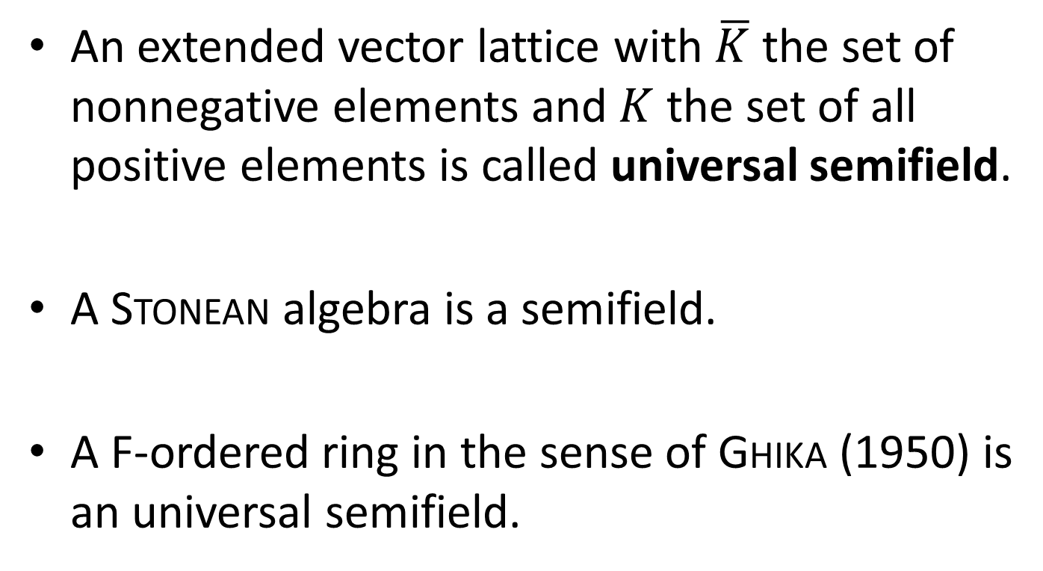
1. Semifields
An extended vector lattice with $\overline{K}$ the set of nonnegative elements and $K$ the set of all positive elements is called universal semifield.
A Stonean algebra is a semifield.
A F-ordered ring in the sense of Ghika (1950) is an universal semifield.

Slide 9
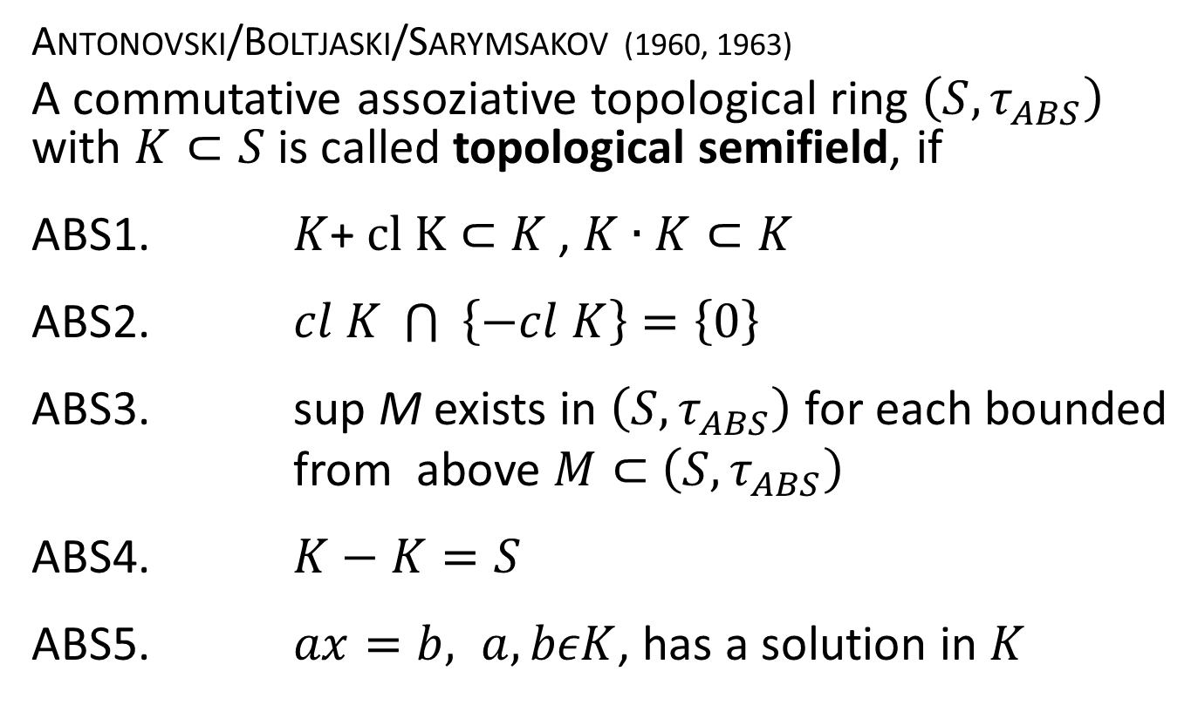
1. Topological semifields
Antonovski/Boltjaski/Sarymsakov (1960, 1963)
A commutative assoziative topological ring $\left(S, τ_{ABS}\right)$ with $K⊂S$ is called topological semifield, if
ABS1. $K$+ $cl K⊂$ $K$ , $K∙K⊂K$
ABS2. $cl K \bigcap{ \left\{−cl K\right\}=\left\{0\right\}}$
ABS3. sup M exists in $\left(S, τ_{ABS}\right)$ for each bounded
from above $M⊂$ $\left(S, τ_{ABS}\right)$
ABS4. $K−K=S$
ABS5. $ax=b, a,bεK$, has a solution in $K$

Slide 10
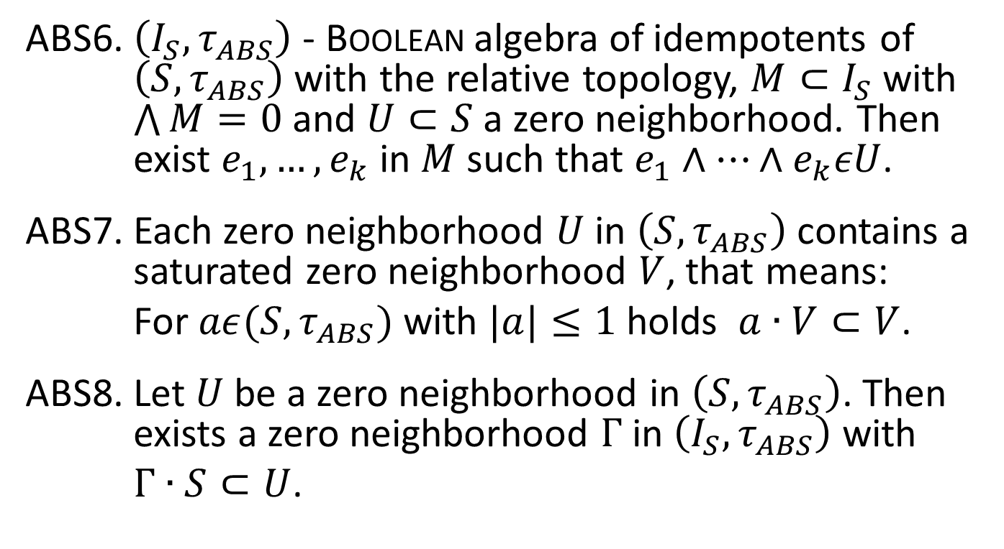
1. Topological semifields
ABS6. $\left(I_{S}, τ_{ABS}\right)$ - Boolean algebra of idempotents of $\left(S, τ_{ABS}\right)$ with the relative topology, $M⊂I_{S}$ with $\bigwedge{M=0}$ and $U⊂S$ a zero neighborhood. Then exist $e_{1},…,e_{k}$ in $M$ such that $e_{1}∧…∧e_{k}εU$.
ABS7. Each zero neighborhood $U$ in $\left(S, τ_{ABS}\right)$ contains a saturated zero neighborhood $V$, that means:
For $aε(S, τ_{ABS})$ with $|a|≤1$ holds $a∙V⊂V$.
ABS8. Let $U$ be a zero neighborhood in $\left(S, τ_{ABS}\right)$. Then exists a zero neighborhood $Γ$in $\left(I_{S}, τ_{ABS}\right)$ with
$Γ∙S⊂U$.

Slide 11
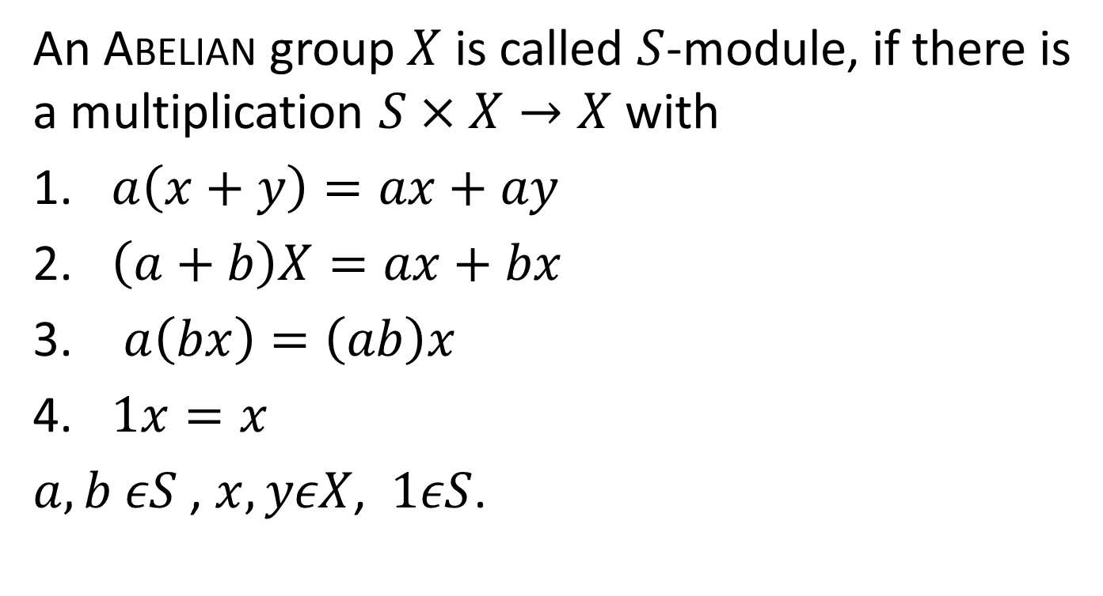
2. Modules over semifields
An Abelian group $X$ is called $S$-module, if there is a multiplication $S×X→X$ with
$a\left(x+y\right)=ax+ay$
$\left(a+b\right)X=ax+bx$
$a\left(bx\right)=\left(ab\right)x$
$1x=x$
$a,b εS$ , $x,yεX$, $1εS$.

Slide 12
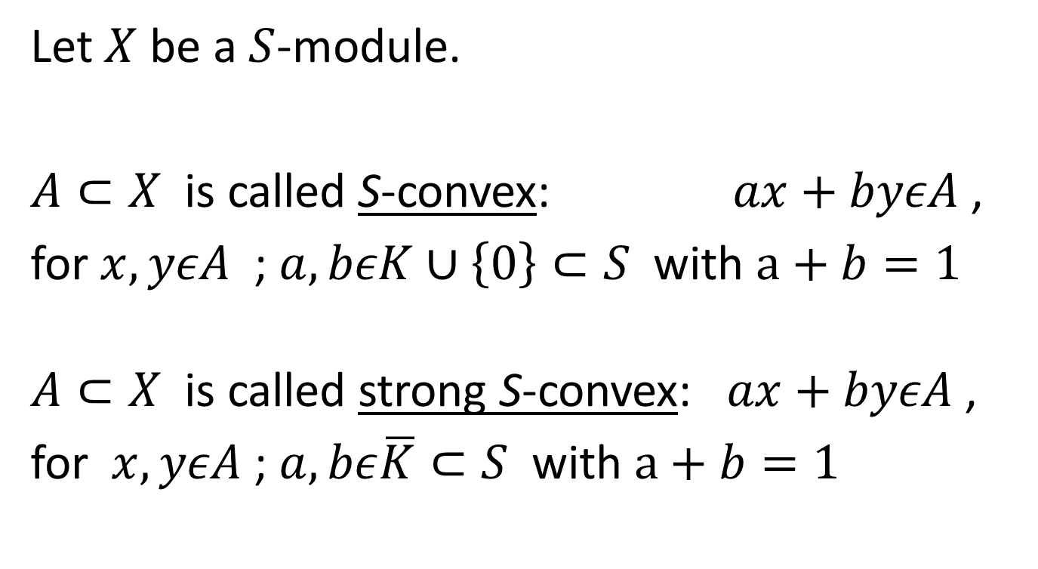
3. S-convex sets in S-modules
Let $X$ be a $S$-module.
$A⊂X$ is called S-convex: $ax+byεA$ ,
for $x,yεA$ ; $a,bεK∪\left\{0\right\}⊂S$ with $a+b=1$
$A⊂X$ is called strong S-convex: $ax+byεA$ ,
for $x,yεA$ ; $a,bε\overline{K}⊂S$ with $a+b=1$

Slide 13
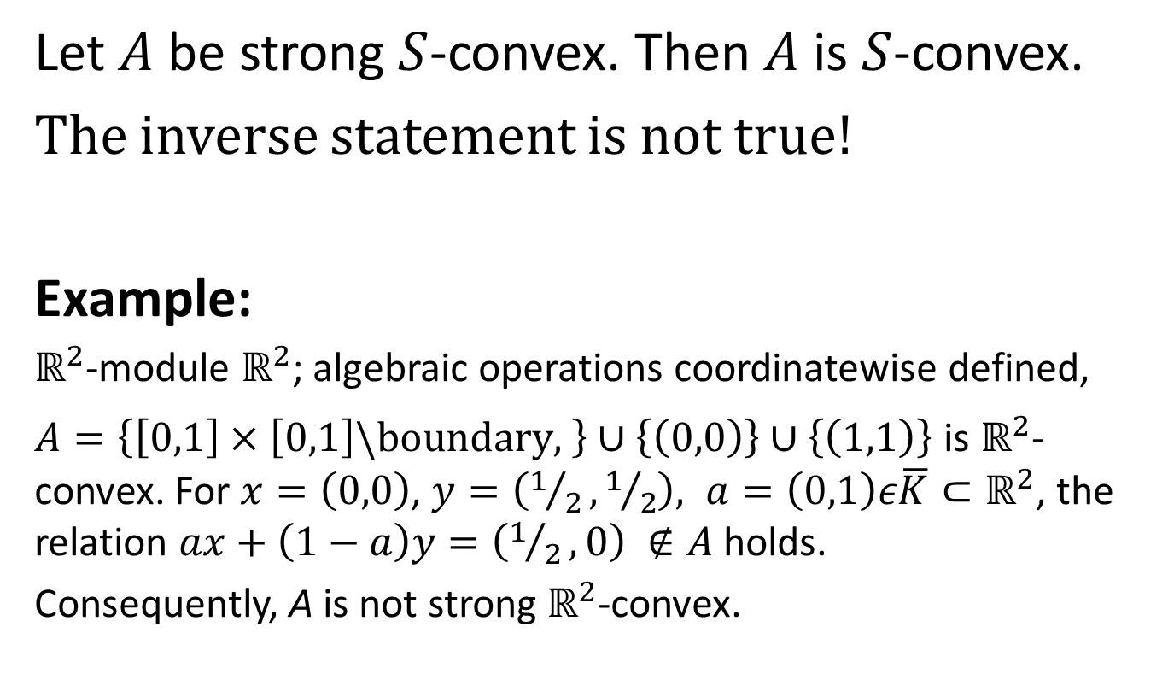
3. S-convex sets in S-modules
Let $A$ be strong $S$-convex. Then $A$ is $S$-convex.
The inverse statement is not true!
Example:
$ℝ^{2}$-module $ℝ^{2}$; algebraic operations coordinatewise defined,
$A=\left\{\left[0,1\right]×\left[0,1\right]\backslash boundary, \right\}$ $∪\left\{\left(0,0\right)\right\}∪\left\{\left(1,1\right)\right\}$ is $ℝ^{2}$-convex. For $x=\left(0,0\right)$, $y=\left(1/2,1/2\right), a=\left(0,1\right)ε\overline{K}⊂ℝ^{2}$, the relation $ax+\left(1−a\right)y=\left(1/2,0\right) ∉A$ holds.
Consequently, A is not strong $ℝ^{2}$-convex.

Slide 14
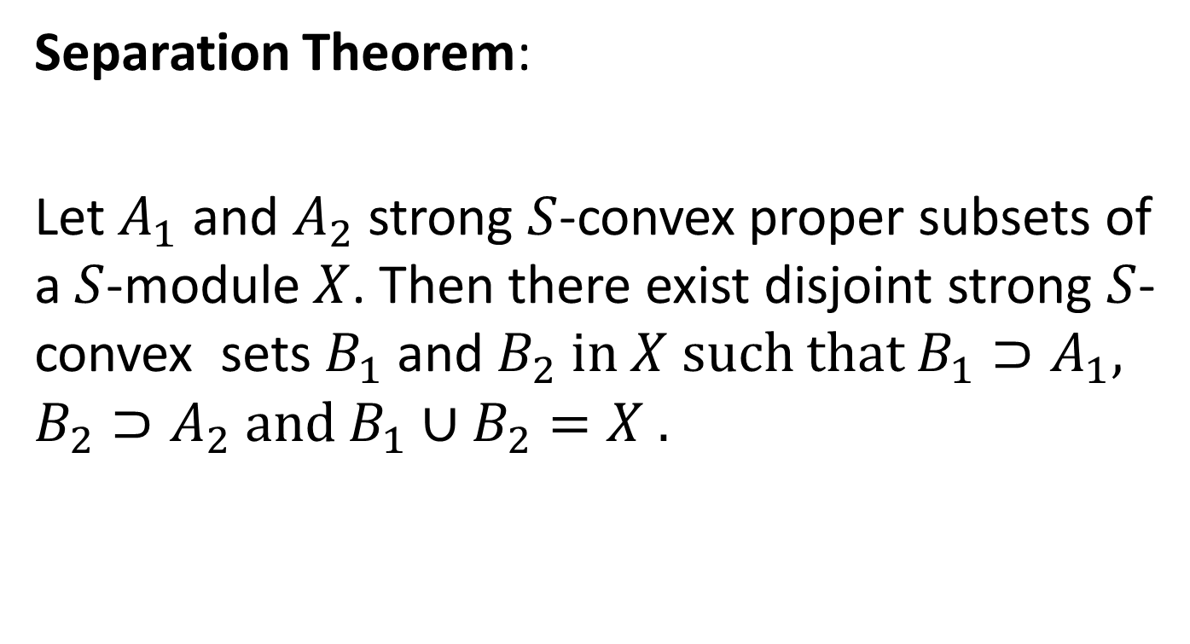
3. S-convex sets in S-modules
Separation Theorem:
Let $A_{1}$ and $A_{2}$strong $S$-convex proper subsets of a $S$-module $X$. Then there exist disjoint strong $S$-convex sets $B_{1}$ and $B_{2}$ in $X$ such that $B_{1}⊃A_{1}$, $B_{2}⊃A_{2}$ and $B_{1}∪B_{2}=X$ .

Slide 15
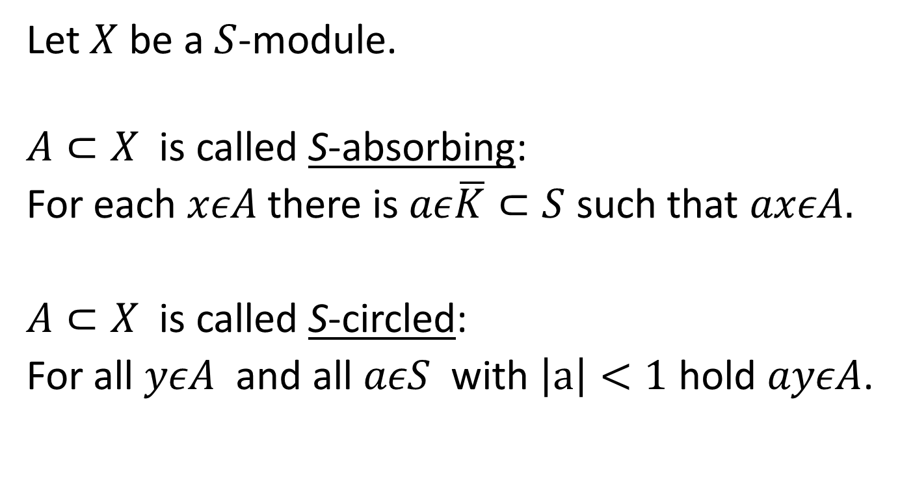
3. S-convex sets in S-modules
Let $X$ be a $S$-module.
$A⊂X$ is called S-absorbing:
For each $xεA$ there is $aε\overline{K}⊂S$ such that $axεA.$
$A⊂X$ is called S-circled:
For all $yεA$ and all $aεS$ with $\left|a\right|<1$ hold $ayεA$.

Slide 16
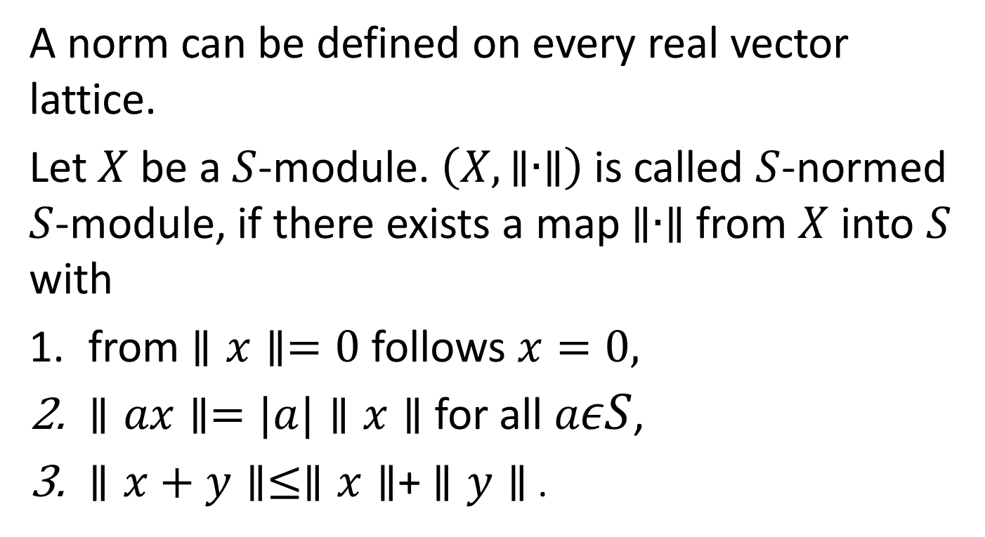
4. S-norm and S-convexity
A norm can be defined on every real vector lattice.
Let $X$ be a $S$-module. $\left(X, ∥∙∥\right)$ is called $S$-normed $S$-module, if there exists a map $∥∙∥$ from $X$ into $S$ with
from $∥x∥=0$ follows $x=0,$
$∥ax∥=|a|∥x∥$ for all $aεS$,
$∥x+y∥≤∥x∥$+ $∥y∥$ .

Slide 17
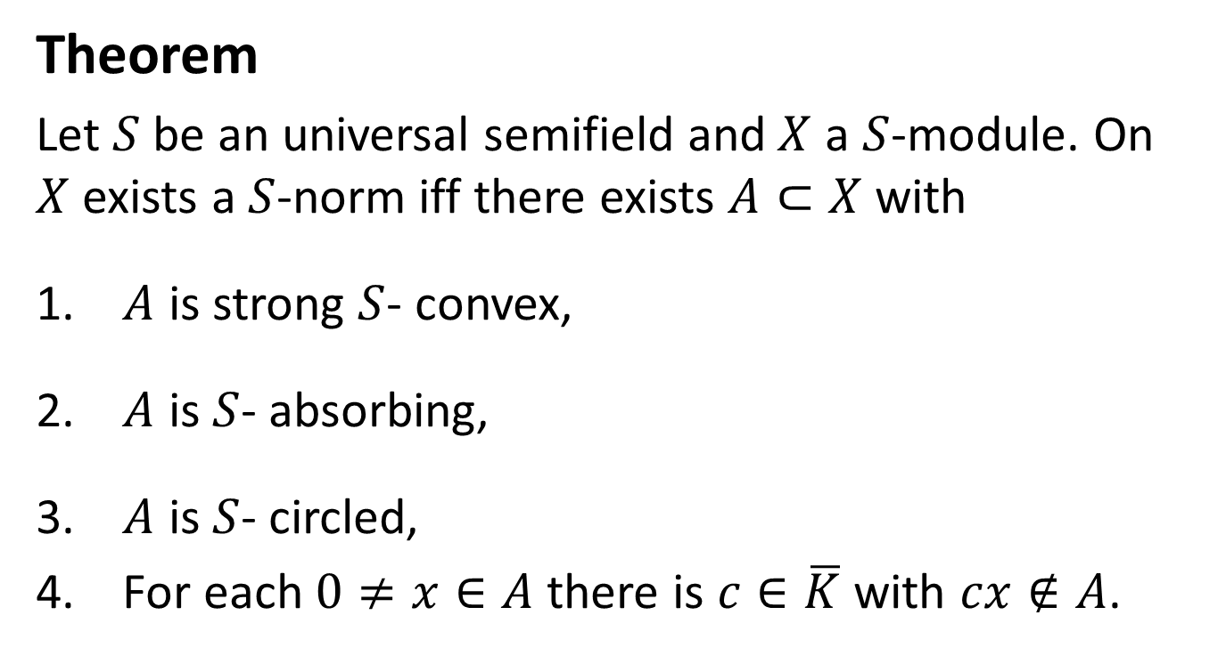
4. S-norm and S-convexity
Theorem
Let $S$ be an universal semifield and$X$ a $S$-module. On $X$exists a $S$-norm iff there exists $A⊂X$ with
$A$ is strong $S$- convex,
$A$ is $S$- absorbing,
$A$ is $S$- circled,
For each $0≠x∈A$ there is $c∈\overline{K}$ with $cx∉A$.

Slide 18
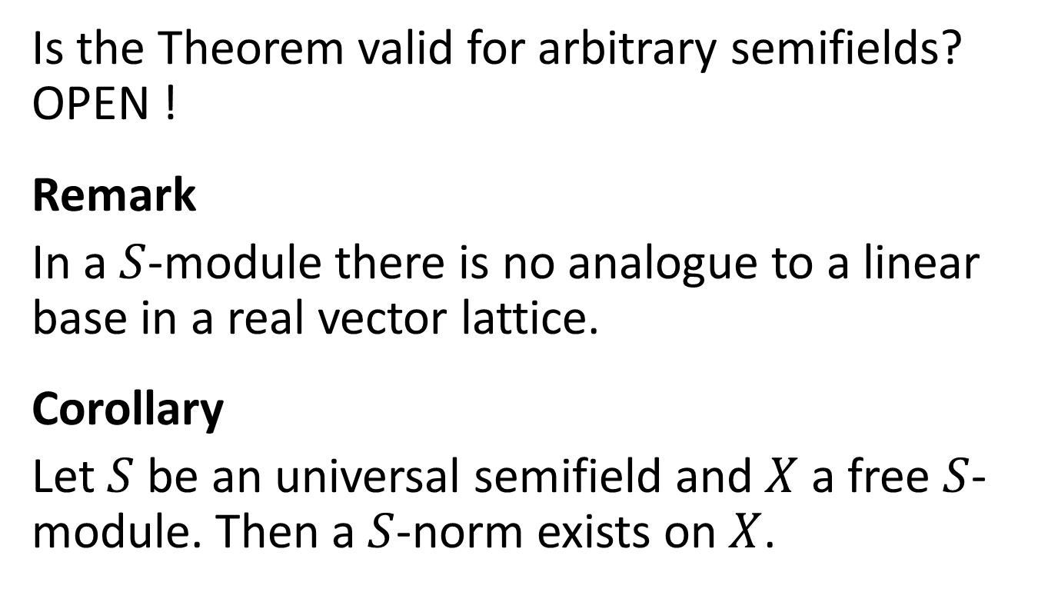
4. S-norm and S-convexity
Is the Theorem valid for arbitrary semifields? OPEN !
Remark
In a $S$-module there is no analogue to a linear base in a real vector lattice.
Corollary
Let $S$ be an universal semifield and$X$ a free $S$-module. Then a $S$-norm exists on $X$.

Slide 19
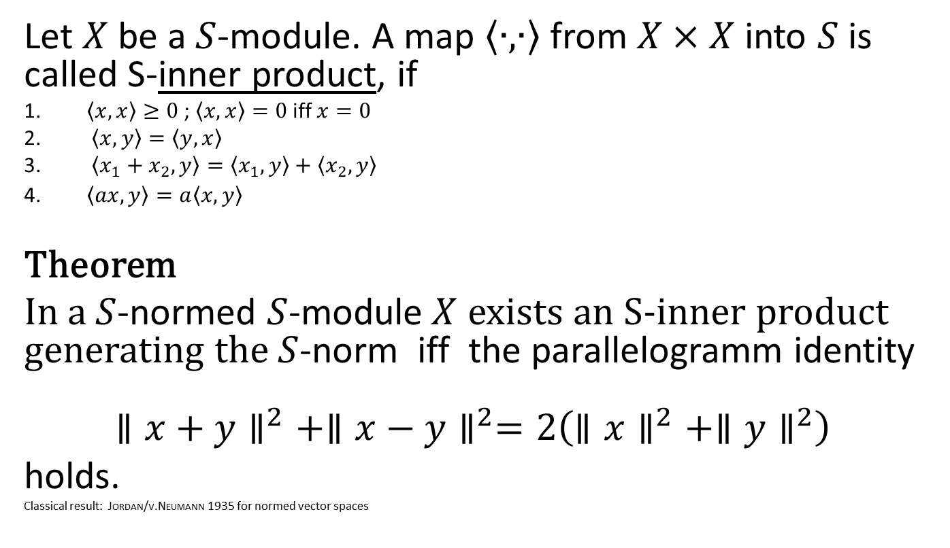
5. S-normability and inner product
Let $X$ be a $S$-module. A map $\left\langle ∙,∙\right\rangle$ from $X×X$ into $S$ is called S-inner product, if
$\left\langle x,x\right\rangle ≥0$ ; $\left\langle x,x\right\rangle =0$ iff $x=0$
$\left\langle x,y\right\rangle =\left\langle y,x\right\rangle$
$\left\langle x_{1}+x_{2},y\right\rangle =\left\langle x_{1},y\right\rangle +\left\langle x_{2},y\right\rangle$
$\left\langle ax,y\right\rangle =a\left\langle x,y\right\rangle$
Theorem
In a $S$-normed $S$-module$X$ exists an S-inner product generating the $S$-norm iff the parallelogramm identity
$${∥x+y∥}^{2}+{∥x−y∥}^{2}=2\left({∥x∥}^{2}+{∥y∥}^{2}\right)$$
holds.
Classical result: Jordan/v.Neumann 1935 for normed vector spaces

Slide 20
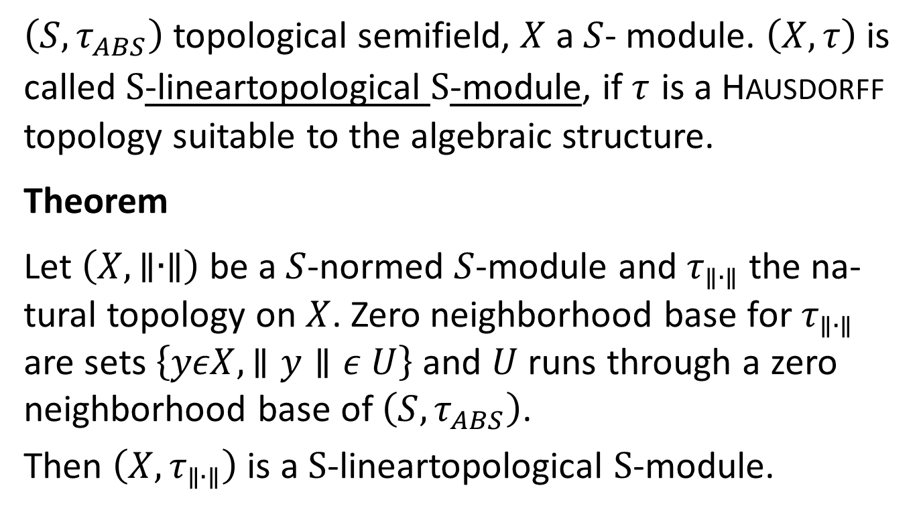
6. S-lineartopological S-module and S-norm
$\left(S, τ_{ABS}\right)$ topological semifield, $X$ a $S$- module. $\left(X, τ\right)$ is called $S$-lineartopological $S$-module, if $τ$ is a Hausdorff topology suitable to the algebraic structure.
Theorem
Let $\left(X, ∥∙∥\right)$ be a $S$-normed $S$-module and $τ_{∥∙∥}$ the na- tural topology on $X$. Zero neighborhood base for $τ_{∥∙∥}$ are sets $\left\{yεX,∥y∥ε U\right\}$ and $U$ runs through a zero neighborhood base of $\left(S, τ_{ABS}\right)$.
Then $\left(X,τ_{∥∙∥}\right)$ is a $S$-lineartopological $S$-module.

Slide 21
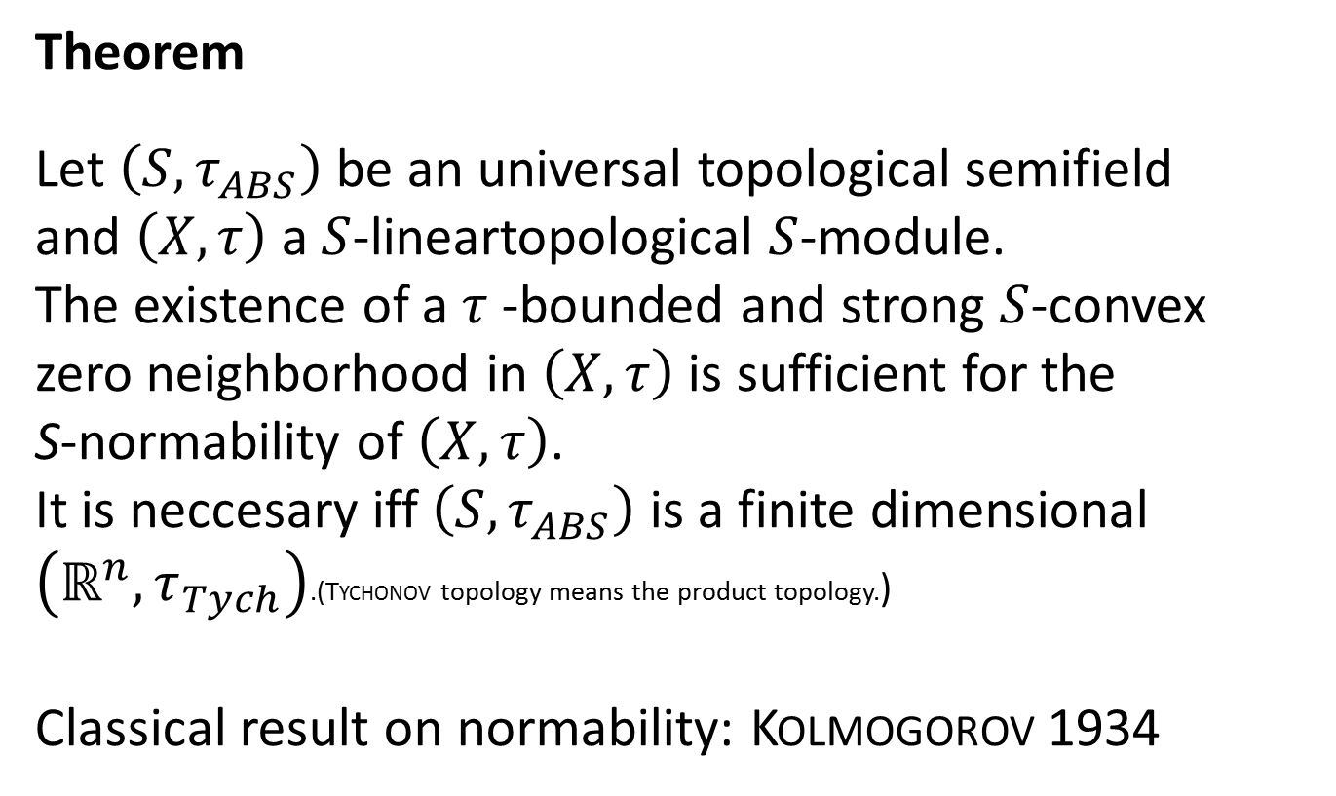
6. S-lineartopological S-module and S-norm
Theorem
Let $\left(S, τ_{ABS}\right)$ be an universal topological semifield
and $\left(X,τ\right)$ a $S$-lineartopological $S$-module.
The existence of a $τ$-bounded and strong $S$-convex
zero neighborhood in $\left(X,τ\right)$is sufficient for the
S-normability of $\left(X,τ\right)$.
It is neccesary iff $\left(S, τ_{ABS}\right)$ is a finite dimensional $\left(ℝ^{n}, τ_{Tych}\right)$.(Tychonov topology means the product topology.)
Classical result on normability: Kolmogorov 1934

Slide 22
7. Extension theorems in S-modules
Namioka and Day: A monotone linear functional defined on a subspace (fulfilling certain conditions) of a preordered vector space can extended to the whole space.
The Hahn-Banach theorem is equivalent to the extension theorem for monotone linear functionals.
We restrict ourselfs to monotone S-linear maps.

Slide 23
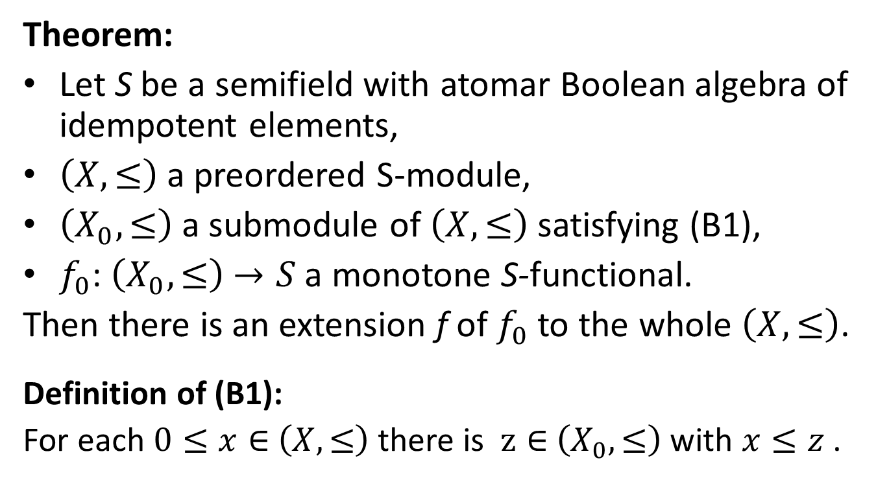
7. Extension theorems in S-modules
Theorem:
Let S be a semifield with atomar Boolean algebra of idempotent elements,
$\left(X,≤\right)$ a preordered S-module,
$\left(X_{0},≤\right)$ a submodule of $\left(X,≤\right)$ satisfying (B1),
$f_{0}$: $\left(X_{0},≤\right)$ $→S$ a monotone S-functional.
Then there is an extension f of $f_{0}$ to the whole $\left(X,≤\right)$.
Definition of (B1):
For each $0≤x∈$ $\left(X,≤\right)$ there is $z∈$ $\left(X_{0},≤\right)$ with $x≤z$ .

Slide 24
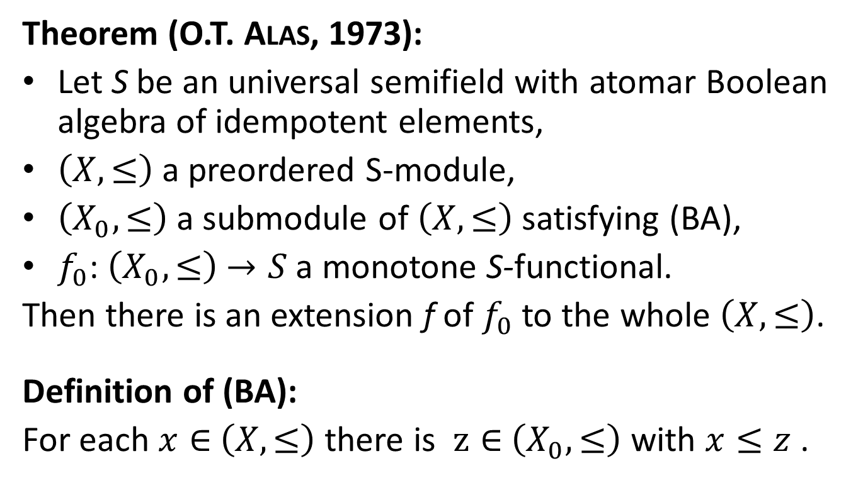
7. Extension theorems in S-modules
Theorem (O.T. Alas, 1973):
Let S be an universal semifield with atomar Boolean algebra of idempotent elements,
$\left(X,≤\right)$ a preordered S-module,
$\left(X_{0},≤\right)$ a submodule of $\left(X,≤\right)$ satisfying (BA),
$f_{0}$: $\left(X_{0},≤\right)$ $→S$ a monotone S-functional.
Then there is an extension f of $f_{0}$ to the whole $\left(X,≤\right)$.
Definition of (BA):
For each $x∈$ $\left(X,≤\right)$ there is $z∈$ $\left(X_{0},≤\right)$ with $x≤z$ .

Slide 25
Thank you for your attention !

Slide 26
8. References
Alas OT: Semifields and positive linear functionals. Math. Japon. 18 (1973), 133-35
Antonovskij MJa, Boltjanski BG, Sarymsakov TA: Topological Semifields (in Russian). Tashkent 1960
Antonovskij MJa, Boltjanski BG, Sarymsakov TA: Topological Boolean Algebras (in Russian). Tashkent 1963
Biebler KE: Extension theorems and modules over semifields (in German).
Analysis Mathematica 15 (1989), 75-104
Ghika A: Asupra inelelor comutative ordonate (in Romanian).
Buletin stiinti c Acad. Rep. Pop. Romine 2 (1950), 509-19
A more detailed bibliography will be found in a publication which is in preparation.

