Slide 1


Open Cirrus Cloud Computing Program Update
TM

Slide 2
Open cloud computing research testbed What is it?
An open, scalable, secure, large scale global testbed for cloud computing research
  Collaborative research focused on data center management & cloud services
  Scalable, multi-continent, multi-datacenter, cloud computing system
  A broad base research community including HP, Intel, Yahoo, and other partners and academic researchers

Slide 3





Open cloud computing research testbed What is it?
A loose federation of “Centers of Excellence” around the globe
  UIUC, Singapore IDA, KIT: 3 initial CoE
  HP, Intel, Yahoo: 3 initial sponsors with CoE
  Specific research germane to each region
Owners of sponsors
  HP: HPL (Prith Banerjee), CTO office, Business Div.
  Intel: Intel Research (Andrew Chien)
  Yahoo: Yahoo! Research (Prabhakar Raghavan)
Each center: 1000-4000 cores and up to PB storage
  base service: PRS (physical resource set)
  required services: Open EC2-like, S3, and Hadoop-on-demand
  plus additional local extensions/variants/service types

Slide 4
Notes:
Yahoo! Research: Prabhakar Raghavan
Intel Research: Andrew Chien

Slide 5



Open Cirrus Cloud Computing Research
TM
Why are we building Open Cirrus?
Our primary aim is to create a new resource for doing systems-level research in datacenter federation, datacenter management, and development of cloud services and applications. In addition we aim
To foster a new systems research community around cloud computing
To democratize innovation in cloud computing by enabling academics to push the rate of progress in cloud computing
To help grow vendor-neutral open-source stacks and APIs for the cloud.
To expose the research community to lower-level hardware platform features (e.g., power management, systems management)
To expose the research community to enterprise level requirements relevant to the adoption of cloud computing for corporate users.
To provide the cloud computing community with realistic traces of cloud workloads.

Slide 6
Open Cirrus Cloud Computing Research
TM
Why is Open Cirrus Unique?
Distributed and heterogeneous datacenters. Open Cirrus is a collection of heterogeneous datacenters in different administrative domains distributed around the world, but with common login credentials, so that researchers can study issues involved in managing and using multiple datacenters.
Support for systems research. Open Cirrus datacenters will support systems research by allowing access to low-level systems resources. For example, researchers can install new OS kernels, access low-level hardware features, and run arbitrary daemons and logging processes.
Support for cloud applications research. OC datacenters will support applications research by allowing access across heterogeneous datacenters and enabling the composition of cloud applications from distributed cloud services resident on other Open Cirrus datacenters. OC will also encourage the development of a new style of application development, Hadoop Style.
Interesting datasets. Open Cirrus datacenters will provide access to interesting datasets such as web crawls, and workload traces.

Slide 7
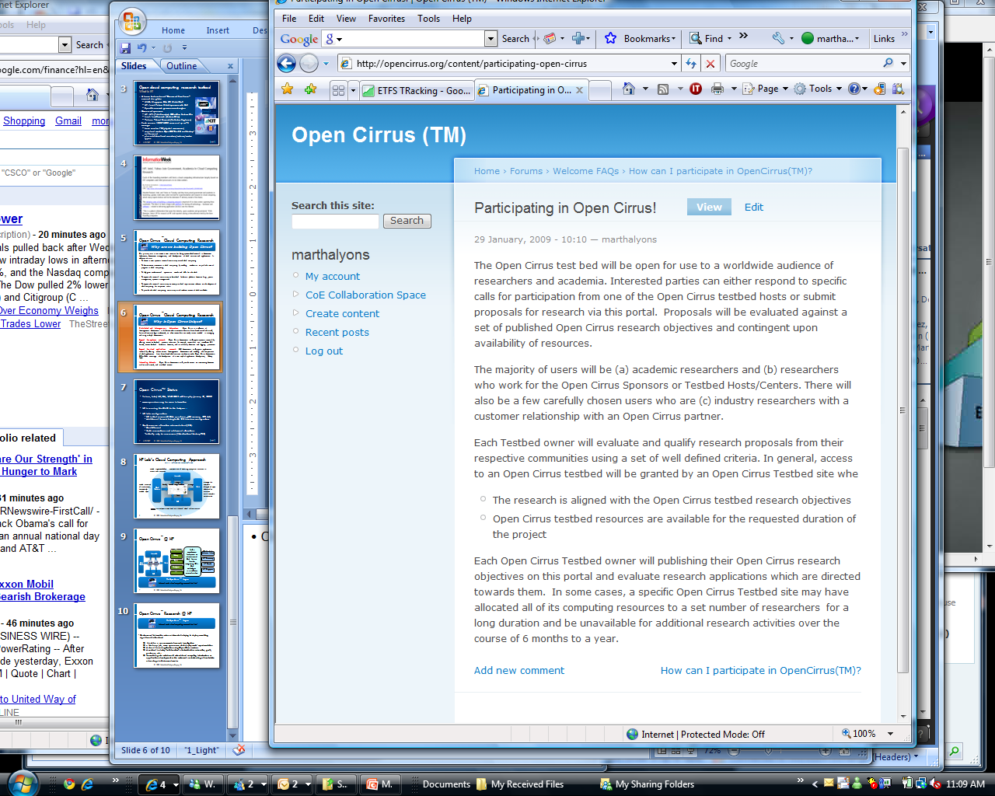

Slide 8
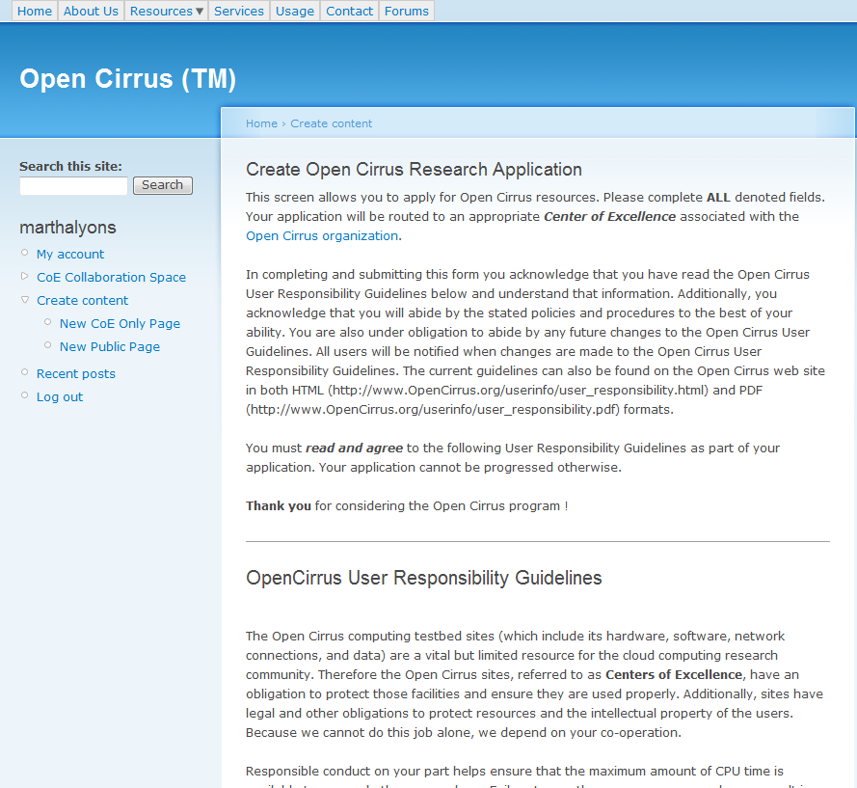

Slide 9
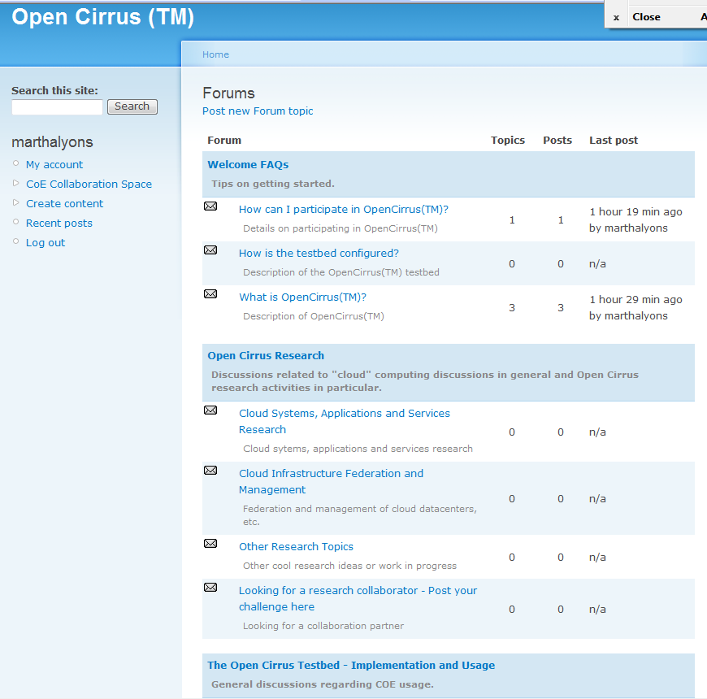

Slide 10
Open Cirrus Research @ HP
TM
Working with HP …..
There are three types of Open Cirrus research activities which HP is sponsoring ..
  Research projects and experiments from within HP Labs or other HP R&D teams
  Collaborative research activities between HP Labs/HP Business Unit and a strategic Customer/Partner/University (involves participation and sponsorship from an HP entity as well as an IP framework)
  Research activities which are independently deployed and executed on the Open Cirrus testbed
  Must be a non commercial research investigation
  a Hadoop job, some open source stack deployment/experimentation
  A cloud based application using Open Cirrus services
  A vertical industry “collaborative” effort with other universities, gov’t, partners, etc ..
  Something else which could extend cloud computing infrastructure or application development or the customer’s understanding of how to take advantage in their own domains

Slide 11
Open Cirrus™ Status
Yahoo, Intel, HP, IDA, UIUC COE will be up by January 29, 2009
www.opencirrus.org for more information
HP is running the CMO for the first year ..
HP Labs configuration
  59 initial servers (2.1GHz quad-core, 4GB memory, 2TB disk)
  Additional Servers being built: 192 in various configurations
Draft resource allocation scheme defined (PRS):
  Credit-based
  Both reservations and on-demand allocations
  Initially only for raw servers (Virtualization/Hadoop TBD)

Slide 12
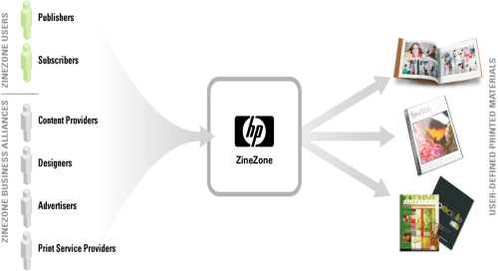

HP Lab’s Cloud Computing Approach
Fulfill the “Everything as a service” vision
enable rigorous/ad-hoc composition of existing ecosystem services to create new services
Mercado
Cloud
Platform
develop
manage
SLiM
integrate
manage the complete lifecycle of apps delivered as services
with complete automation
enable creation of multi-tenant, horizontally-scalable apps
www.magcloud.com
Web
service
Web
service
host
Cells
secure virtual partitions built on a shared cloud infrastructure
12

Slide 13



Open Cirrus @ HP
TM
Physical Resource Set
Build a
top-to-bottom
(ecosystem to
infrastructure)
Cloud Service
Provider
integrating HPL’s
Cloud technologies
in a well-chosen
vertical market
Mercado
FSI Vertical
Customer Interest
Hadoop
Cloud
Platform
SLiM
HP Germany
Tashi
web
service
web
service
HP Canada
Eucalyptus
HP Singapore
Cells
….
TM
The Open Cirrus Program
Internet scale cloud computing research test bed
13

