Slide 1
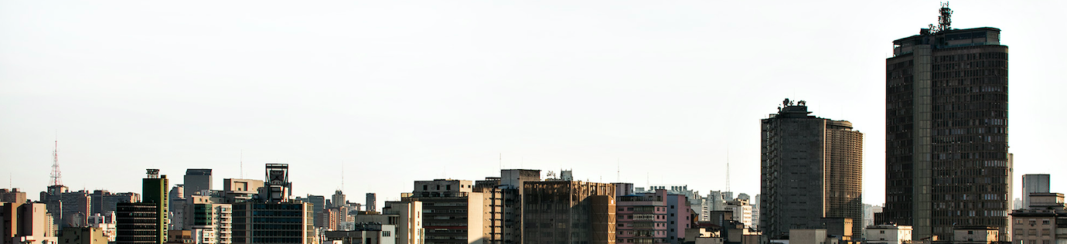
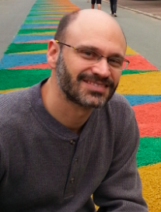
Software and science making cities better
city-university collaborations
Prof. Fabio Kon
Department of Computer Science
University of São Paulo, Brazil
Fulbright Visiting Professor
MIT Senseable City Lab

Slide 2
Collaborations
35 CS professors +
  Architects, Urban Planners, Economists, Health Professionals, Transportation Engineers
São Paulo City Hall (21M people in Great São Paulo)
Smaller cities in Brazil (demands are different)

Slide 3
  InterSCity lab in Brazil
~60 people working:
  USP, FGV, PUC-Rio, Scipopulis, UFABC, UFG, UFMA, UFMS, UFRJ, Unicamp, Unifesp
  interface between Computer Science and Cities
  6-year funding (2017 to 2023)
  InterSCity.org
  Open Source software
  Open Datasets

Slide 4
Our view
Smart City =
"a city in which its social, business, and technological aspects are supported by ICT to improve the quality of life of its citizens in an integrated, affordable, and sustainable way.”
we’re interested in developing a
                Software platform for Smart Cities

Slide 5
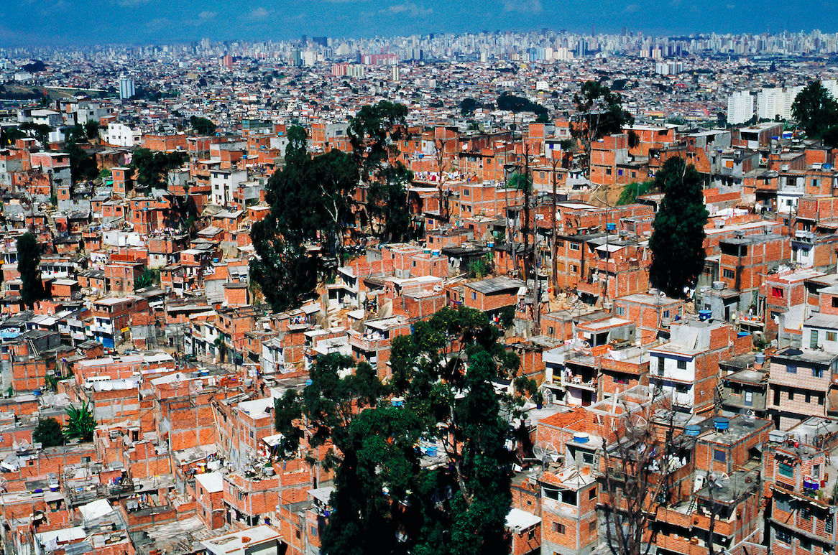
Our view on Smart Cities
    Although we don’t ignore high-tech solutions for the elite, we prefer to focus on:
  people (technology is a
  means not an end)
  low-income populations
  developing countries
  underprivileged neighborhoods

Slide 6
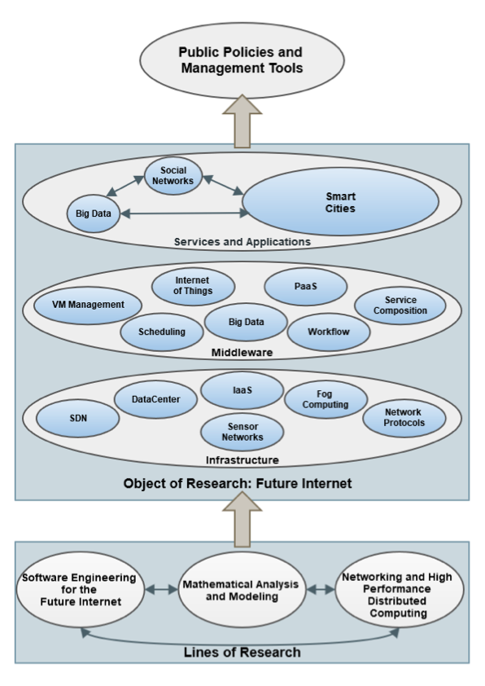
The InterSCity Project
3 lines of research
3 levels

Slide 7
Projects
City Simulator
Smart City Software Platform
Health Dashboard
Accessibility Ranking
Scipopulis Startup
BikeSCience @ MIT Senseable City Lab

Slide 8
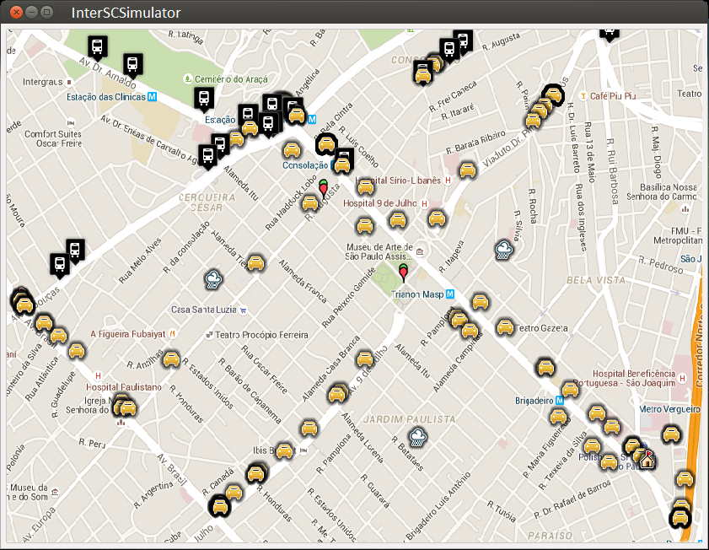
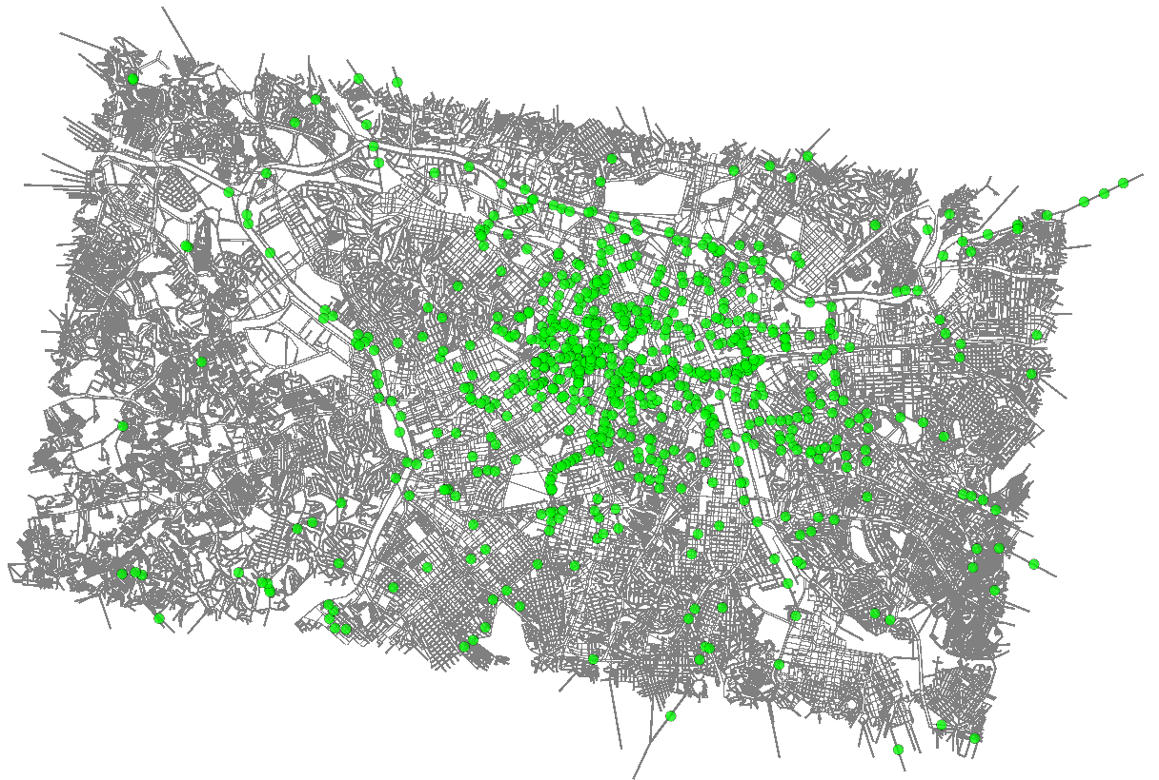
1 - InterSCimulator
Erlang-based large-scale simulator for Smart Cities
Simulations with 17 million agents in super-real-time
Multimodal transportation
  cars, pedestrians, buses, subway, (bicycles).
  Impact analysis of changes in the transportation infrastructure and associated costs.
  Population from Paraisópolis favela (slum) in SP.

Slide 9
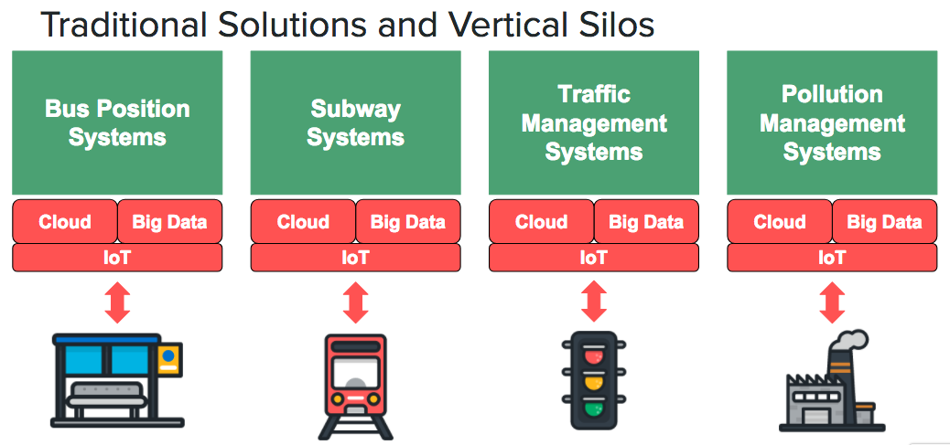
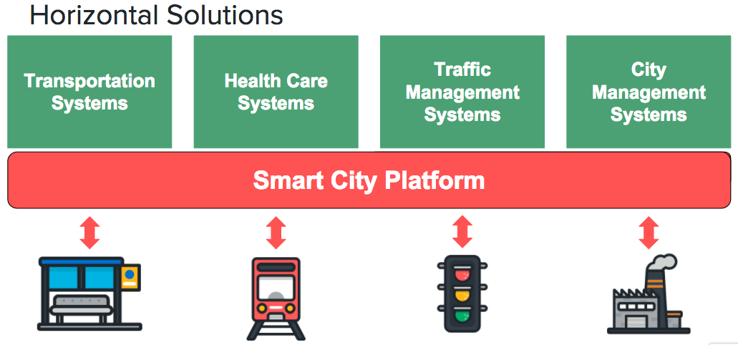
2- A generic Software Platform for Smart Cities

Slide 10

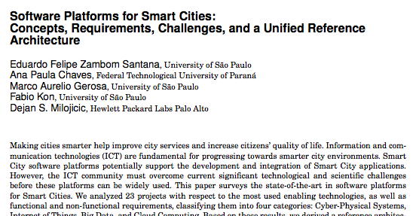
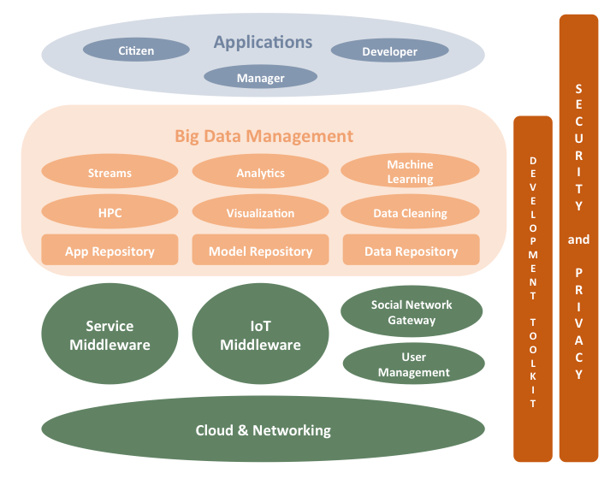
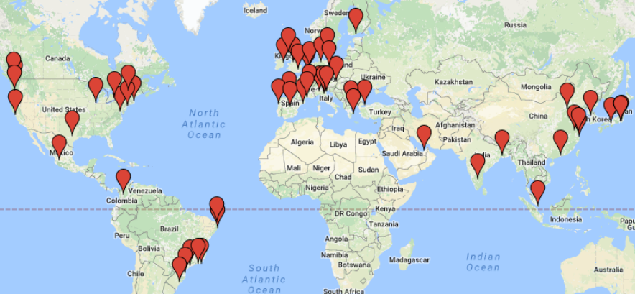
Survey and proposed reference architecture for
Smart City Software Platforms

Slide 11
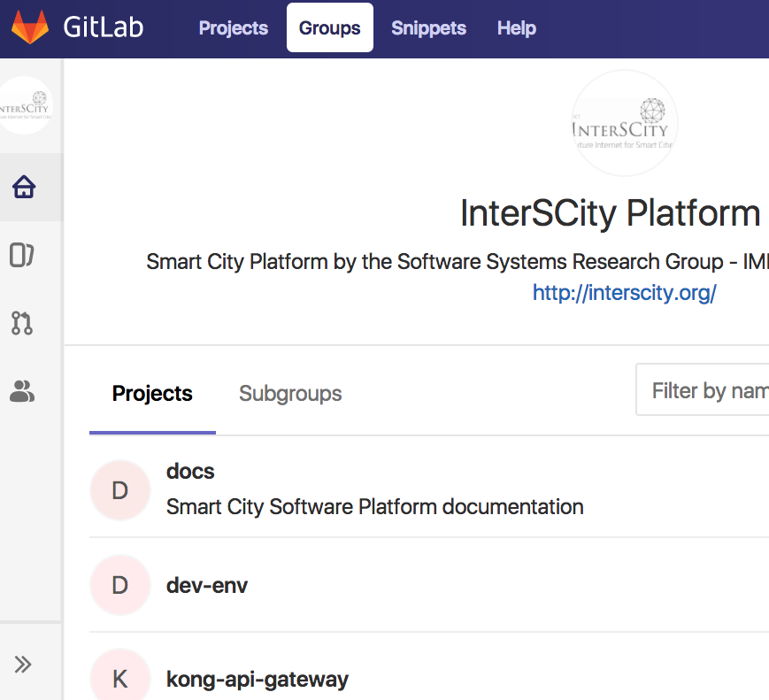
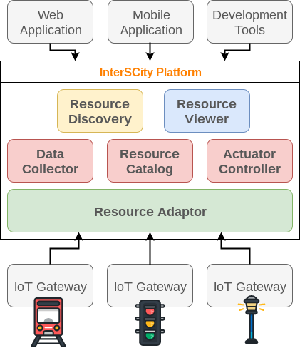
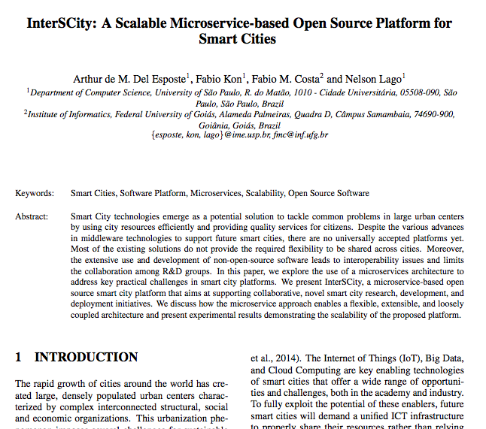

Slide 12
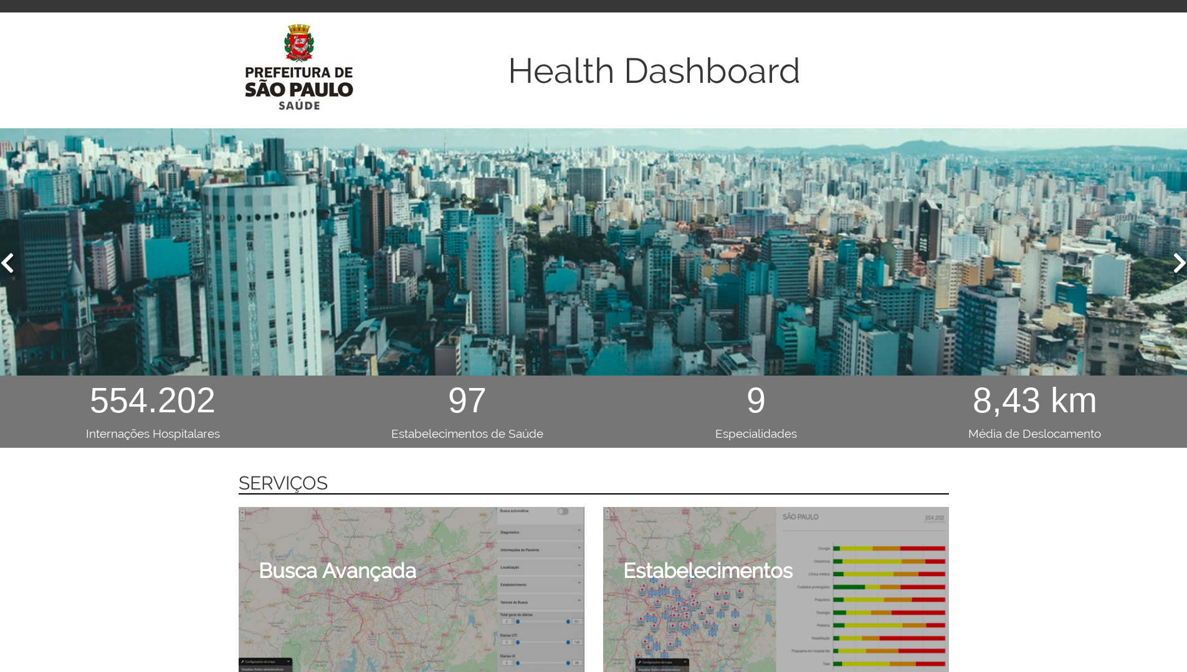
3 -

Slide 13
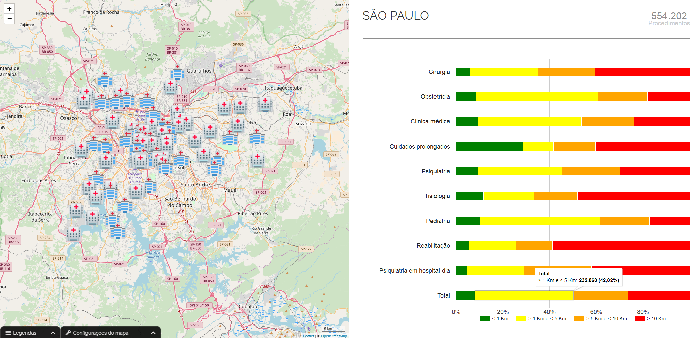

Slide 14
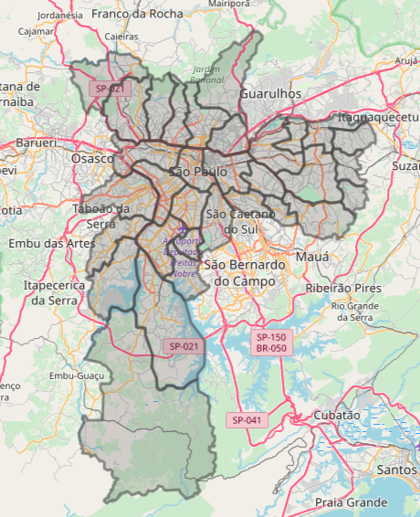
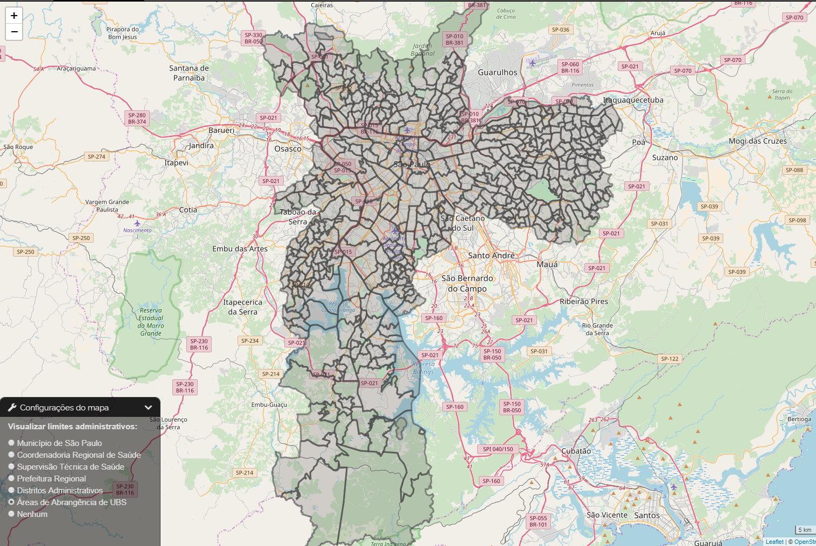
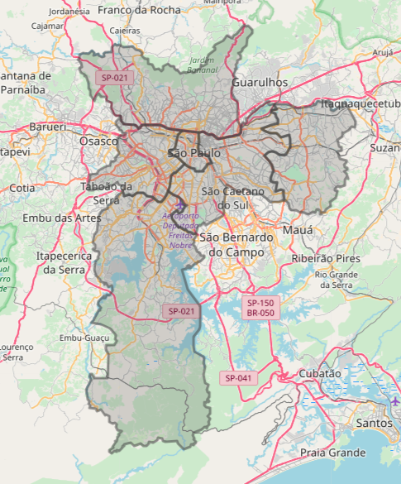
Multiple ways
of dividing
the city

Slide 15
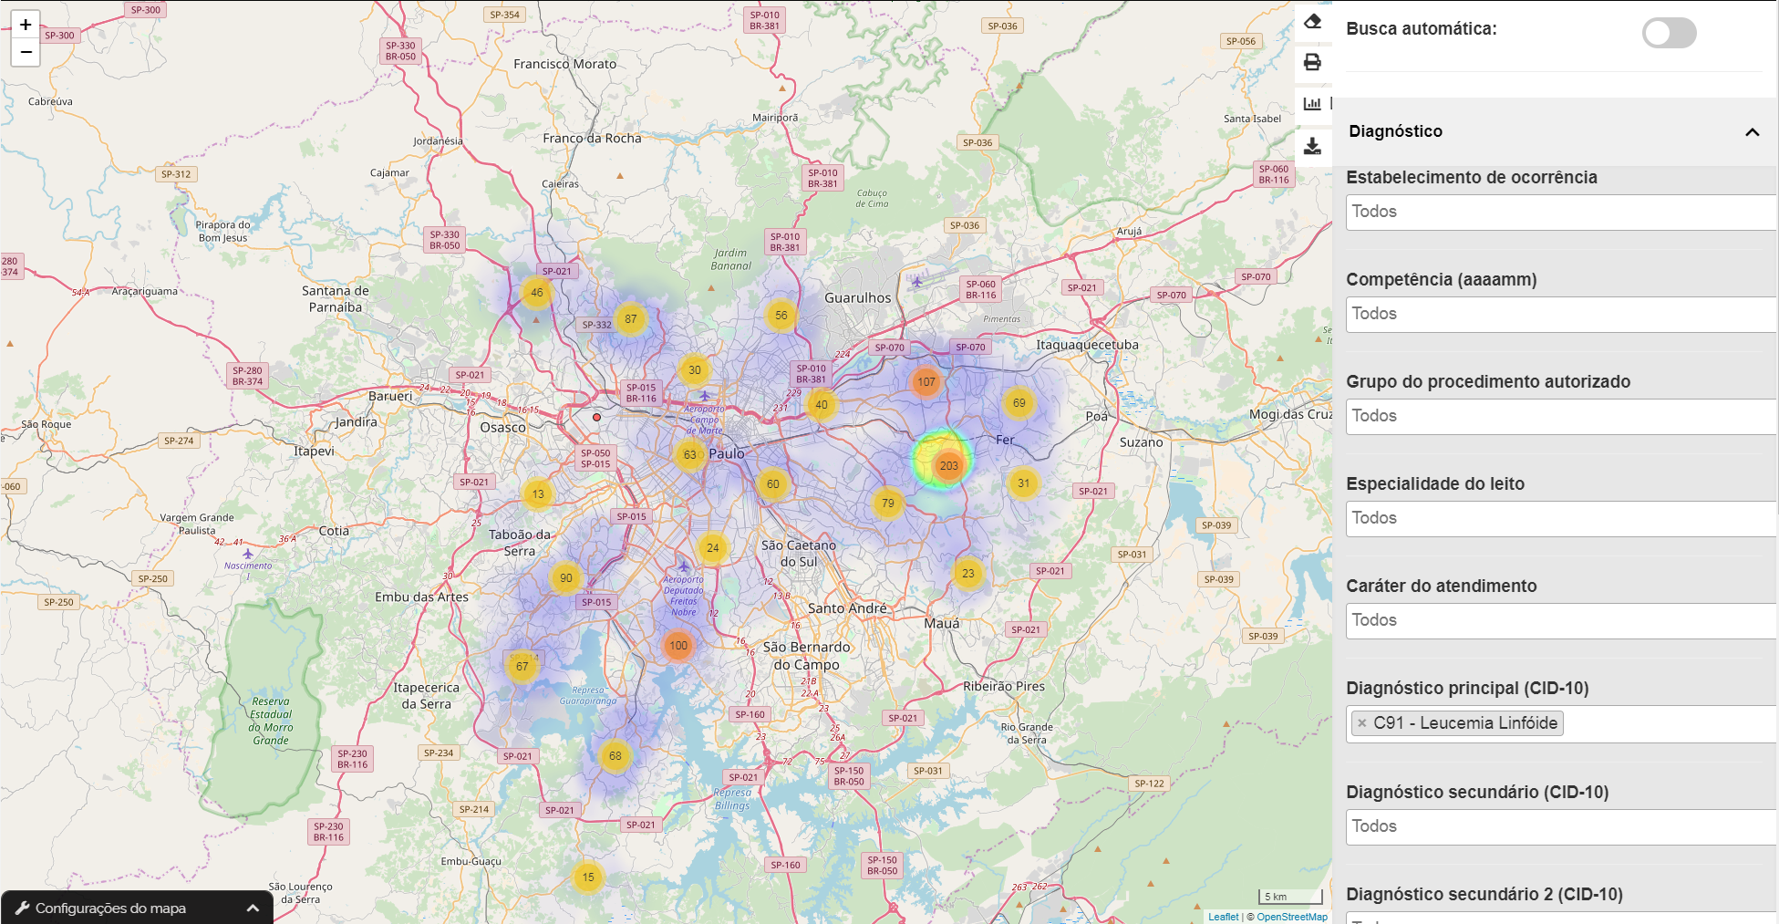
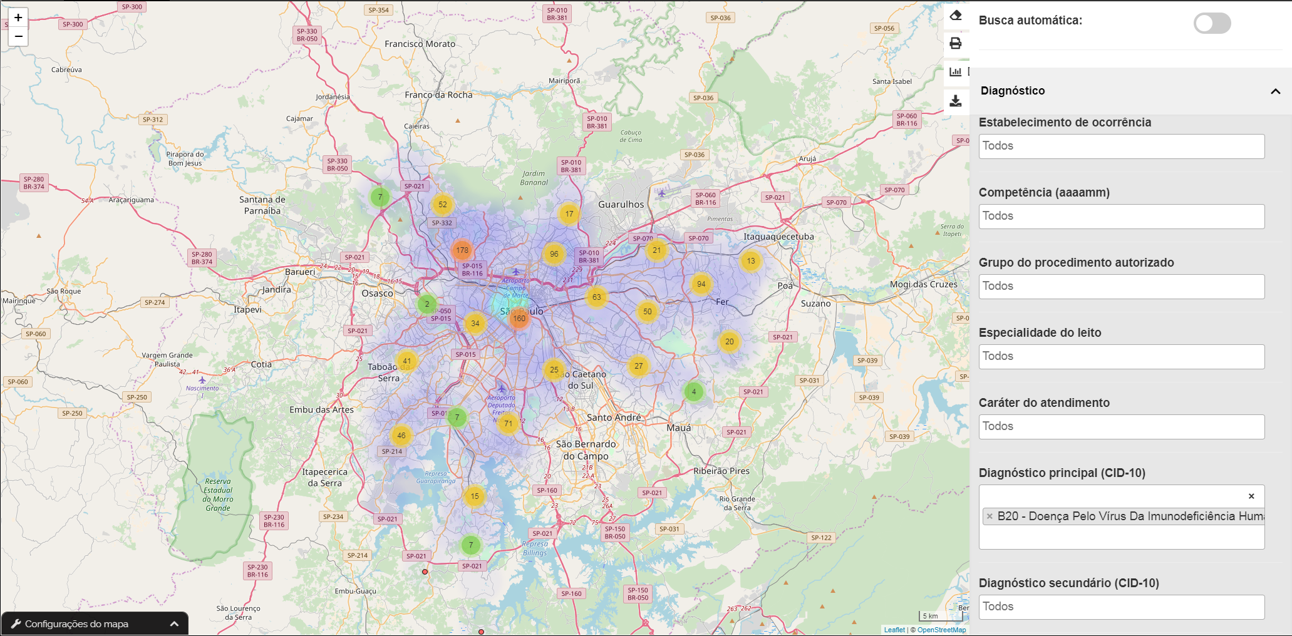
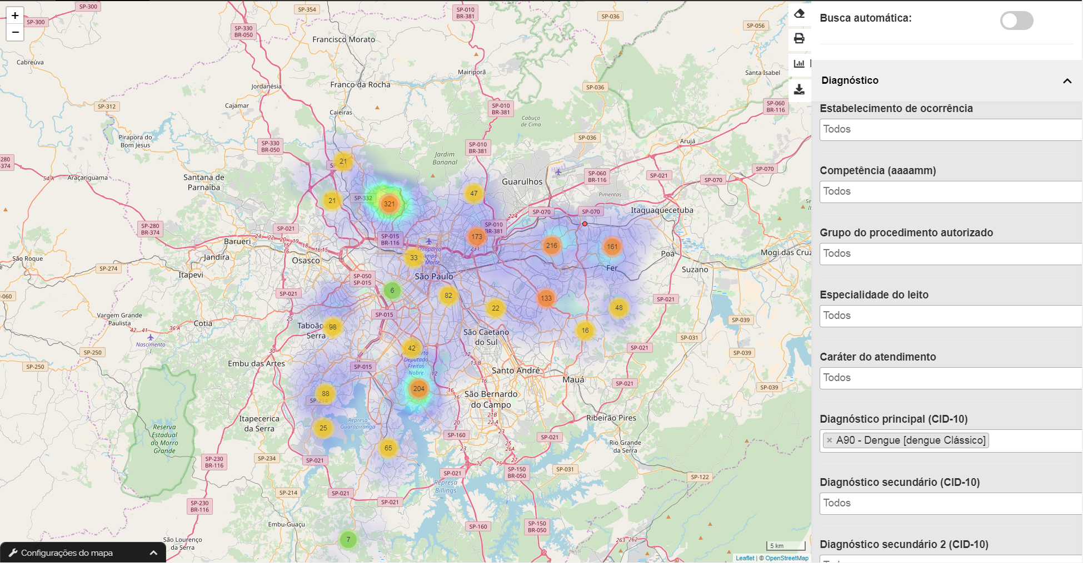
Leukemia
HIV
Dengue
Fever

Slide 16
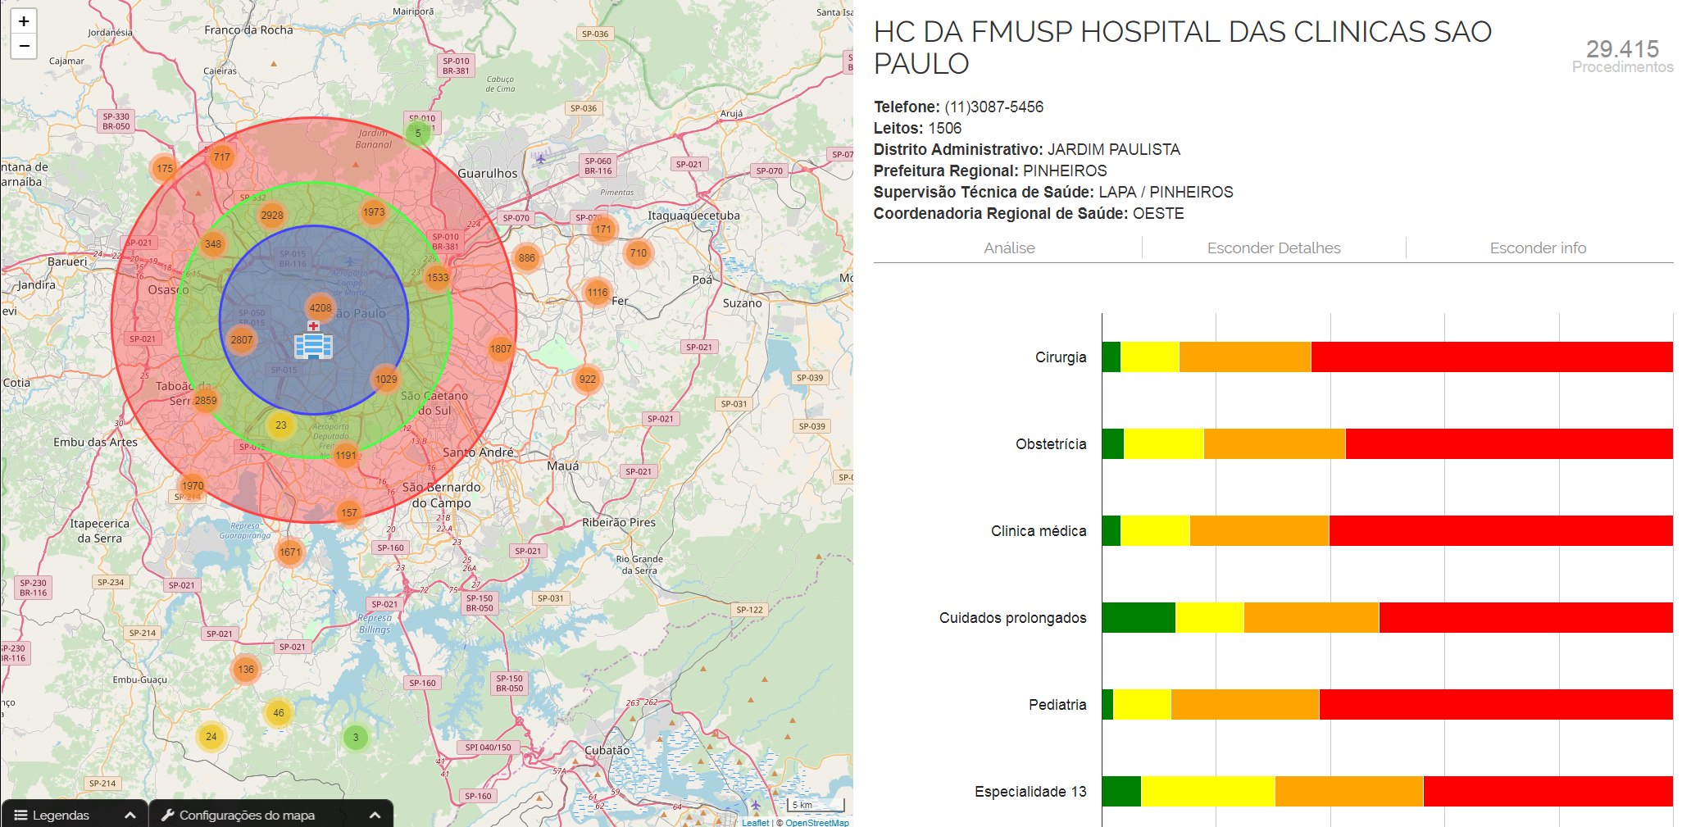
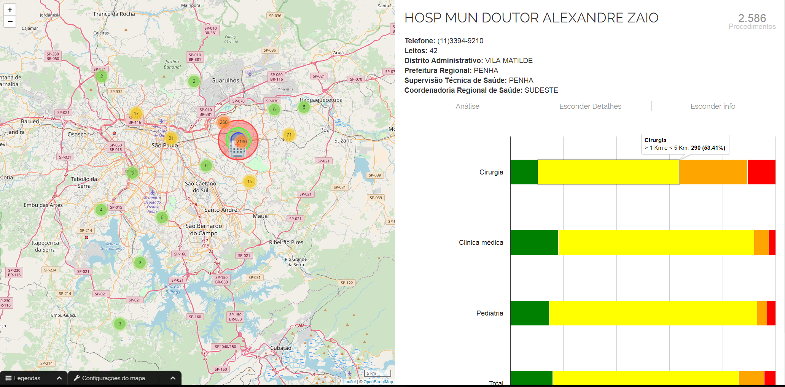
Metropolitan
Hospital
Regional
Hospital

Slide 17
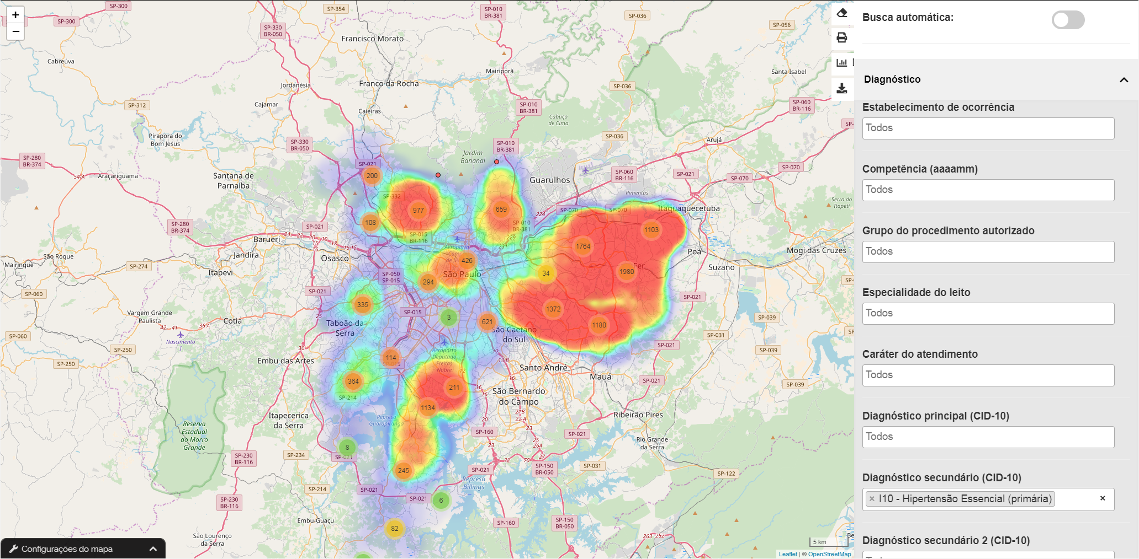
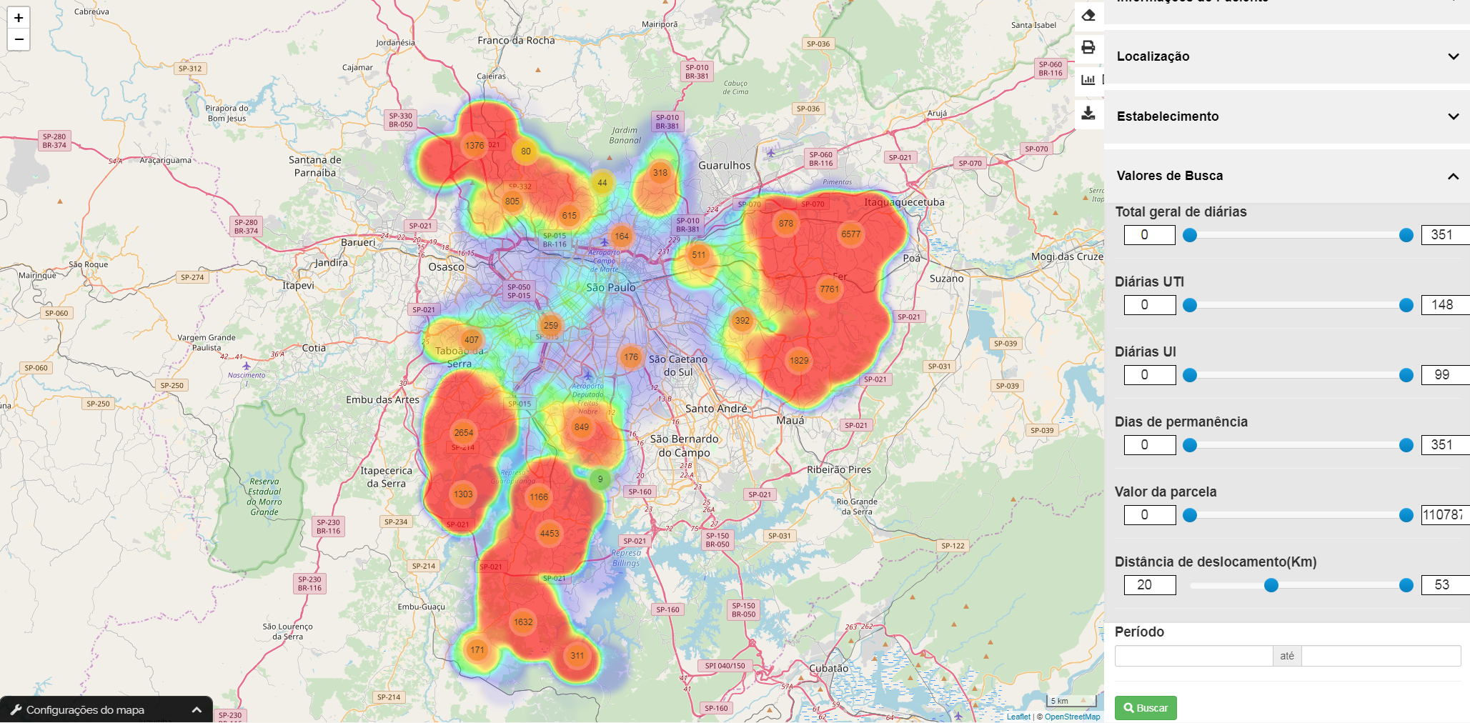
Hypertension
(most frequent)
>20Km
to get service

Slide 18
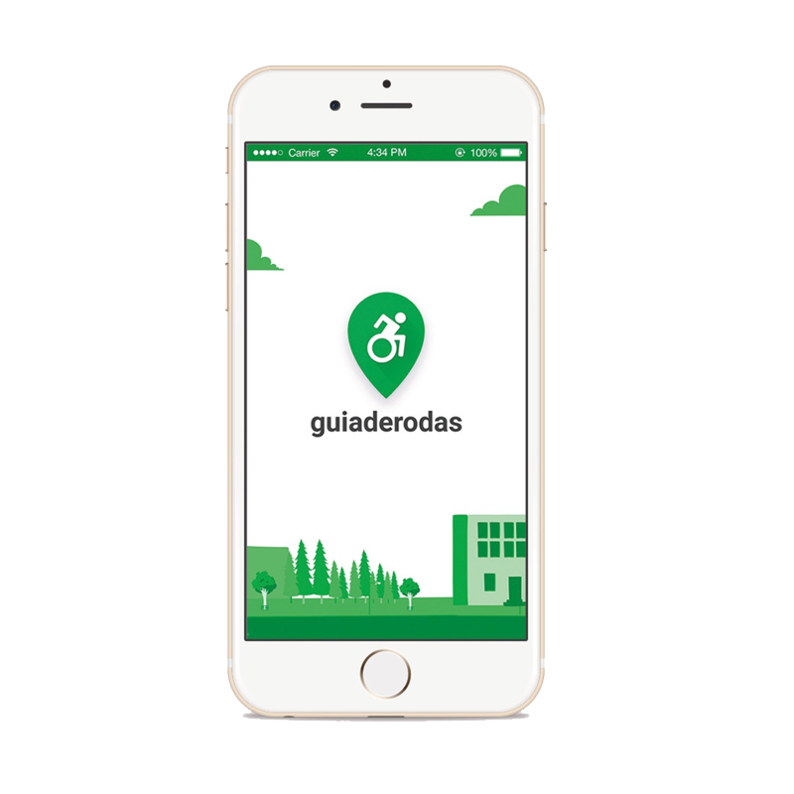
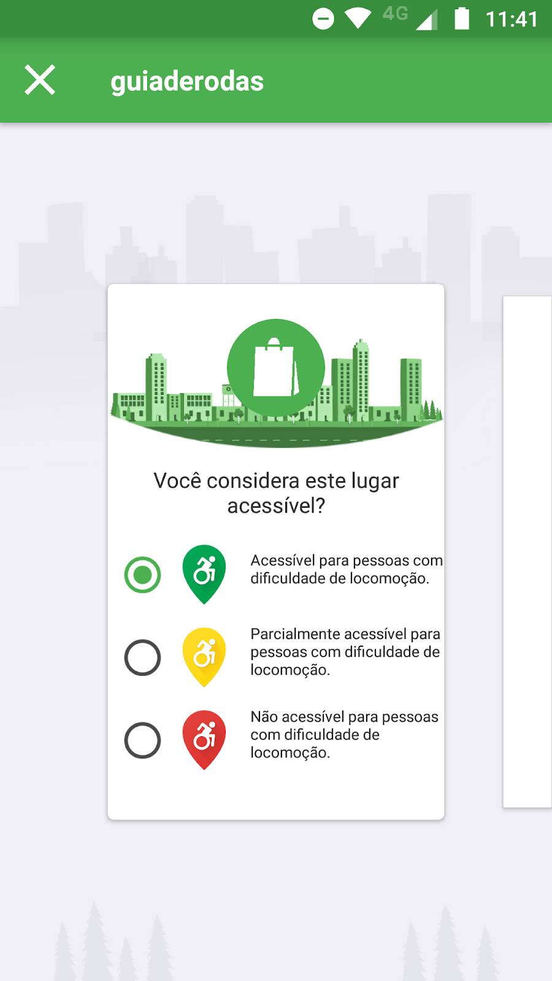
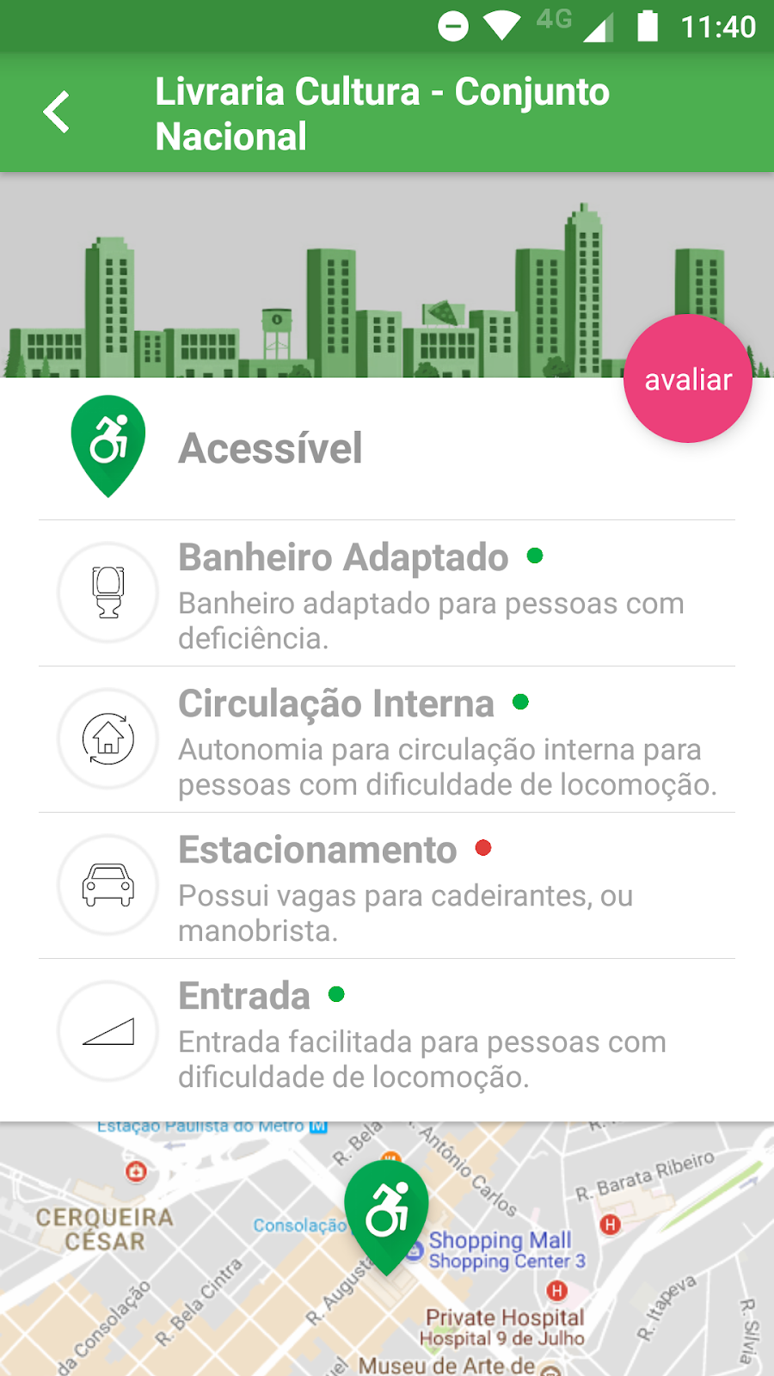
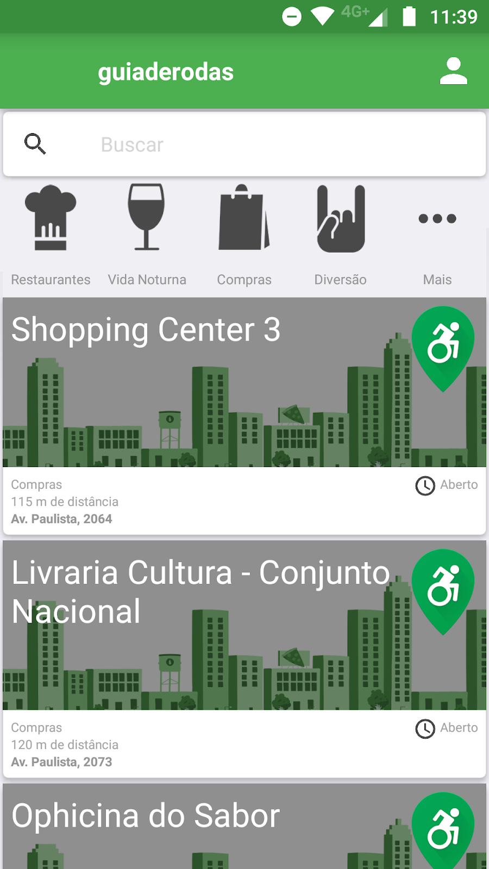
4 -
Crowdsourcing startup App: guiaderodas

Slide 19
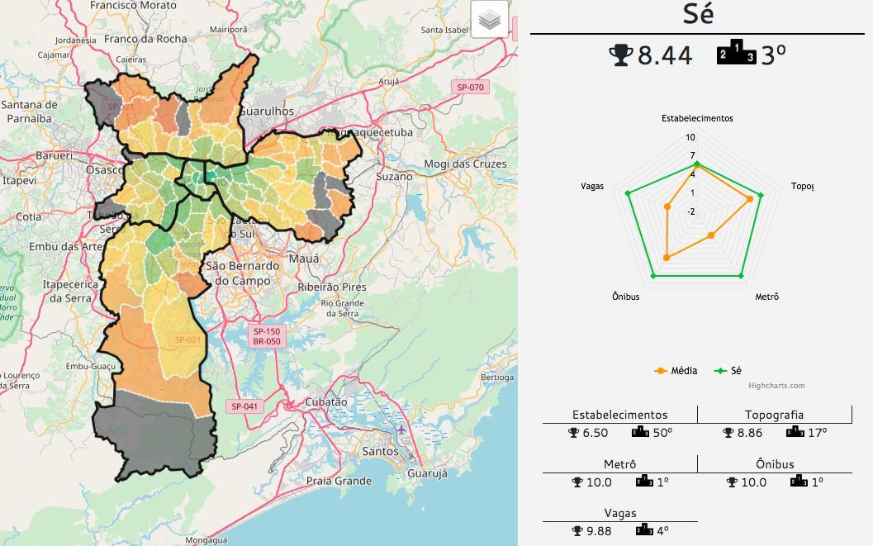
Accessibility Ranking

Slide 20
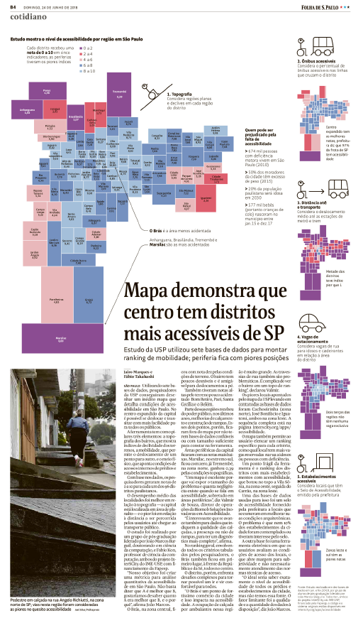

Slide 21

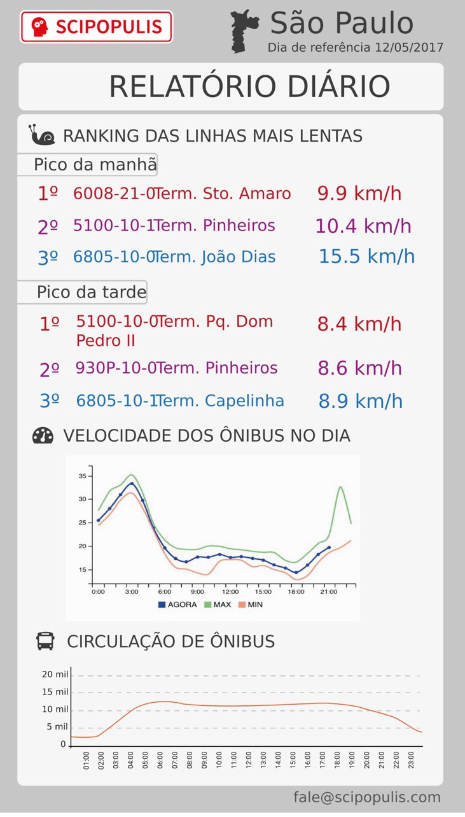
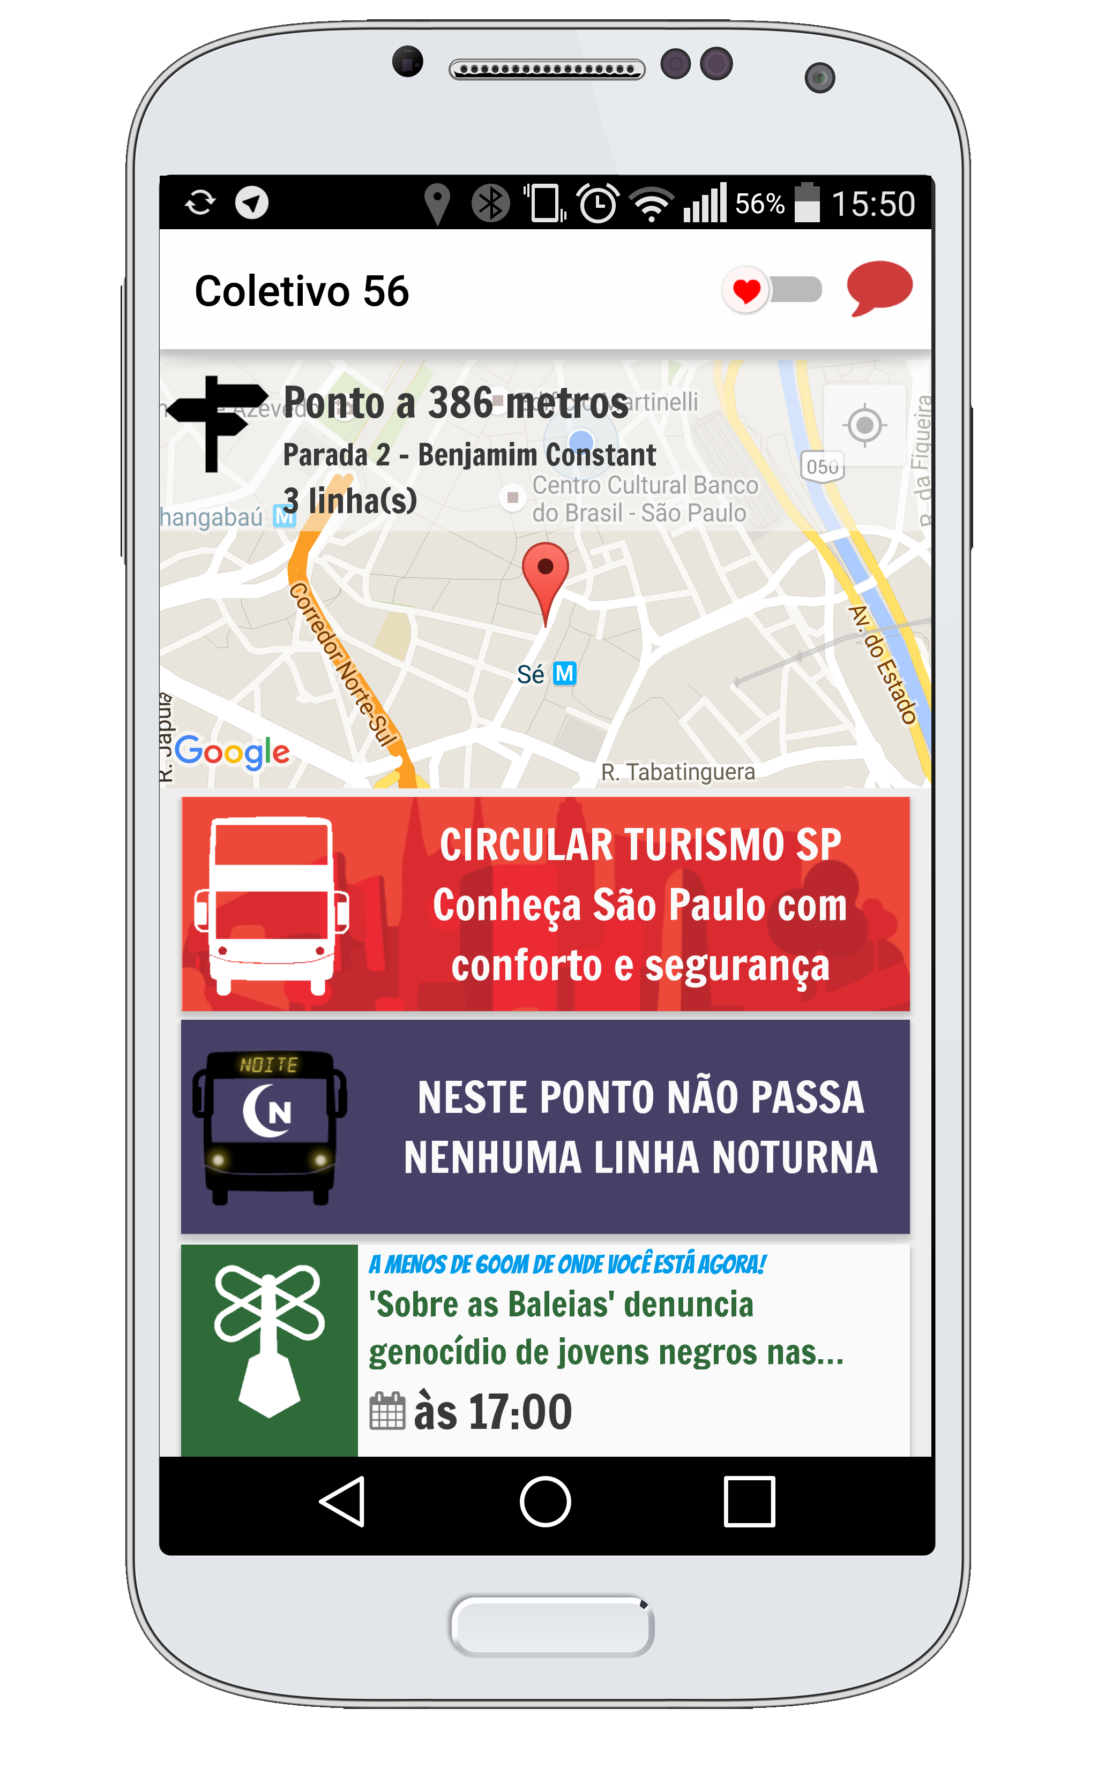
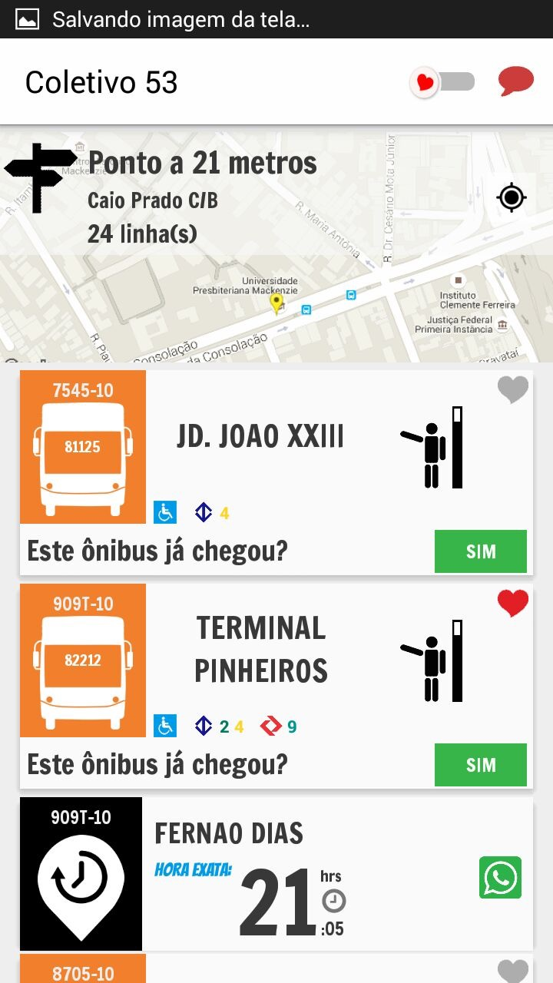
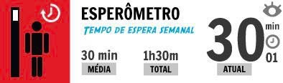
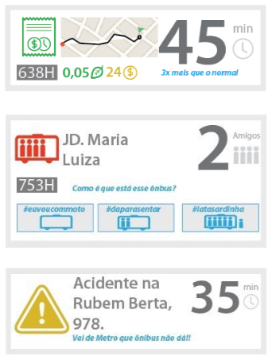

Scipopulis’ COLETIVO APP
(for citizens)

Slide 22

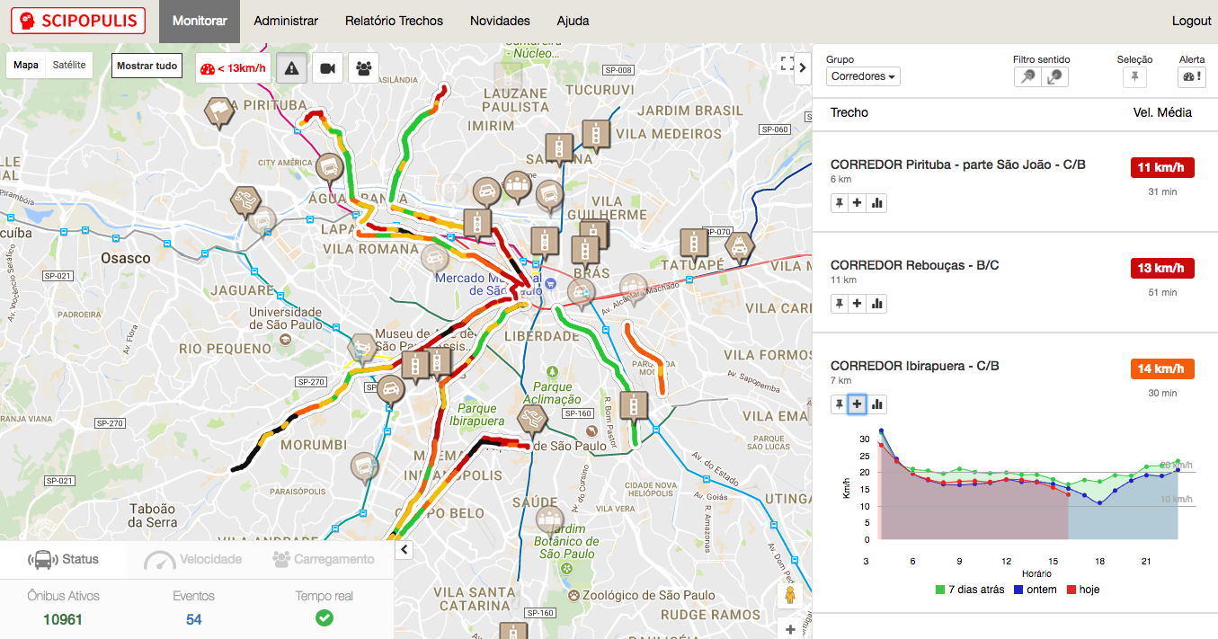
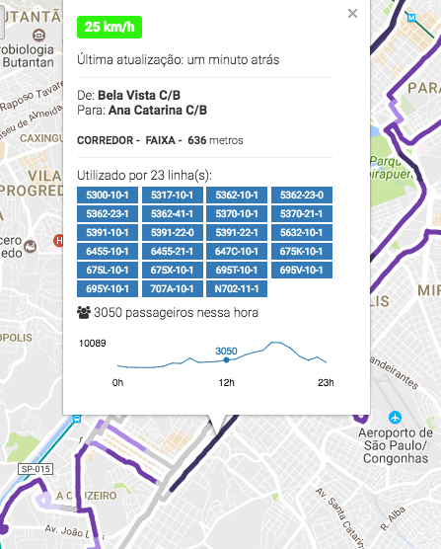
REAL TIME DASHBOARD
(for system operators)
In use by the São Paulo secretary of transportation
in test at: Rio de Janeiro, Curitiba, Santiago (Chile), Brasilia, etc.

Slide 23
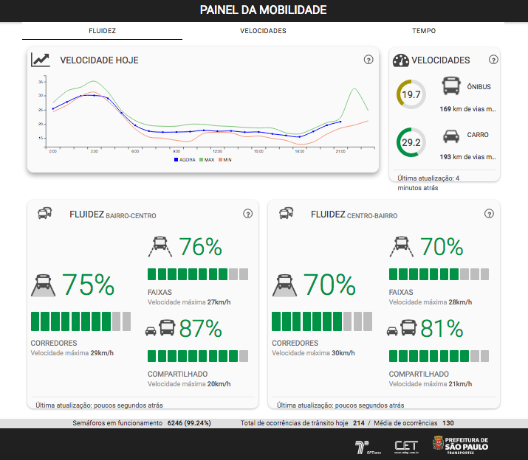
MOBILITY PANEL
(CONSOLITADED BUS SPEEDS for citizens)

Slide 24
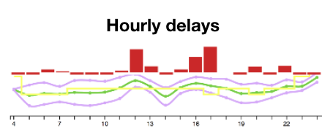
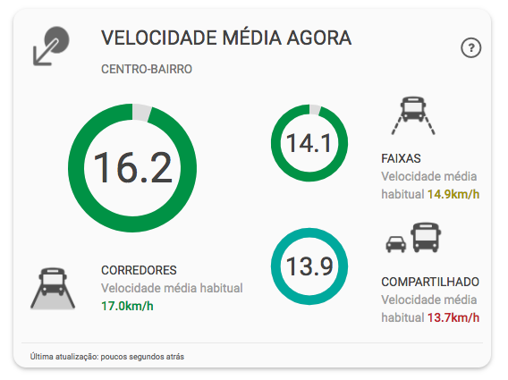
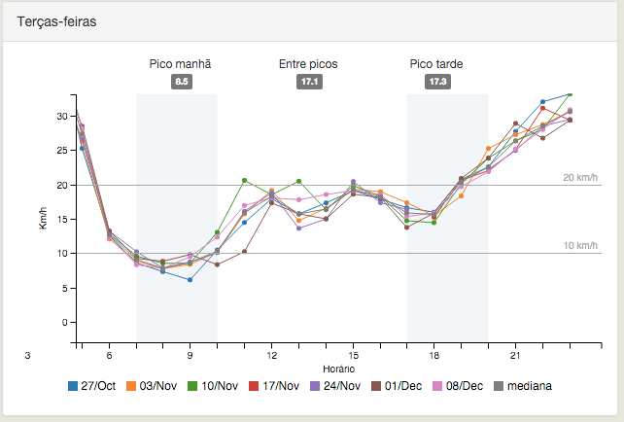
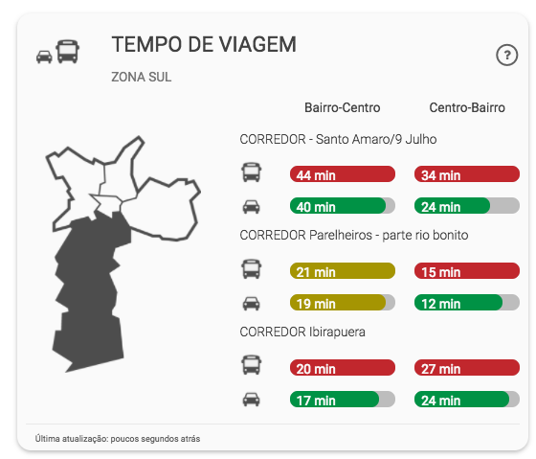
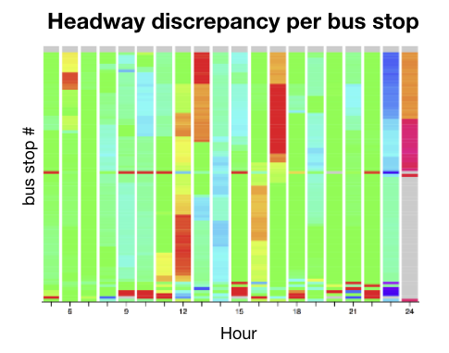
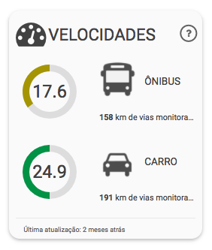
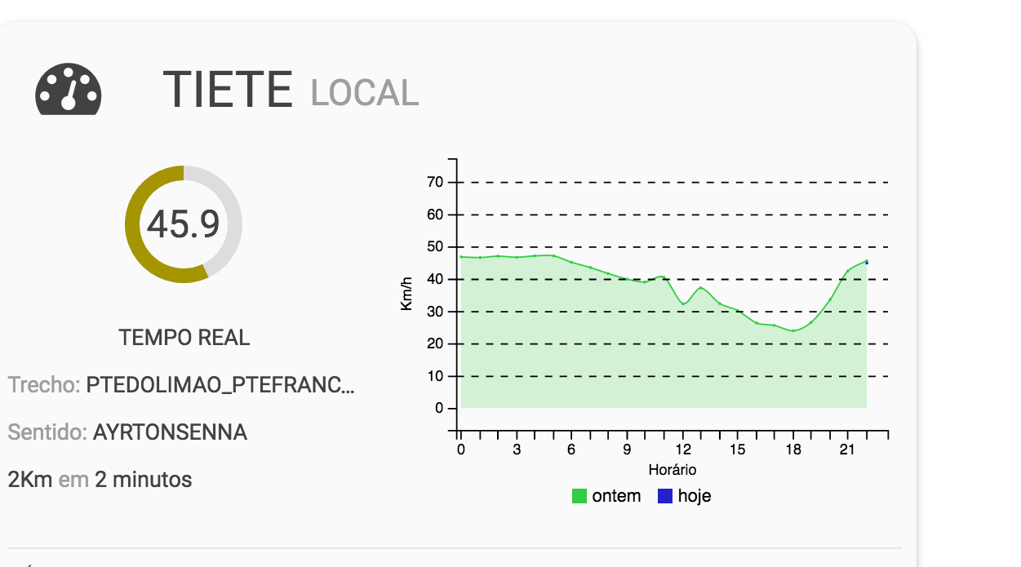
DATA ANALYSIS and visualization
Historical data
Comparing bus x auto

Slide 25
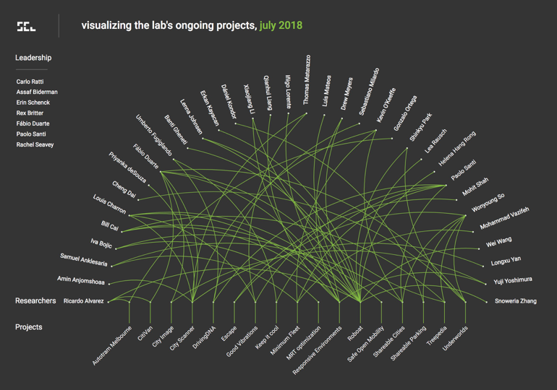

Slide 26
BikeScience @ MIT Senseable City Lab
Use of bikes for urban transportation is increasing
  15+ million shared bikes, increasing rapidly
    (just a small fraction) of the total # of trips
Bike transportation has numerous advantages:
  for the city
  for the planet
  for the user

Slide 27
Bikes are underutilized
London - bikes are faster
  than public transport for most trips < 8 miles [Properly 2013]
  1/3 of current car trips [City of London 2017]
USA [Dept. of Transportation 2017]
  35% of car trips are < 2 miles / 46% < 3 miles
  1% of trips are on a bike

Slide 28
Next steps
Analyze flows in 20 cities identifying
  common patterns and different classes of cities
Analyze relations with socioeconomic and topographic data from city districts develop ML model
Analyze data from dockless systems
Two papers to be submitted soon!

Slide 29
The Future
Advanced collaborative research among InterSCity partners
  Middleware implementation: scalability, performance, usability by developers
  Big Data processing, analysis, and visualization
  Machine Learning to improve city services
Establish and strengthen international collaborations

Slide 30
Contact
kon@ime.usp.br
interscity.org
(post-doc fellowships available)

