Slide 1

INF219 – Software Environments
Second class
Understanding a problem:
Empirical Evaluation of Software Environments
Marco Aurélio Gerosa
University of California, Irvine
Spring/2014

Slide 2
Creating a new tool

Slide 3





Inventor-oriented development of a tool
My tool is great!
Clipart from http://www.clker.com/

Slide 4
Issues
- Are you a typical developer? Really?
- How do you know that your “problem” is really a problem?
- How do you know the extension of your problem?
- How do you know that you actually solved or mitigated the problem?
- How do you identify collateral effects of your solution?

Slide 5

Most of the developed tools
are never used in practice…

Slide 6


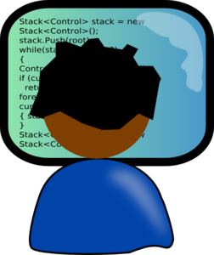
Answer
Conduct empirical/experimental studies

Slide 7

Why and when to do empirical studies while developing tools for software environments?

Slide 8


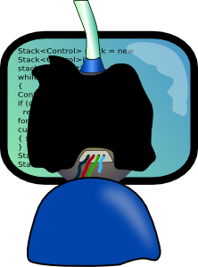
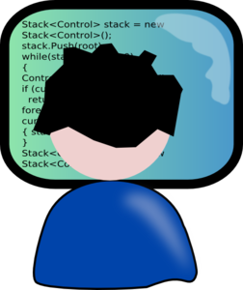
Researcher-based development of a tool
Survey
Evaluate
Understand
Prototype
Confirm (if necessary)

Slide 9

Empirical Research vs Pure Invention
Research is more solid, systematic, and based on relatively low biased data
But, it takes more time and it can refrain creativity
In practice, try to reach a balance
However, if you want to publish, nowadays you really need to overkill – but it is how science works
Remember:
“If I had asked people what they wanted, they would have said faster horses.”
(Henry Ford)
You can avoid that if you collect the right data using the right means
Also, you may understand better the real context and effects of the tool, making a better case for the tool adoption
  How many tools end up not being used?
  80s SigChi bulletin: ~90% of evaluative studies found no beneﬁts of tool
LaToza (2011) http://www.cs.cmu.edu/~bam/uicourse/2011hasd/lecture02-HCI%20Methods%201.pdf

Slide 10
Types of empirical studies
Goal
Exploratory
  define and understand problems and raise hypotheses
Descriptive
  describe a situation
Confirmatory / causal / explanatory
  test hypotheses
Objects of analysis
Quantitative
  Numerical measurements / analysis
Qualitative
  Interpretive data acquisition / analysis

Slide 11
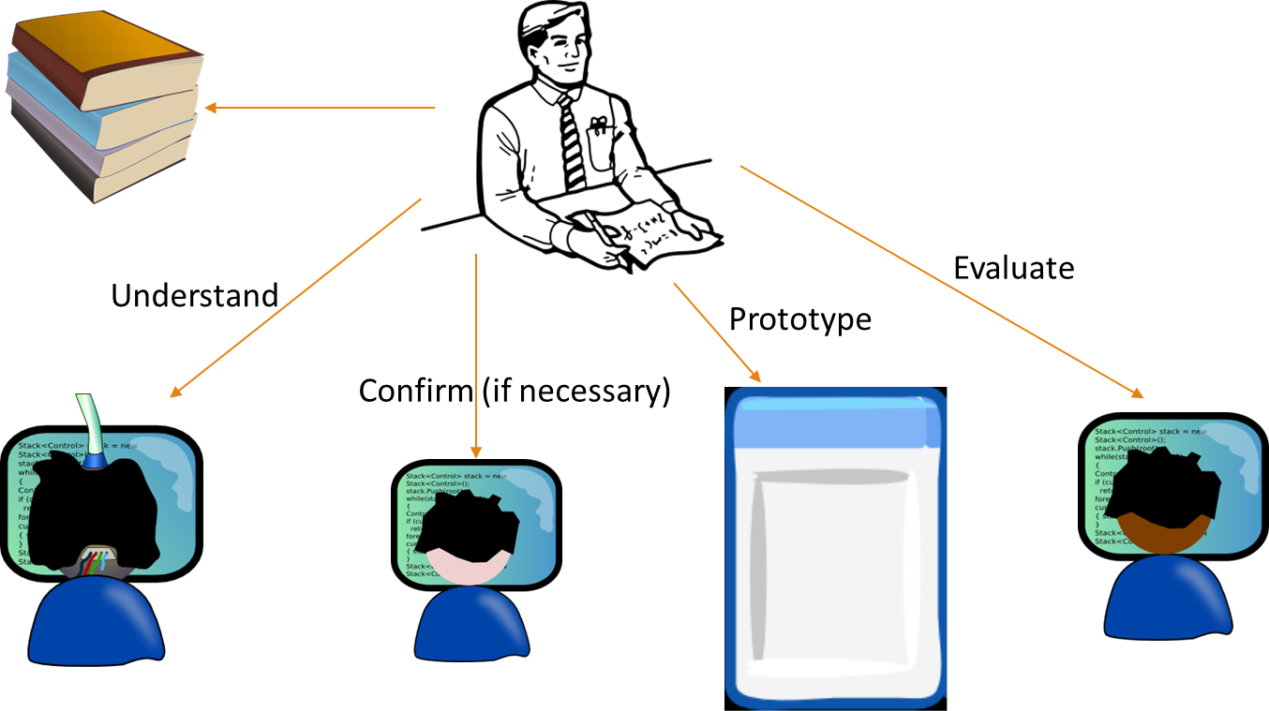
What kinds of research can be used?
- Exploratory?
- Descriptive?
- Causal?
- Quantitative?
- Qualitative?

Slide 12

Empirical research
Studies provide evidences for or against theories
Theories of developer activity
A model describing the strategy by which developers frequently do an activity that describes problems that can be addressed (“design implications”) through a better designed tool, language, or process that more effectively supports this strategy.
Models & theories
Scientific study
Evidences
Reality
LaToza (2011) http://www.cs.cmu.edu/~bam/uicourse/2011hasd/lecture02-HCI%20Methods%201.pdf

Slide 13
Exercise
Let’s improve how developers design software systems
How can we do that in a research-based way?

Slide 14
A single study will not answer all questions
Remember!
- Set scope
- Describe limitations of study
- Pick population to recruit participants from
- Plan follow-up complementary studies
LaToza (2011) http://www.cs.cmu.edu/~bam/uicourse/2011hasd/lecture02-HCI%20Methods%201.pdf

Slide 15
Research Methods

Slide 16
Example of a cycle
LaToza (2011) http://www.cs.cmu.edu/~bam/uicourse/2011hasd/lecture02-HCI%20Methods%201.pdf

Slide 17
Some methods for exploratory studies
Field observations / ethnography
  Observe developers at work in the ﬁeld
Surveys
  Ask many developers speciﬁc questions
Interviews
  Ask a few developers open-ended questions
Contextual inquiry
  Ask questions while developers work
Indirect observations
  Study artifacts (e.g., code, code history, bugs, emails, ...)
  To do high quality studies is quite difficult, but even quick-and-dirty ones can provide useful [Check the literature for additional guidelines]
LaToza (2011) http://www.cs.cmu.edu/~bam/uicourse/2011hasd/lecture02-HCI%20Methods%201.pdf

Slide 18
Field observations / ethnography
Find software developers
  Pick developers likely to be doing relevant work
Watch developers do their work in their ofﬁce
Ask developers to think-aloud
  Stream of consciousness: whatever they are thinking about
  Thoughts, ideas, questions, hypotheses, etc.
Register it
  Sometimes can be invasive, but permits detailed analysis
  Audio: can analyze tasks, questions, goals, timing
  Video: can analyze navigation, tool use, strategies
  Notes: high level view of task, interesting observations
LaToza (2011) http://www.cs.cmu.edu/~bam/uicourse/2011hasd/lecture02-HCI%20Methods%201.pdf

Slide 19
Surveys
Can reach many (100s, 1000s) developers
  Websites to run surveys (e.g., SurveyMonkey, Google Docs)
Find participants
  Probabilistic sampling is only possible for small and well defined population (e.g. within a company)
  Snowball sampling (mailing list, twitter etc.)
Prepare multiple choice & free response questions
  Multiple choice: faster, standardized response
  Free response: more time, more detail, open-ended
Background & demographics questions
  E.g., experience, time in team, state of project, ....
Open comments
LaToza (2011) http://www.cs.cmu.edu/~bam/uicourse/2011hasd/lecture02-HCI%20Methods%201.pdf

Slide 20
Semi-structured interviews
Define a script
Prompt developer with question on focus areas
  Let developer talk
  Follow to lead discussion towards interesting topics
Manage time
  Move to next topic to ensure all topics covered
It is hard to not bias the interviewee
LaToza (2011) http://www.cs.cmu.edu/~bam/uicourse/2011hasd/lecture02-HCI%20Methods%201.pdf

Slide 21
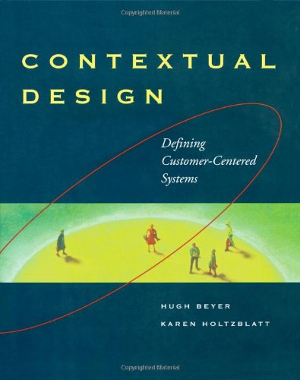
Contextual inquiry
Interview while doing ﬁeld observations
Learn about environment, work, tasks, culture, breakdowns
Principles of contextual inquiry
  Context - understand work in natural environment
  Ask to see current work being done
  Seek concrete data - ask to show work, not tell
    Bad: usually, generally
    Good: Here’s how, let me show you
  Partnership - close collaboration with user
    User is the expert
  Interpretation - make sense of work activity
    Rephrase, ask for examples, question terms & concepts
  Focus - perspective that deﬁnes questions of interest
LaToza (2011) http://www.cs.cmu.edu/~bam/uicourse/2011hasd/lecture02-HCI%20Methods%201.pdf

Slide 22
Indirect observations
Indirect record of developer activity
Examples of artifacts (where to get it)
  Code & code changes (version control systems)
  Code changes
  Bugs (bug tracking software)
  Emails (project mailing lists, help lists for APIs)
You can also collect data from instrumented tool (e.g., Hackstat)
Advantage:
  Lots of data, easy to obtain
Disadvantages:
  Can only observe what is in the data
LaToza (2011) http://www.cs.cmu.edu/~bam/uicourse/2011hasd/lecture02-HCI%20Methods%201.pdf

Slide 23
Examples
Which methods would you use in these situations?
1. You’d like to design a tool to help web developers reuse code more easily.
2. You’d like to help developers better prioritize bugs to be ﬁxed.
Field observations?
Surveys?
Interviews?
Contextual inquiry?
Indirect observations?
LaToza (2011) http://www.cs.cmu.edu/~bam/uicourse/2011hasd/lecture02-HCI%20Methods%201.pdf

Slide 24
Evaluation
Ok, you figured out a problem and conceived a tool.
But is this the right tool? Would it really help?
Which features are most important to implement?
Solution: low cost evaluation studies
  Evaluate mockups and prototypes before you build the tool!
Tool isn’t helpful: come up with a new idea
Users have problems using tool: ﬁx the problems
LaToza (2011) http://www.cs.cmu.edu/~bam/uicourse/2011hasd/lecture02-HCI%20Methods%201.pdf

Slide 25
Low cost evaluation methods
Paper prototyping
  Do tasks on paper mockups of real tool
  Simulate tool on paper
Wizard of Oz
  Simulate tool by computing results by hand
Heuristic evaluation
  Assess tool for good usability design
Cognitive walkthrough
  Simulate actions needed to complete task
LaToza (2011) http://www.cs.cmu.edu/~bam/uicourse/2011hasd/lecture02-HCI%20Methods%201.pdf

Slide 26
Paper prototyping
Build paper mockup of the tool
  May be rough sketch or realistic screenshots
Often surprisingly effective
Experimenter plays the computer
  Experimenter simulates tool by adding / changing papers
Good for checking if user
  Understands interface terminology
  Commands users want match actual commands
  Understands what tool does
  Finds the tool useful
Challenges - must anticipate commands used
  Iteratively add commands from previous participants
  Prompt users to try it a different way
LaToza (2011) http://www.cs.cmu.edu/~bam/uicourse/2011hasd/lecture02-HCI%20Methods%201.pdf

Slide 27
Wizard of Oz
Participant believes (or pretends) to interact with real tool
  Experimenter simulates (behind the curtain) tool
  Computes data used by tool by hand
Participant’s computer is “slave” to experimenter’s computer
Especially for AI and other hard-to-implement systems
  E.g.: Voice user interface - experimenter translates speech to text
Advantages
  High ﬁdelity - user can use actual tool before it’s built
Disadvantages
  Requires working GUI, unlike paper prototypes
LaToza (2011) http://www.cs.cmu.edu/~bam/uicourse/2011hasd/lecture02-HCI%20Methods%201.pdf

Slide 28
Prototyping
Paper
Implemented UI (no business logic)
Wizard of Oz
Implemented prototype
Real system
Increased fidelity
Better if sketchier for early design
- Use paper or “sketchy” tools, not real widgets
- People focus on wrong issues: colors, alignment, names
- Rather than overall structure and fundamental design
LaToza (2011) http://www.cs.cmu.edu/~bam/uicourse/2011hasd/lecture02-HCI%20Methods%201.pdf

Slide 29
Heuristic evaluation [Nielsen]
Multiple evaluators use dimensions to identify usability problems
Evaluators aggregate problems & clarify
Structured assessment based on experience
Problems may be are categorized according to their estimated impact on user performance or acceptance
Examples of heuristics: (Jakob Nielsen)
  Visibility of system status; Match between system and the real world; User control and freedom; Consistency and standards; Error prevention; Recognition rather than recall; Flexibility and efficiency of use; Aesthetic and minimalist design; Help users recognize, diagnose, and recover from errors; Help and documentation
Advantage:
  Users are not necessary
Disadvantage
  Highly influenced by the knowledge of the expert reviewer
LaToza (2011) http://www.cs.cmu.edu/~bam/uicourse/2011hasd/lecture02-HCI%20Methods%201.pdf

Slide 30
Cognitive walkthrough
How easy it is for new users to accomplish tasks with the system?
Cognitive walkthrough is task-specific
Task analysis - sequence of actions required by a user to accomplish a task and the responses from the system to those actions
Evaluators walk through the steps, asking themselves a set of questions
  Will the user try to achieve the effect that the subtask has? Does the user understand that this subtask is needed to reach the user's goal?
  Will the user notice that the correct action is available?
  Will the user understand that the wanted subtask can be achieved by the action?
  Does the user get feedback? Will the user know that they have done the right thing after performing the action?

Slide 31
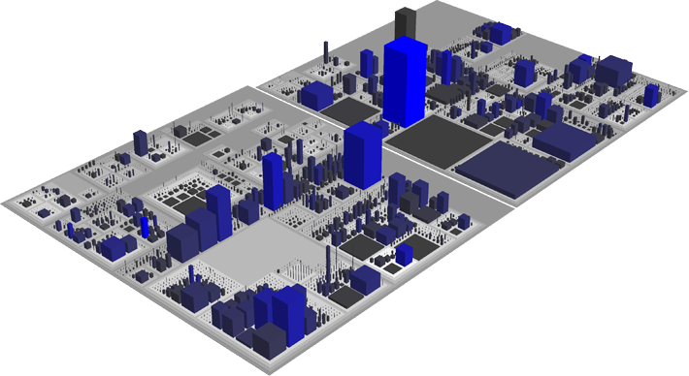
Exercise
How would you use the evaluation methods in this situation?
You’re designing a new notation for visualizing software
Paper prototyping
Wizard of Oz
Heuristic evaluation
Cognitive walkthrough
LaToza (2011) http://www.cs.cmu.edu/~bam/uicourse/2011hasd/lecture02-HCI%20Methods%201.pdf
Codecity: http://www.inf.usi.ch/phd/wettel/codecity.html

Slide 32
More robust evaluations
You want to write a paper claiming that your tool is useful
You want to get a company to try it out.
Solution: run a higher cost, but more convincing evaluation study
Lab experiments - controlled experiment to compare tools
  Measure differences of your tool w/ competitors
  Usually based on quantitative evidence
Field deployments
  Users try your tool in their own work
  Data: usefulness perceptions, how use tool
  Can be more qualitative
LaToza (2011) http://www.cs.cmu.edu/~bam/uicourse/2011hasd/lecture02-HCI%20Methods%201.pdf

Slide 33
Lab studies
Users complete tasks using your tool or competitors
  Within subjects design - all participants use both
  Between subjects design - participants use one
Typical measures - time, bugs, quality, user perception
  Also measures from exploratory observations (think-aloud)
  More detailed measures = better understood results
Advantage
  Controlled experiment (more precision)
Disadvantages
  Less realism and generalizability
  Users still learning how to use tool, unfamiliar with code
  Beneﬁts may require longer task
LaToza (2011) http://www.cs.cmu.edu/~bam/uicourse/2011hasd/lecture02-HCI%20Methods%201.pdf

Slide 34
Field deployments
Give your tool to developers. See how they use it
Low control, more realism
Data collection: interviews, logging data, observations
Qualitative measures
  Perception: do they like the tool?
  Use frequency: how often do they use it?
  Uses: how do they use it? what questions? tasks? why?
  Wishes: what else would they like to use it for?
Quantitative comparison is possible, but it is hard
  Different tasks, users, code
LaToza (2011) http://www.cs.cmu.edu/~bam/uicourse/2011hasd/lecture02-HCI%20Methods%201.pdf

Slide 35
Analysis

Slide 36
Techniques for qualitative data analysis
Contextual design
  Set of models for understanding how work is done
Content analysis / grounded theory
  Technique for analyzing texts
  Used both to ﬁnd patterns in data & convert to quantitative data
Process models
  Models of steps users do in a task
Taxonomies
  What things exist, how are they different, and how are they related?
Afﬁnity diagrams
  Technique for synthesizing many disparate observations or interpretations into a coherent whole
LaToza (2011) http://www.cs.cmu.edu/~bam/uicourse/2011hasd/lecture02-HCI%20Methods%201.pdf

Slide 37
Quantitative data analysis
Frequency
  How often do things occur? (counts, %s, avg times, ...)
  Descriptive statistics
Correlational
  How are multiple variables related? (correlations, ....)
  Estimate variable x from variables a, b, c (regression, classiﬁers, ....)
Controlled experiment (causal)
  Statistical test

Slide 38
Qualitative vs. quantitative
Qualitative analysis most useful for
  Figuring out what’s there, what’s being done
  What’s important?
  How are things done?
  Why is person doing / using / thinking something?
Limitations
  Small n: few examples, may not generalize
  Interpretations could be biased
Quantitative analysis most useful for
  Testing hypotheses
  Investigating relationships between variables
  Predicting
Limitations
  Lack interpretation
Therefore, great studies mix both approaches
LaToza (2011) http://www.cs.cmu.edu/~bam/uicourse/2011hasd/lecture02-HCI%20Methods%201.pdf

Slide 39
Other aspects of a scientific study

Slide 40
What to observe
Learning a new tool
Pilot studies
IRB Approval
Maximize validity
  more participants, data collected, measures
  longer tasks
  more realistic conditions
Minimize cost
  fewer participants, data collected, measures
  shorter tasks
  less realistic, easier to replicate conditions
Studies are not proofs - results could always be invalid
  Software Engineering is very context dependent
  Don’t sample all developers x tasks x situations, and measures are imperfect
Search results that are
  interesting
  relevant to research questions
  valid enough so that your target audience believes them
LaToza (2011) http://www.cs.cmu.edu/~bam/uicourse/2011hasd/lecture02-HCI%20Methods%201.pdf

Slide 41
Some types of validity
Validity = should we believe the results?
Construct validity
  Does measure correspond to construct or something else?
External validity
  Do results generalize from participants to population?
Internal validity
  Are the differences between conditions caused only by experimental manipulation and not other variables? (confounds)
See also:
https://en.wikipedia.org/wiki/Bias_(statistics)
https://en.wikipedia.org/wiki/Cognitive_bias
LaToza (2011) http://www.cs.cmu.edu/~bam/uicourse/2011hasd/lecture02-HCI%20Methods%201.pdf

Slide 42
Conclusion

Slide 43
Final considerations
Field studies of programmers reveal interesting new areas for tool research and development
  Can focus research on important problems
  Design from Data about real problems, barriers, opportunities
Following research methods will result in better quality tools
  More usable, effective, etc.
Software Engineering tools and methods often benefit from valid evaluation with people
  Need real evidence to answer questions about what is better/faster/easier
  Often demanded by reviewers
  Relevant to any claims of better/faster/easier for people
  There are valid evaluation criteria beyond “Taste”, “Intuition”, “My experience,” and anecdotes
LaToza (2011) http://www.cs.cmu.edu/~bam/uicourse/2011hasd/lecture02-HCI%20Methods%201.pdf

Slide 44
Summary
Pure invention x empirical research approach for developing innovative tools
When to do empirical studies
Types of empirical studies
Research methods
  exploratory studies
  low cost evaluation
  robust evaluation
Qualitative and quantitative analysis
Some points to observe when conducting studies
Validity

Slide 45
To Do
Define the groups and the topic of your seminar
Read the papers assigned for the 3rd class (check your group):
  http://www.ime.usp.br/~gerosa/classes/uci/inf219
Produce the slides-based summary for the two papers
“Wherever you go, go with all your heart.” (Confucius)

Slide 46
Thank you!
See you next class
Marco Gerosa
Web site: http://www.ime.usp.br/~gerosa
Email: mgerosa@uci.edu / gerosa@ime.usp.br
Office: DBH 5228 (by appointment)

Slide 47
Acknowledgments
This class was based on the slides from Thomas LaToza:
http://www.cs.cmu.edu/~bam/uicourse/2011hasd/lecture02-HCI%20Methods%201.pdf
http://www.cs.cmu.edu/~bam/uicourse/2011hasd/lecture03-HCI%20Methods%202.pdf

