Slide 1

INF219 – Software Environments
First class
Introduction to the course
Marco Aurélio Gerosa
University of California, Irvine
Spring/2014

Slide 2
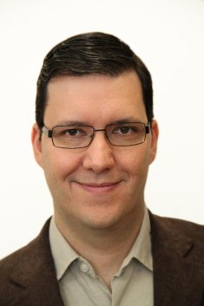
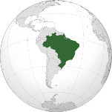
The instructor
Ph.D. in Computer Science (2006)
Bachelor in Computer Engineering (1999)
Associate Professor at the University of São Paulo, Brazil
Visiting Professor at UCI
Research area: Intersection of Software Engineering and CSCW
Web site: http://www.ime.usp.br/~gerosa
Email: mgerosa@uci.edu / gerosa@ime.usp.br
Office: DBH 5228 (by appointment)

Slide 3
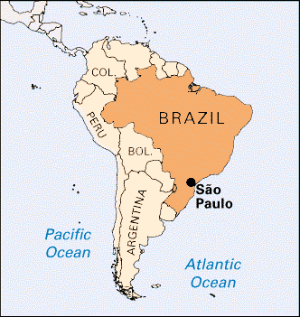
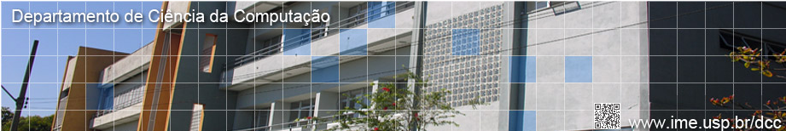
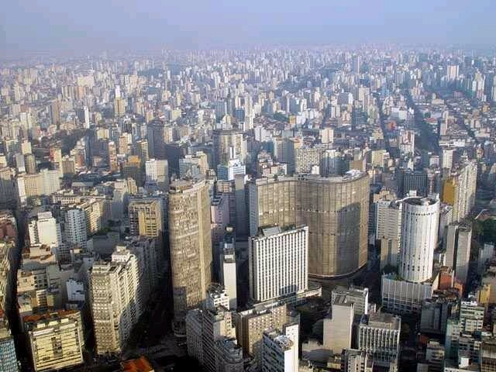
Where I came from
University of São Paulo
  Latin America largest university
  Total area: 76 million m² (800 million ft²)
  92000 students
  5800 faculty
  2400 doctorate degrees per year
  25% of Brazilian scientific production
Computer Science Department
São Paulo
http://www5.usp.br/en/usp-em-numeros/

Slide 4
Who are you?
Your name
A little bit about yourself
Your advisor
Your research interests
Experience with software environments

Slide 5
About the course

Slide 6
Logistics
Room: ICS 180
Lectures: Mondays and Wednesdays, 2pm - 3:20pm
Number of students: 17 (so far…)
Website: http://www.ime.usp.br/~gerosa/classes/uci/inf219
Additional resources: http://eee.uci.edu

Slide 7
How can we interact online?
UCI EEE
Google Groups
Facebook

Slide 8
Before the content,
let’s discuss the form

Slide 9
How to memorize, understand, and be able to apply, analyze, synthesize, and evaluate the knowledge covered by the course?
And how to develop academic skills at the same time?

Slide 10
Practice! Do it by yourself!

Slide 11
Learning…
“I hear and I forget.
I see and I remember.
I do and I understand.”
(Confucius)

Slide 12
Learning…
“I hear and I forget.
I see and I remember.
I do and I understand.”
(Confucius)
This class and the other lectures
Readings and the examples presented
Papers discussion and presentation, student seminar, term project

Slide 13
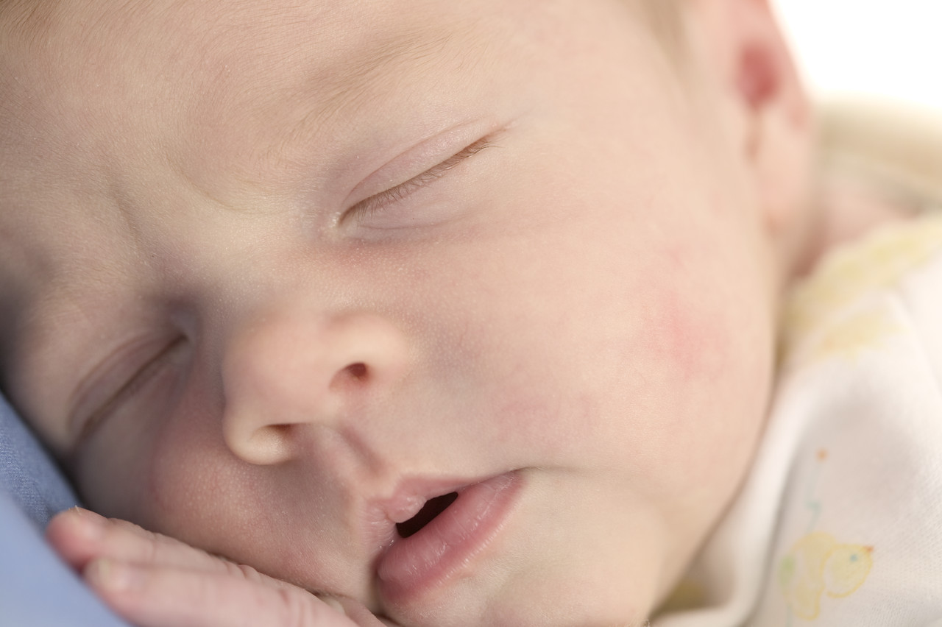
Attitude I: Just be present at the lectures

Slide 14

Attitude II: Pay close attention and be quiet
http://pidsfriendz.wikispaces.com/

Slide 15

Attitude III: What I really want
http://chrislindholm.wordpress.com/

Slide 16


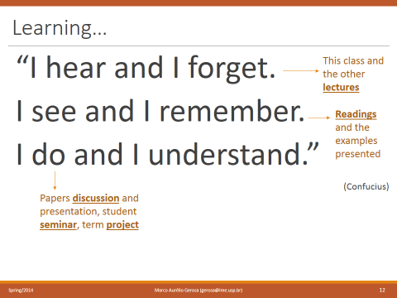
Back to the course
- Lectures: their content is doomed to be forgotten, but hopefully it will stay in short memory enough time to support and guide the subsequent discussion
=> Be attentive
- Readings: prepare yourself to the class to come
=> study and synthetize knowledge
- Discussions: formalize your thoughts and share your ideas with us
=> participate
- Seminar: understand at least one of the course’s topics in depth
=> go in depth and show quality in what you do
- Term project: apply the concepts in a piece of research
=> practice and learn
Role of the instructor => Mediator of these processes
Remember:

Slide 17
1. Reading and reporting
Read 1 to 3 papers before most of the classes (most typically 1 paper)
Read critically
Prepare a set of slides summarizing the paper
  focus on the motivation, applicability, and results
  conclude with your opinion about the paper and with a critical view on its positive and negative aspects
  state questions and problems to be further discussed in the classroom
In the beginning of the class, one student will be randomly selected to give an 8-10 min presentation about the paper using his/her own slides
  So, be prepared!!!
Submit in advance your slides at EEE Dropbox

Slide 18
2. Discussions
Remember: I want to hear you!

Slide 19
2. Discussions
Remember: I want to hear you!
No exceptions!
Prepare yourself to the discussion as you would prepare yourself to a meeting at your job

Slide 20
3. Student Seminars
In group, study and present one topic in depth
  Read the literature we selected
  Search the literature and find additional important studies we missed
  Map the main concepts about the topic
  Identify important and interesting works published in the literature
  Investigate the state-of-the-practice, actual examples, and tools used in software industry
  Identify one or two key articles for the class to read
    Let us know at least 1 week before your scheduled presentation date
    One random student will do the 10 min presentation about the paper
  Compile a categorized bibliography about the topic
  Prepare a 30 minute overview of the area using slides
  Prepare questions and challenges to motivate the discussion in class
We’re looking forward to learn about the area from your perspective!

Slide 21
References
  In the website, there is an initial list of relevant references. Let’s improve it!

Slide 22
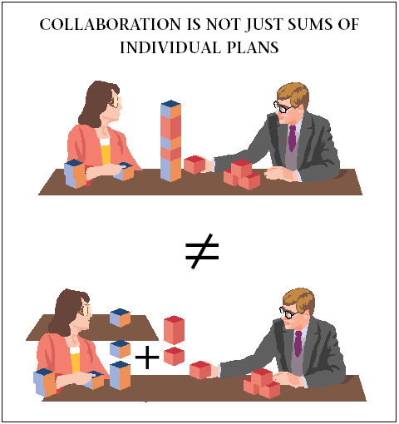
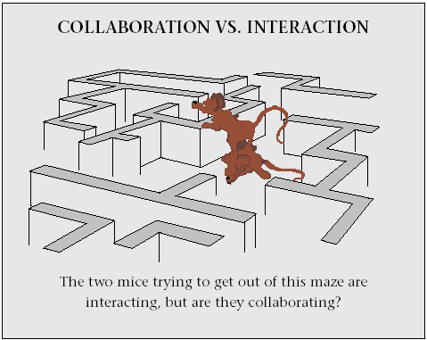
Groups
Groups of 2 (or 3 depending on the number of enrolled students) – preferably mixing Ph.D. and MSc students
Define your group, post it in the shared document https://docs.google.com/document/d/1KwRp4Gs5zO0PxBMXXDnb6UeKj4JNx-Tp2_llWaBeH6A/edit?usp=sharing and send me an email just in case (mgerosa@uci.edu)
Topics are chosen in a first-to-come-first-to-serve basis => act quickly!
Real collaboration is expected!
Grosz. Collaborative Systems. AI Magazine, 17(2): 67-85. Summer 1996

Slide 23
4. Term project
Objective: to conduct a small research project and write a paper about it
What is a good research project involving software environments?
Remember: We want to support software developers

Slide 24
Software developers
are human beings,
not machines

Slide 25
What is a good research in the area?
Technical aspects are not enough!
A good research needs to consider the human and social aspects of software development.
So, a good research comprises [Myers, 2011]:
Contextual inquiry or lab study to discover an interesting issue that has not previously been known
Survey to validate that is actually widespread
A model that represents and generalizes what is happening
Tool developed that embodies interesting technical contributions and addresses the problems
Lab study of the tool, compared to the way it is done now, that shows significant improvements
Brad Myers (2011) http://www.cs.cmu.edu/~bam/uicourse/2011hasd/lecture01.intro.pptx

Slide 26
So, what do you need to do?
Choose a topic
Conduct an empirical evaluation with humans to understand the problem to be solved (more details next class)
Survey the literature (related work) and software repositories to find evidences of the relevance of the problem
Conceive a solution
Implement it
Evaluate it
Report (write an academic paper)

Slide 27
The topic
Substantial latitude is allowed, but it has to be related to software environments and must consider human/social aspects of software development
  Tip: consider something related to your seminar or to your graduation theme
Small changes are allowed along the quarter (the project is iterative and incremental)
The research proposal must be approved by the instructor
Proposal: motivation, research question, objective, method (more details about it on the second class) – 1 or 2 pages
Due date: April, 9th

Slide 28
Feedback on the project (I)
Some classes will be used for the projects follow up
All the students are expected to give constructive feedback during classes and/or in the online discussion
April 16th: Topics and empirical evaluations
April 30th: Solution proposed
May, 21th: Prototype
Jun, 11th: Final presentation

Slide 29
Feedback on the project (II)
The academic paper will be submitted via Easy Chair, simulating a scientific conference
You will be part of the program committee of the conference
You are going to receive papers from the other groups to review
The reviews will be considered as part of the reviewer’s grade, but will not affect negatively the grade of the authors of the papers.
  Therefore, you can be critical (but always in a constructive way) without prejudicing the colleagues
The reviews will be anonymous

Slide 30
Grading
What will be considered:
Presence and participation in the classes and in the online discussion
Critical opinions, questions, and challenges shared with the class on the discussions
Feedback provided to your peers
The demonstrated understanding of the class topics
The quality of what you produce in the courses activities:
  Summary slides
  8-10 min paper presentations
  Seminar
  Term project

Slide 31
Finally, the content

Slide 32
Description
Catalogue description: Study of the requirements, concepts, and architectures of comprehensive, integrated, software development and maintenance environments. Major topics include process support, object management, communication, interoperability, measurement, analysis, and user interfaces in the environment context.
This edition’s scope: This edition highlights human and social aspects of software engineering, as well as information mining from software repositories. We are going to discuss how software environments can be improved considering these elements.
Key aspects:
- Understanding software development problems
- Conceiving tools to help developers
- Evaluating these tools

Slide 33
What are we going to study?
A historical perspective
How to improve software environments
Next steps and future of the area
Focus on research, but without forgetting the state-of-the-practice

Slide 34
Topics
Understanding a problem
A historical perspective
Eclipse IDE & Moderns IDEs
Supporting coding and testing
Under the hood: Building and extending IDEs
Supporting software analysis and design
Version Control Systems & Configuration Management
Mining software repositories
Software analytics
Software visualization
Integrating IDEs and Social Media
Distributed Software Environments
IDEs @ the Cloud

Slide 35
Introduction to Software Environments

Slide 36
What is a software environment?
Write down what you consider to be a software environment

Slide 37
What is a software environment?
Refers to the collection of hardware and software tools a system developer uses to build software systems.
The set of software tools collected together (sometimes using a common database or user interface) for use by a software developer, or team of developers, when developing software.
An environment is a collection of CASE tools and workbenches that supports the software process.
Dart et al. (1992)
Oxford Dictionary of Computing
http://en.wikipedia.org/wiki/Computer-aided_software_engineering

Slide 38
Many related terms
CASE tool (Computer-Assisted Software Engineering) and ICASE (Integrated CASE)
  A marketing term, used to describe the use of software tools to support software engineering
IPSE (Integrated Project Support Environment)
  A software system that provides support for the full life cycle of software development and also the project control and management aspects of a software-intensive project.
SEE (Software Engineering Environment) and ISEE (Integrated Software-Engineering Environment)
  Concern for the entire software life cycle (rather than just program development) and offer support for project management (rather than just technical activities)
SDE (Software Development Environment)
  The set of software tools collected together (sometimes using a common database or user interface) for use by a software developer, or team of developers, when developing software
PSE (Programming Support Environment) or Programming Environment
  A software system that provides support for the programming aspects of software development, repair, and enhancement. A typical system contains a central database and a set of software tools. A programming support environment might be considered as a more technologically advanced form of PDS.
Oxford Dictionary of computing, 6th ed.
http://www.oxfordreference.com/view/10.1093/acref/9780199234004.001.0001/acref-9780199234004

Slide 39
Many related terms
PDS (Program Development System)
  A software system that provides support to the program development phase of a software project.
Workbench
  Another name for software development environment
Toolbox and Toolkits
  A set of software tools, probably from several vendors, not necessarily as closely related or providing as full coverage of the software life cycle as a toolkit. The set of tools in a toolkit is usually from a single vendor.
SDK (Software Development Kit)
  A collection of the software tools, code libraries, documentation, etc., necessary to develop a specific type of software, commonly provided as a single installable package.
Software tool
  A program that is employed in the development, repair, or enhancement of other programs
Oxford Dictionary of computing, 6th ed.
http://www.oxfordreference.com/view/10.1093/acref/9780199234004.001.0001/acref-9780199234004

Slide 40
Why automated tools in
software environments?
CASE tools vs. notepad, vi, etc.

Slide 41
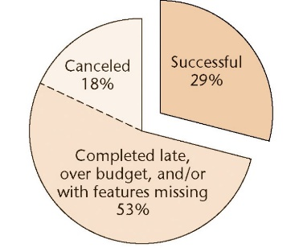
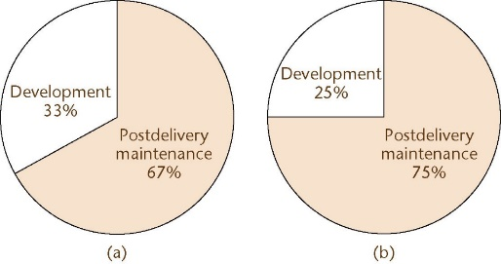
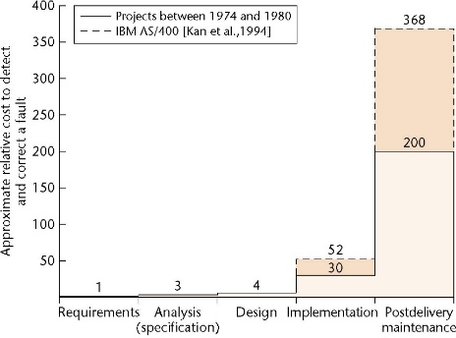
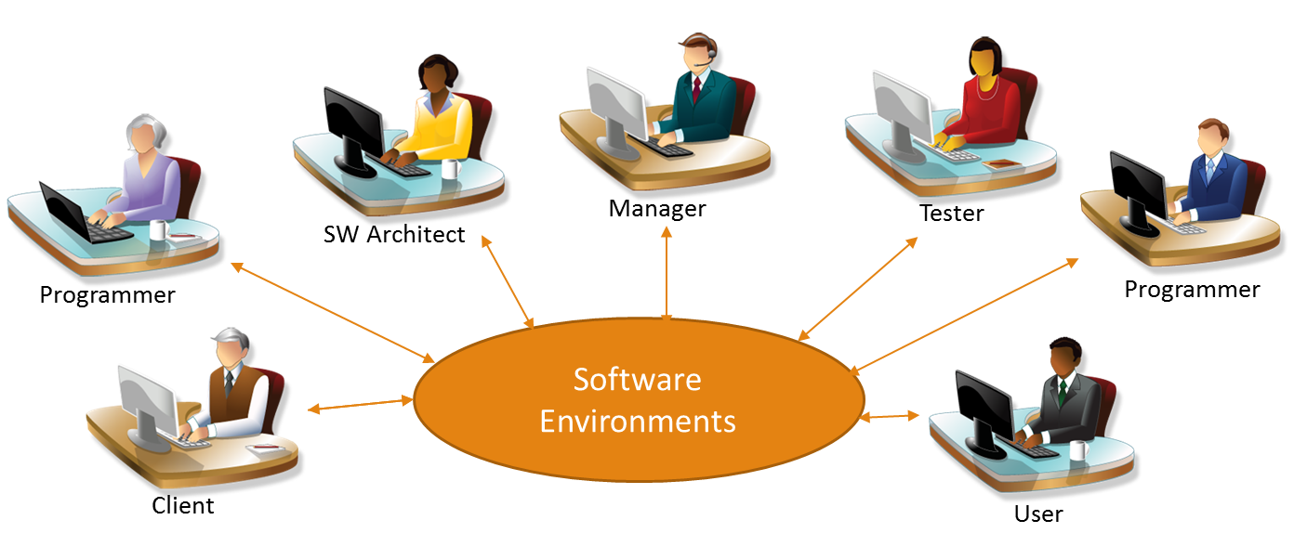
Some benefits
Yes, we know that software engineering is difficult
Increase productivity
Increase quality
Automate software processes
Reduce costs
Foster collaboration
Support management
[Schach, 2009]
And involves a lot of stakeholders

Slide 42
If we have benefits, we have disadvantages too. What are they?

Slide 43
Possible problems
Learning curve
Dependency on third parties vendors
Cost of the solution (Total Cost of Ownership)

Slide 44
What is an Integrated Development Environment (IDE)?

Slide 45
A definition
Tool integration is about the extent to which tools agree. The subject of these agreements may include data format, user-interface conventions, use of common functions, or other aspects of tool construction.
An IDE normally consists of a source code editor, build automation tools, and a debugger.
The boundary between an integrated development environment and other parts of the broader software development environment is sometimes blur.
Integrated development environments are designed to maximize programmer productivity by providing tight-knit components with similar user interfaces.
One aim of the IDE is to reduce the configuration necessary to put together multiple development utilities
Thomas & Nejmeh: Definitions of Tool Integration for Environments (IEEE Software 1992)
http://en.wikipedia.org/wiki/Integrated_development_environment

Slide 46
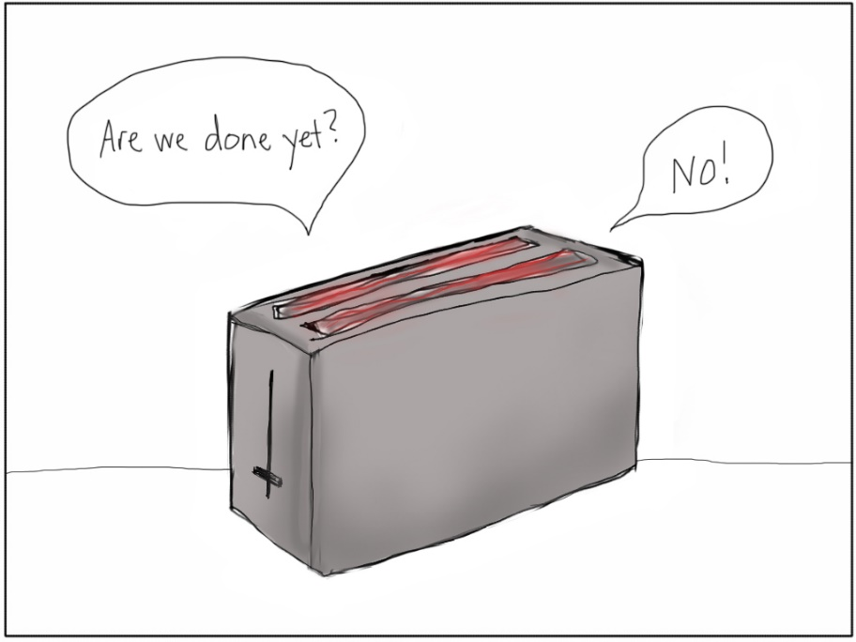
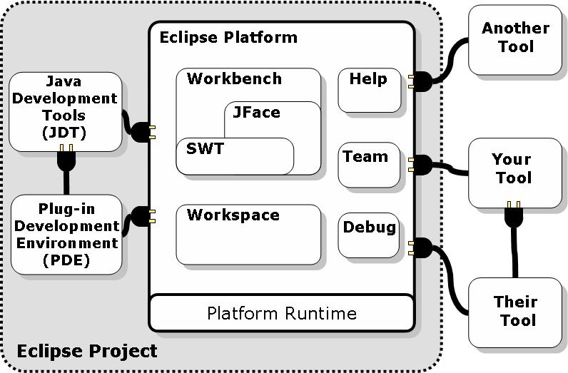

Extending IDEs
Component-based software development
Plugins

Slide 47
Different software environments
Focus on a programing language / technology
Focus on a process / method
Focus on a domain
Focus on an organization

Slide 48
Some more definitions
Program
  A set of statements that can be submitted as a unit to some computer system and used to direct the behavior of that system
Programming
  The process of transforming a mental plan of desired actions for a computer into a representation that can be understood by the computer
Development
  All programmer activities involved in software (except use)
  Includes design, programming (coding), testing, documentation, etc.
Software Engineering
  Development + Requirements Analysis + processes
End-User Development
  End users doing development activities themselves
Visual Programming
  Programming using graphics
  2D layout is significant (beyond indentation)
Interface Builders
  Draw the layout of static parts of a user interface, and code is generated to create that layout at run-time
Brad Myers (2011) http://www.cs.cmu.edu/~bam/uicourse/2011hasd/lecture01.intro.pptx

Slide 49
Other related terms
Library
  A collection of programs and packages that are made available for common use within some environment
Framework
  A template for the development of software applications or components
Application Programming Interface (API)
  A body of code providing reusable functionality that is intended to be used without looking inside at the internal implementation
Domain-Specific Languages (DSL)
  Programming languages designed for a particular audience
Brad Myers (2011) http://www.cs.cmu.edu/~bam/uicourse/2011hasd/lecture01.intro.pptx
Oxford Dictionary of computing, 6th ed.
http://www.oxfordreference.com/view/10.1093/acref/9780199234004.001.0001/acref-9780199234004

Slide 50
Some definitions
Human Aspects of Software Development
  All the parts of development that affect the developer
  Not the parts that affect the end user
Mining Software Repositories
  Analysis of data available in software repositories to uncover interesting and actionable information about software systems and projects
http://2014.msrconf.org/
Brad Myers (2011) http://www.cs.cmu.edu/~bam/uicourse/2011hasd/lecture01.intro.pptx

Slide 51
Collaboration tools and social media can be part of a software environment?
  Remembering the definition: Software Environment refers to the collection of hardware and software tools a system developer uses to build software systems.

Slide 52










Mining software repositories
Discussion lists
Comments on issues
Code comments
User reports
Q&A sites
Social media
Source code
and artifacts
Issue trackers
Project management systems
Reputation systems
Practitioner
Researcher
Applications
Information about a project
Decision making
Information about an ecosystem
Software understanding
Mining
Information about Software Engineering
Support maintenance
Empirical validation of ideas & techniques

Slide 53





Repositories of repositories
93K projects
1 million users
250K projects
11.3 millions repositories
5.4 millions users
In 2013:
3 millions new users
152 millions pushes
25 millions comments
14 millions issue
7 millions pull requests
661K projects
29 billions of lines of codes
3 millions users
30K projects
https://launchpad.net
http://www.ohloh.net/
36K projects
33K projects
https://github.com/about/press
http://octoverse.github.com/
http://en.wikipedia.org/wiki/CodePlex
324K projects
3.4 millions developers
200 projects
http://projects.apache.org/indexes/alpha.html
http://sourceforge.net/apps/trac/sourceforge/wiki/What%20is%20SourceForge.net
http://en.wikipedia.org/wiki/Comparison_of_open_source_software_hosting_facilities

Slide 54
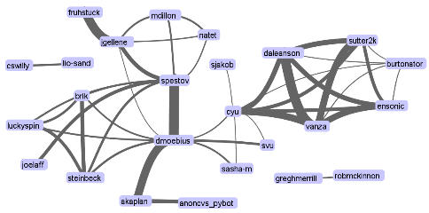
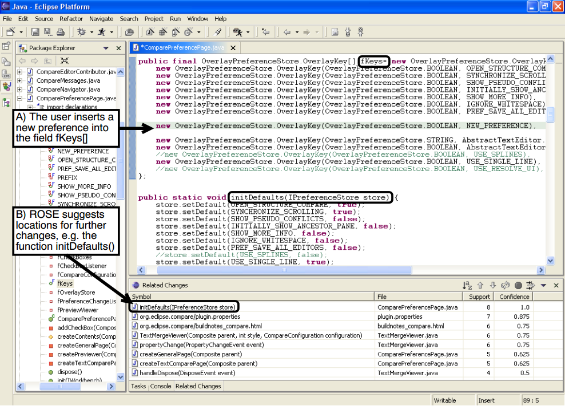
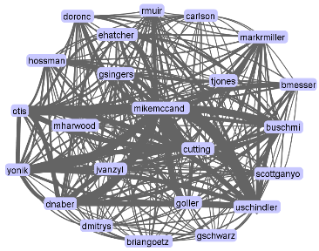
Examples
Zimmermann, Weissgerber, Diehl, and Zeller. Mining Version Histories to Guide Software Changes. IEEE Trans. Software Eng. 31, 6 (June 2005)
Christian Bird, Alex Gourley, Prem Devanbu, Michael Gertz, and Anand Swaminathan. 2006. Mining email social networks. MSR 2006
Santana, F. et a. “XFlow: An Extensible Tool for Empirical Analysis of Software Systems Evolution”. ESELAW 2011
https://github.com/mjwillson/ProgLangVisualise
http://www.igvita.com/slides/2012/bigquery-github-strata.pdf

Slide 55
Conclusion

Slide 56
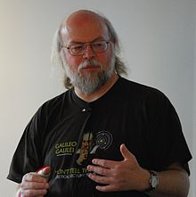
The other side of the coin
“One of the things I've found kind of depressing about the craft of computer programming is that you see all these fancy development environments out there, and they tend to be targeted at solving certain specific kinds of problems, like building user interfaces. But if you go around and look at the high-end developers, the people who actually have to implement algorithms, if you're using one of these high-end IDEs the IDEs generally don't help you much at all, because they drop you into this simple text editor. The number one software development environment for high-end developers these days is still essentially EMACS. At their heart, these tools are 20 years old, and there hasn't been much in the way of dramatic change. People have made all kinds of stabs at graphical programming environments and that, and they've tended to be failures for one reason or another.”
Why is it that people still use ASCII text for programs? It just feels like there's so much territory out there that's beyond the bounds of ASCII text that's just line after line, roughly 80 characters wide, mostly 7-bit ASCII, something that you could type in on a teletype.”
James Gosling
http://www.gotw.ca/publications/c_family_interview.htm
http://en.wikipedia.org/wiki/James_Gosling

Slide 57
  Where to look for research in this area?
Scientific venues
  ICSE, CHI, FSE, UIST, CSCW, TSE, TOSEM, ICSM, ICPC, JVLC, Journal of Systems & Software, etc.
Search engines
  http://scholar.google.com
  http://dblp.uni-trier.de/db
  http://www.scopus.com
  http://ieeexplore.ieee.org
  http://dl.acm.org
  http://citeseer.ist.psu.edu
Tip: Use a tool to manage your references, such as http://www.zotero.org, http://www.mendeley.com, or http://jabref.sourceforge.net

Slide 58
To Do
Read the guidelines of the course at the website http://www.ime.usp.br/~gerosa/classes/uci/inf219 (these slides will also be there)
    Although I will most probably report the major updates about the course in the discussion list, you can monitor this page with an online service such as http://www.changedetection.com/ or http://www.watchthatpage.com/
Define the groups and the topic of your seminar
Read the paper assigned for the 2nd class (check the webpage)
Produce the slides-based summary of the paper
“Wherever you go, go with all your heart.” (Confucius)

Slide 59
Fair Play!
Do not cheat
Do not copy other works without proper citation
Do not overload the other(s) member(s) of the group
See also:
http://honesty.uci.edu/students.html

Slide 60
Summary
Who we are
The dynamics of the course
  Attitude
  Assignments
  Topics
What is a software environment
Terminology
Tool support for Software Engineering
IDEs
Mining software repositories
Where to find research on the area
Fair play

Slide 61
Thank you!
Marco Gerosa
Web site: http://www.ime.usp.br/~gerosa
Email: mgerosa@uci.edu / gerosa@ime.usp.br
Office: DBH 5228 (by appointment)

Slide 62
Acknowledgments
This course is based on other courses from André van der Hoek, Susan Elliott Sim, Myers and LaToza, and Leonardo Murta. I also would like to thank the feedback received from David Redmiles, Yi Wang, Andre van der Hoek, Thomas LaToza, Gustavo Oliva, Igor Steinmacher, and Igor Wiese.

