Slide 1
On the performance of real-time DSP on Android devices
André J. Bianchi and Marcelo Queiroz
Insitute of Mathematics and Statistics
Department of Computer Science
University of São Paulo

Slide 2
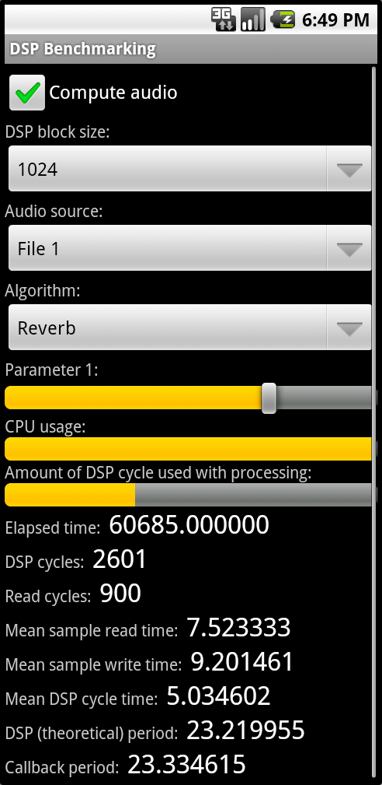
On the performance of real-time DSP on Android devices
3
1
By looking at the results, we can determine which device is more suitable for each kind of task, under our DSP model, in terms of computing power.
How to obtain useful information about
the performance of Android devices for DSP, that can aid aesthetic, and algorithmic decisions regarding hardware and software choice?
2
A simple application that stresses the device by running common DSP tasks and measures the time it takes to accomplish these tasks, might do the work!

