Slide 1
Combinatorial Stochastic Search and Selection (Part 2) Bobby Kleinberg São Paulo School of Advanced Science on ACO July 2016

Slide 2
Part II: Prophet Inequalities (Joint work with S. Matthew Weinberg.)

Slide 3
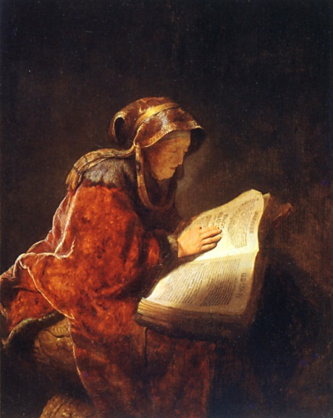
The Prophet Inequality
Theorem: (Krengel, Sucheston, Garling 1978) If $X_{1}, …,X_{n}≥0$ are independent random variables, then there exists a stopping rule $τ$ such that
$$E\left[X_{τ}\right]≥\frac{1}{2}⋅E\left[\max_{t}{X_{t}}\right].$$
I will present two proofs: one by Samuel-Cahn (1984) and one by K. & Weinberg (2012).

Slide 4
1st Proof: Beat the Median
For simplicity assume no point masses: $∀t,x Pr\left(X_{t}=x\right)=0$
Let $m$ be such that $\operatorname{Pr}\left(\max_{t}{X_{t}}>m\right)=\frac{1}{2}.$
Algorithm: Choose the earliest $τ$such that $X_{τ}>m.$
$$E\left[\max_{t}{X_{t}}\right]≤ m+ \sum_{t=1}^{n}{E[{\left(X_{t}−m\right)}^{+}]}$$
$$E\left[X_{τ}\right]≥\frac{1}{2}m+\frac{1}{2}\sum_{t=1}^{n}{E[{\left(X_{t}−m\right)}^{+}]}$$
Notation: $x^{+}$ denotes $\max\left\{x,0\right\}.$

Slide 5
2nd Proof: Beat Half the Expectation
Let $T=\frac{1}{2}E[\max_{t}{X_{t}].}$
Algorithm: Choose earliest $τ$ such that $X_{τ}>T.$

Slide 6
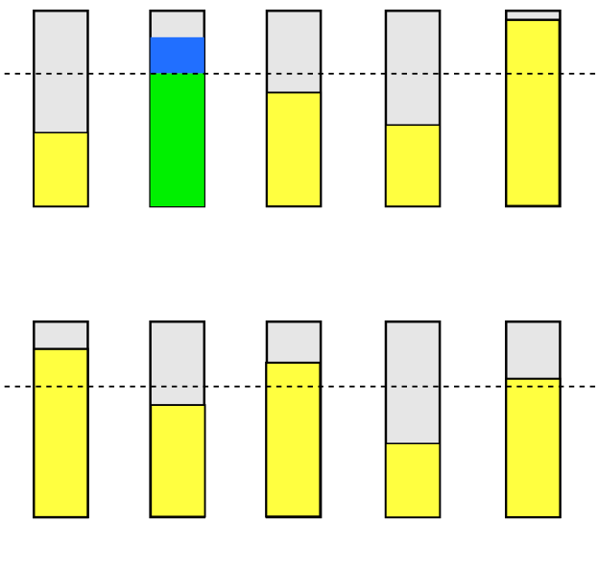
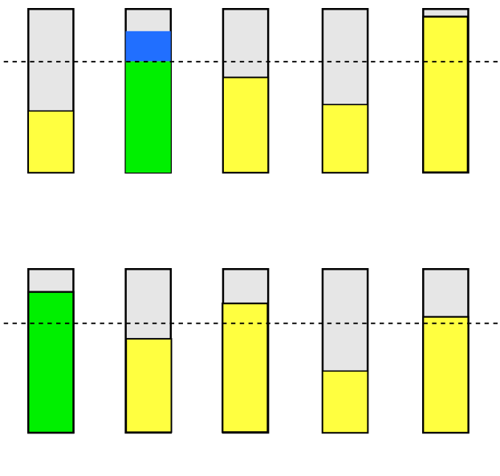
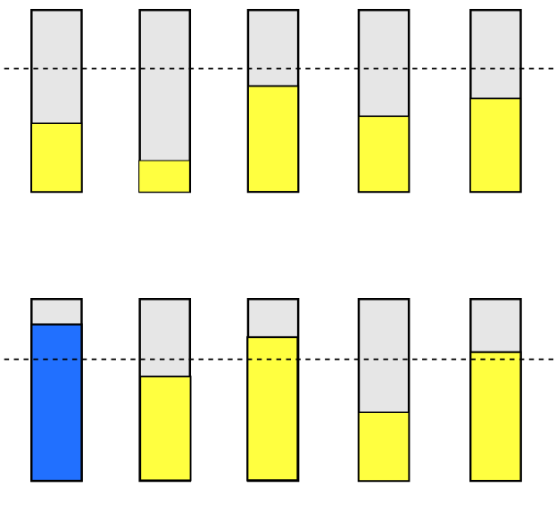
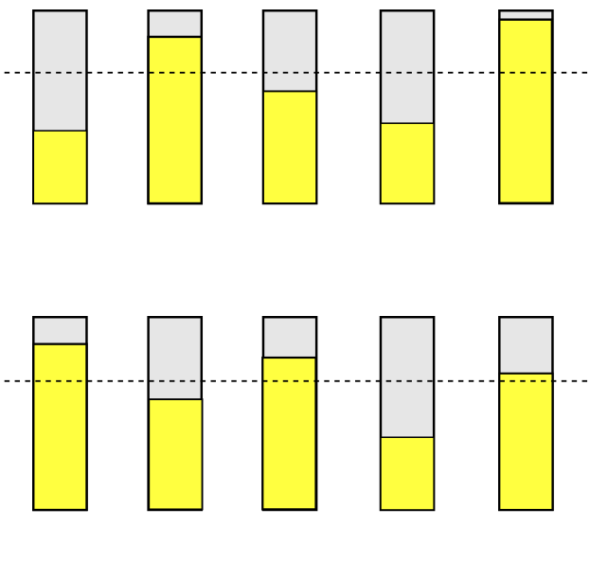
2nd Proof: Beat Half the Expectation
Run gambler and prophet on independent random sequences.
Divide gambler’s payoff into:
green portion = first T units
blue portion = excess
Color prophet’s payoff:
green if gambler picks something
blue if gambler picks nothing

Slide 7
2nd Proof: Beat Half the Expectation
Will prove:
$$E\left[G^{′}s green\right]=\frac{1}{2} ⋅ E[P^{′}s green]$$
$$E\left[G^{′}s blue\right]≥ \frac{1}{2}⋅E[P^{′}s blue]$$
Green portion is easy.
If G picks something, his green share is $T$ and P’s green share is $2T$in expectation.

Slide 8
2nd Proof: Beat Half the Expectation
Will prove:
$$E\left[G^{′}s green\right]=\frac{1}{2} ⋅ E[P^{′}s green]$$
$$E\left[G^{′}s blue\right]≥ \frac{1}{2}⋅E[P^{′}s blue]$$
Green portion is easy.
If G picks nothing, both G and P get zero green share.

Slide 9
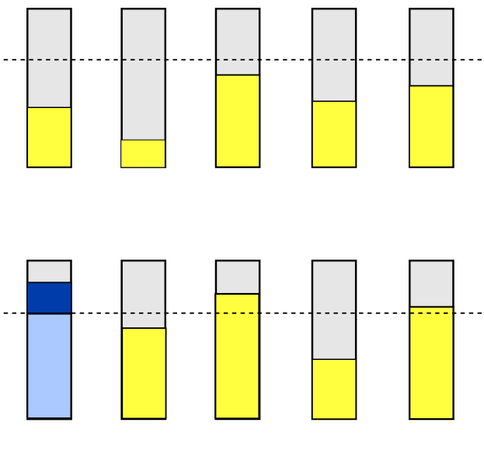
2nd Proof: Beat Half the Expectation
To prove:
$$E\left[G^{′}s blue\right]≥ \frac{1}{2}⋅E\left[P^{′}s blue\right].$$
Step 1: Divide P’s blue into
light blue (first T or less) and
dark blue (excess above T).
By our choice of T,
$$E\left[P^{′}s dark blue\right]≥\frac{1}{2}⋅E\left[P^{′}s blue\right].$$

Slide 10
2nd Proof: Beat Half the Expectation
To prove: $E\left[G^{′}s blue\right]≥E\left[P^{′}s dark blue\right].$

Slide 11
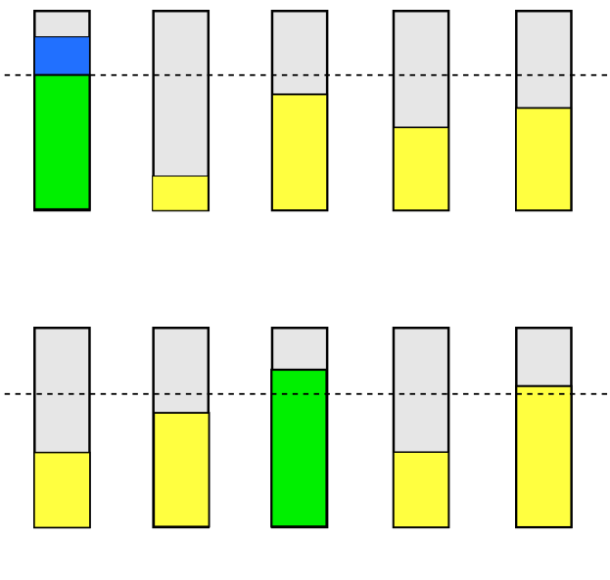
2nd Proof: Beat Half the Expectation
$$∀t E\left[G^{′}s blue in box t\right]≥E\left[P^{′}s dark blue in box t\right].$$
Proof by coupling: swap G’s and P’s t^{th} boxes. If P has dark blue in box t on left, G has same amount of blue in box t on right.

Slide 12
Factor ½ is Optimal
Suppose $n=2$ and
$$X_{1}=1 with probability 1$$
$$X_{2}=\left\{\begin{matrix}\frac{1}{ε} & with probability ε \\ 0 & otherwise\end{matrix}\right\}$$
Then $E\left[\max{X_{t}}\right]=2−ε,$but $E\left[X_{τ}\right]=1.$

Slide 13
Combinatorial Prophet Inequalities
In a combinatorial prophet inequality one has:
a finite set $U$ with a collection of feasible subsets, $I⊆2^{U}$
independent random weights $w:U→\left[0,∞\right)$
Elements arrive in predetermined order, reveal their weights.
Algorithm chooses elements, at their arrival time, subject to the constraint that $\{chosen elements\}∈I.$
Goal: Design algorithms such that $E\left[ALG\right]≥c⋅E[OPT]$.

Slide 14
The Matroid Prophet Inequality
Theorem (K. & Weinberg, 2012): For every matroid there exists an algorithm satisfying
$$E\left[ALG\right]≥ \frac{1}{2}⋅E\left[OPT\right].$$
Remark: Chawla et al. (2010) obtained the same prophet inequality in the free order model. Improved to $1−\frac{1}{e}$ by Yan (2011).

Slide 15
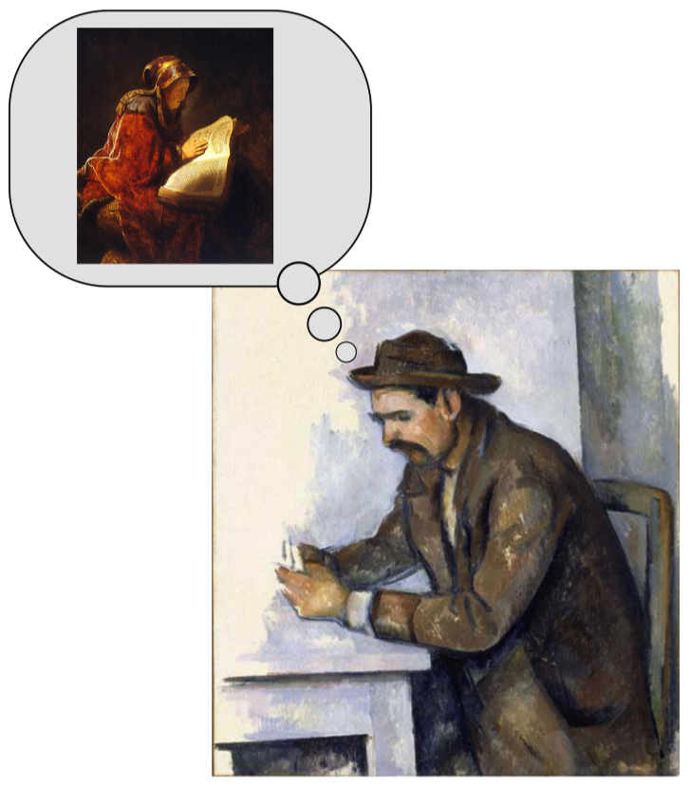
The Superstitious Gambler Algorithm
Gambler pretends he’ll select a set $A$, then die and go to heaven, where he becomes a prophet.
In heaven an independent $n$-tuple of weights are sampled.
Gambler can observe these weights and choose any set $R$ such that $A∪R∈I.$
But rewards are discounted by $\frac{1}{2}$ in heaven!

Slide 16
The Superstitious Gambler Algorithm
When inspecting element $x$ consider:
Adding $x$ to $A$ and then dying.
Dying now without picking $x$.
Select $x$ if and only if the first alternative is better than the second.

Slide 17
Intuition for Analysis
If gambler goes straight to heaven on day 1, he gets $\frac{1}{2}⋅OPT.$
Instead:
He picks elements on earth that preclude heavenly rewards. Let $C$=“cost set”={precluded elements}.
He abstains from picking elements in anticipation of heavenly rewards, but then dies and there is no afterlife. Let $R$=“remainder set”={hallucinated rewards}.

Slide 18
Intuition for Analysis
If gambler goes straight to heaven on day 1, he gets $\frac{1}{2}⋅OPT.$
Instead:
He picks elements on earth that preclude heavenly rewards. Let $C$=“cost set”={precluded elements}.
He only picks an element on earth when its value exceeds the expected cost.

Slide 19
Intuition for Analysis
If gambler goes straight to heaven on day 1, he gets $\frac{1}{2}⋅OPT.$
Instead:
He abstains from picking elements in anticipation of heavenly rewards, but then dies and there is no afterlife. Let $R$=“remainder set”={hallucinated rewards}.
Threshold for selecting each $x$ is low enough that the expected excess above threshold accounts for half its value. This excess is as likely to show up on earth as in heaven.

Slide 20
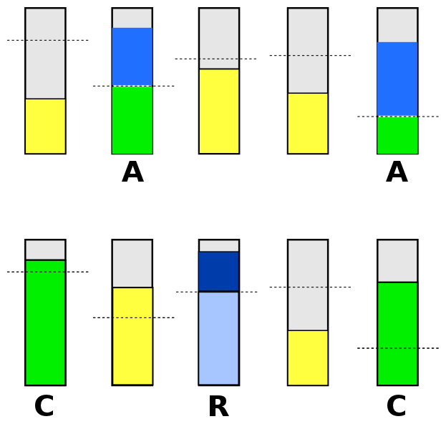
Proof Sketch in One Slide
$$E\left[G^{′}s green\right]≥\frac{1}{2}⋅E[P^{′}s green]$$
…by definition of G’s thresholds.
$$E\left[G^{′}s blue\right]≥E[P^{′}s dark blue]$$
…by coupling argument.
$$E\left[P^{′}s dark blue\right]≥\frac{1}{2}⋅E[P^{′}s blue]$$
…by combinatorial argument using matroid axioms.

Slide 21
Selected Open Problems
Free order prophet inequality: is $1−\frac{1}{e}$optimal?
Combinatorial prophet inequality: can gambler always obtain at least ${OPT}/{O(\log{n)}}$? Rubinstein [2016] proved $OPT/O(\log^{2}{n)}$.
Poly-time approximability of gambler’s optimal policy?

Slide 22
Part III: Pandora’s Problem (Joint work with Bo Waggoner and E. Glen Weyl.)

Slide 23
Problem Formulation
$U=$ set of sealed boxes.
$c_{i}$ = cost to open box $i$.
$v_{i}$ = random prize in box $i$. (indep., known distribution)
Once opened, the prize in a box can be claimed now or any time in the future. Only claim one prize.
Goal: Maximize expected prize minus cost.
Notes:
Example applications: interviewing job candidates, acquiring start-ups.

Slide 24
Weitzman’s Example
Cost = 15
Prize = $\left\{\begin{matrix}100 & w. prob. 1/2 \\ 55 & w. prob. 1/2\end{matrix}\right\}$
Cost = 20
Prize = $\left\{\begin{matrix}240 & w. prob. 1/5 \\ 0 & w. prob. 4/5\end{matrix}\right\}$
Red is better in expectation, better in worst case, lower variance, and less costly to open.
Nevertheless, optimal policy opens blue first!

Slide 25
Optimal Policy: “Pandora’s Rule”
For each box $i$ let $σ_{i}$ be the (unique, if $c_{i}>0$) solution to
$$E\left[{\left(v_{i}−σ_{i}\right)}^{+}\right]=c_{i}$$
where ${\left(⋅\right)}^{+}$ denotes $\max\left\{⋅,0\right\}.$
Optimal policy: open boxes in decreasing order of $σ_{i}$ until largest revealed prize exceeds largest remaining $σ_{i}.$
Cost = 15
Prize = $\left\{\begin{matrix}100 & w. prob. 1/2 \\ 55 & w. prob. 1/2\end{matrix}\right\}$
$σ_{red}=70$
Cost = 20
Prize = $\left\{\begin{matrix}240 & w. prob. 1/5 \\ 0 & w. prob. 1/2\end{matrix}\right\}$
$σ_{blue}=140$

Slide 26
Analysis of Optimal Policy
Suppose you could buy insurance on any box that
covers the cost if you open the box
collects any excess prize above $σ_{i}$ if you claim the prize inside the box.
Insurance has zero net value for non-exposed policies (those that claim the prize in box$i$whenever $v_{i}>σ_{i}$), positive net value otherwise.

Slide 27
Amortization Lemma
Definition: covered call value of box $i$ is $κ_{i}=\min\left\{v_{i},σ_{i}\right\}.$
Let $I_{i}, A_{i}$ be the indicator random variables of the events {open box $i$} and {claim prize $i$}.
Lemma: For any policy and any box $i$,
$$E\left[A_{i}v_{i}−I_{i}c_{i}\right]≤E\left[A_{i}κ_{i}\right]$$
with equality if and only if the policy is non-exposed.
LHS=value without insurance, RHS=value with insurance.

Slide 28
Analysis of Pandora’s Rule
Pandora’s Rule
always gets the maximum $κ_{i}$
is non-exposed
$$E\left[Pandora\right]=E[\max_{i}{ κ}_{i}]$$
For any other policy,
$$E\left[net value\right]≤E\left[\max_{i}{κ_{i}}\right]$$
3
15
14
11
9
6
2

Slide 29
Combinatorial Pandora’s Problem
Given $U=\left\{boxes\right\}, I⊆2^{U}=\left\{feasible subsets\right\},$ open some boxes and claim any feasible subset of prizes.
Generalized Pandora’s Rule: Place boxes in a queue initially sorted by decreasing $σ_{i}$. Repeatedly take box from head of queue.
If precluded due to previous selections, remove it.
If closed, open and reinsert into queue with priority $v_{i}$.
If open, claim its prize.

Slide 30
Combinatorial Pandora’s Problem
Generalized Pandora’s Rule (GPR) simulates the greedy algorithm for selecting $S∈I$ to maximize $\sum_{i∈S}{κ_{i}}$.
If that algorithm $α$-approximates the max-weight set, then GPR $α$-approximates the optimal policy.
Examples:
GPR is precisely optimal for matroids.
GPR is 2-approximate for weighted bipartite matching.

Slide 31
Adversarial Inspection Order
Rather than letting the algorithm choose the sequence of boxes, suppose it is set by an adversary.
Algorithm: Calculate $T=\frac{1}{2}⋅E\left[\max_{i} κ_{i}\right].$ If $σ_{i}<T$ leave box $i$ closed. Else, open it and claim its prize iff $v_{i}≥T.$
Theorem: This 2-approximates the optimal policy.
Proof: Amortization lemma + prophet inequality.

Slide 32
Descending Price Coordinates Search
Suppose $n$ firms are competing to hire $m$ people.
Each wants to hire only one.
$c_{ij}$ = cost to interview; $v_{ij}$ = value if hired. (indep.)
Descending Price Procedure: Price $p$ decreases continuously from $∞.$ At any time, any firm can pay $p$ to hire a candidate of their choice.
Theorem: In any equilibrium, expected value of matches made is at least $\frac{1}{2}\left(1−e^{−2}\right)≈0.43$ of optimal.
Notes:
I haven’t left myself time to say anything substantial about the proof.

Slide 33
Open Questions
How well can poly-time efficient policies approximate the optimal policy for…
weighted bipartite matching
budgeted exploration
optional inspection
Are these problems even computationally hard?

