Slide 1
Combinatorial Stochastic Search and Selection (Part 1) Bobby Kleinberg São Paulo School of Advanced Science on ACO July 2016

Slide 2
The Essence of Stochastic Search
There are n sealed boxes.
Each has a prize inside.
You open boxes sequentially.
You may claim one prize from an open box.
Maximize expected value of prize.

Slide 3
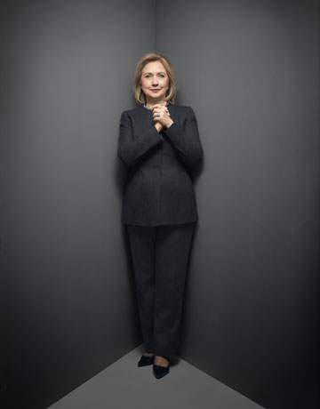
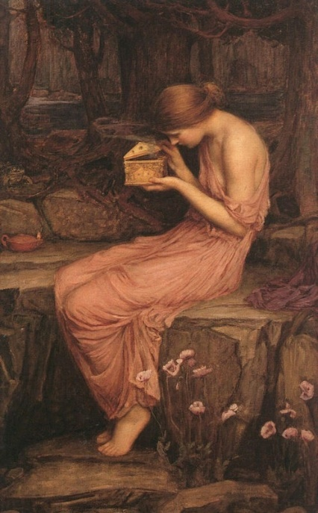
Secretary Problem
M. Flood, 1949
Prophet Inequality
Krengel & Sucheston, 1978
Pandora’s
Box
Weitzman, 1979

Slide 4
Secretary Problem
random order
Prophet Inequality
independent random values
Pandora’s
Box
inspection costs

Slide 5
Application: Labor Markets
A firm wants to hire one of n job candidates.
Secretary: interviews occur in random order, immediate hiring decision after each.
Prophet: interviews occur in pre-specified order, immediate hiring decision after each.
Pandora’s Box: firm determines interview order, pays for interview, defers decisions until end.

Slide 6
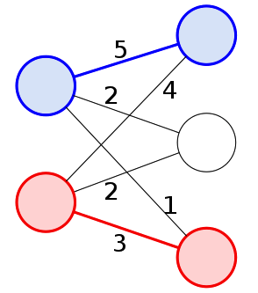
Variations on the Theme
Combinatorial versions: Pick more than one element, subject to feasibility constraint.
Order of inspection: Worst case? Random? Chosen by the algorithm itself?
Strategic versions: e.g. firms competing to hire.
Non-linear objectives: elements can be substitutes, complements.
Notes:
These variations are motivated by the hiring application. But each of them (with the possible exception of the game-theoretic one) also seems mathematically well motivated on its own.

Slide 7
Part I: Secretary Problems

Slide 8
The Secretary Problem
Observe elements of a totally ordered set $X$ in (uniformly) random order $x_{1},…,x_{n}.$
Stopping rule $τ$ knows $n=\left|X\right|,$decides whether to stop at $x_{k}$based on relative order of $x_{1},…,x_{k}.$
Maximize probability of stopping on maximum element.
Theorem (Lindley ‘61, Dynkin ‘63): There exists a stopping rule with Pr(success) greater than $\frac{1}{e}≈0.367.$

Slide 9
Solution by Dynamic Programming
Analyze Markov chain with states $\{s_{1},…,s_{n}\}$where $s_{k}$ represents currently observing $x_{k}=max \{x_{1},…,x_{k}\}.$
$$Pr\left(s_{i}→s_{j}\right)=\frac{i}{j\left(j−1\right)}.$$
Let $v(k)$ denote Pr(success) if one applies optimal policy starting from $s_{k}.$
Calculate $v(k)$ in order from $k=n$ to $k=1.$

Slide 10
Solution by Dynamic Programming
$$v\left(n\right)=1, v\left(k\right)=\max_{}\left\{\frac{k}{n} ,\sum_{ℓ=k+1}^{n}{\frac{k}{ℓ(ℓ−1)}⋅v(ℓ)}\right\}$$
Lemma: Let $t$ be such that $1−\frac{1}{t}<\frac{1}{t+1}+⋯+\frac{1}{n−1}≤1.$ If $k>t$, then $v\left(k\right)=\frac{k}{n}$and it is optimal to stop in state $s_{k}$. Else, it is optimal to continue.
After time $t$ pick an element if it beats all predecessors.
$$s_{1}$$
$$s_{i}$$
$$\frac{i}{j\left(j−1\right)}$$
$$s_{j}$$
$$s_{n}$$
Notes:
Probability of opt policy stopping in state k is t/[k(k-1)]. Probability of winning

Slide 11
Solution by Dynamic Programming
Lemma: The value of the optimal policy is $\frac{t}{n}\left(\frac{1}{t}+⋯+\frac{1}{n−1}\right).$
Proof: Pr(stop in state $s_{k}$) = $\frac{1}{k}⋅\frac{t}{k−1}$for $k>t$. Conditional on stopping in state $s_{k}$, probability of winning is $\frac{k}{n}.$ Now sum over $k$.
Observation: $t$ is defined by $\frac{1}{t}+⋯+\frac{1}{n−1}≈1,$hence $\ln{n−\ln{t≈1. }}$ This means $t≈\frac{n}{e},$so $\frac{t}{n}\left(\frac{1}{t}+⋯+\frac{1}{n−1}\right)≈\frac{1}{e}.$

Slide 12
Secretary Problem for Matchings
Bipartite $G=\left(U∪V, E\right).$Edge weights $w(i,j).$
Vertices $i∈U$arrive in random order, reveal weights of incident edges.
Algorithm must decide which edge $\left(i,j\right)$ to choose, if any, upon arrival of $i.$
$M=\{chosen edges\}$must form a matching. Maximize its expected total weight.
5
2
4
1
2
3

Slide 13
Secretary Algorithm for Matchings
Algorithm (Kesselheim, Radke, Tönnis, & Vöcking, 2013)
Let $U^{k}=\{u_{1},…,u_{k}\}$ = first $k$ vertices to arrive.
Let $M^{k }=$ max-weight matching on $U^{k}∪V.$
If $M^{k}$ contains $e^{k}=\left(u^{k},v\right)$ and $v$ is free and $k>⌊\frac{n}{e}⌋$, pick $e^{k}.$
Theorem: Expected total weight of selected edges is at least $\frac{1}{e}⋅$OPT.

Slide 14
Analysis of the Algorithm
If $M^{k}$ contains $e^{k}=\left(u^{k},v\right)$ and $v$ is free and $k>⌊\frac{n}{e}⌋$, pick $e^{k}.$
Theorem: Expected total weight of selected edges is at least $\frac{1}{e}⋅OPT.$
Lemma 1: $E\left[w\left(e^{k}\right)\right]≥\frac{1}{n}⋅OPT.$
Proof:$E\left[w\left(e^{k}\right)\right]=\frac{1}{k}⋅E\left[w\left(M^{k}\right)\right]≥\frac{1}{k}⋅\frac{k}{n}⋅OPT.$

Slide 15
Analysis of the Algorithm
If $M^{k}$ contains $e^{k}=\left(u^{k},v\right)$ and $v$ is free and $k>⌊\frac{n}{e}⌋$, pick $e^{k}.$
Lemma 2: $\operatorname{Pr}\left(e^{k} chosen\right)≥\frac{t}{k−1},$where $t=\left\lfloor \frac{n}{e}\right\rfloor .$
Proof: For each time step $ℓ∈\left(t,k\right),$edge $\left(u^{ℓ},v\right)$is chosen with probability at most $1/ℓ.$ Hence
$$Pr\left(v free at time k\right)≥\prod_{ℓ=t+1}^{k−1}{\left(1−\frac{1}{ℓ}\right)}=\frac{t}{k−1}.$$

Slide 16
Analysis of the Algorithm
Lemma 1: $E\left[w\left(e^{k}\right)\right]≥\frac{1}{n}⋅OPT.$
Lemma 2: $\operatorname{Pr}\left(e^{k} chosen\right)≥\frac{t}{k−1},$where $t=\left\lfloor \frac{n}{e}\right\rfloor .$
Combining the two lemmas,
$$E\left[w\left(chosen edges\right)\right]≥\frac{t}{n}⋅OPT⋅\sum_{k=t+1}^{n}{\frac{1}{k−1}}>\frac{OPT}{e}.$$

Slide 17
Combinatorial Secretary Problems
In a combinatorial secretary problem one has:
a finite set $U$ with a collection of feasible subsets, $I⊆2^{U}$
weights $w:U→\left[0,∞\right),$initially unknown
Elements arrive in random order, reveal their weights.
Algorithm chooses elements, at their arrival time, subject to the constraint that $\{chosen elements\}∈I.$
Goal: maximize expected total weight of chosen elements.
Notes:
Remark: the matching problem we just saw is not a true example of a combinatorial secretary problem. If it were, edges would arrive in random order, rather than vertices arriving with all their edges at once. The most prominent open problem about combinatorial secretary problems is the “matroid secretary problem”. To tell you about it, I need to introduce matroids. I’ll take some time to present the basic definitions and an important property about optimization and matroids.

Slide 18
Matroids
Definition: A matroid consists of a ground set $U$and collection of independent sets $I⊆2^{U}$ satisfying
$∅∈I$
$S⊆T, T∈I ⇒ S∈I$
$\left|S\right|<\left|T\right|, S,T∈I⇒ ∃t∈T∖S, S∪\{t\}∈I$ (exchange axiom)
Key examples:
$U = \left\{vectors\right\}, I = \{linearly independent sets\}.$
$U=\{edges of an undirected graph\}, I=\left\{forests\right\}.$

Slide 19
Matroid Terminology
Basis of a matroid: a maximal independent set.
Exercise: All bases have the same cardinality.
Circuit in a matroid: a minimal dependent set.
Rank of a subset $S$: size of maximal indep. subset of $S$.
Span of $S$: unique maximal $T⊇S$ s.t. rank($T$)=rank($S$).
Exercise: Justify uniqueness by showing that if $T,T′⊇S$ with rank($T$)=rank($T’$)=rank($S$) then rank($T∪T′$)=rank($S).$
Notes:
Go through examples of what these mean in vector spaces and graphs.

Slide 20
Matroids and Greedy Algorithms
Lemma: For a matroid $\left(U,I\right)$ and weights $w:U→\left[0,∞\right),$let $U_{θ}$ denote $\{x∈U | w\left(x\right)>θ\}.$ For any $S∈I$the following are equivalent.
S is a maximum weight basis.
For all $θ$, rank($S∩U_{θ}$) = rank($U_{θ}$).
$S$is a basis, and no $y∈S$lies in the span of $U_{w(y)}.$

Slide 21
Matroids and Greedy Algorithms
The following are equivalent.
S is a maximum weight basis.
For all $t$, rank($S∩U_{t}$) = rank($U_{t}$).
$S$is a basis, and no $y∈S$lies in the span of $U_{w(y)}.$
Corollary 1: To choose a max-weight basis of $\left(U,I\right),$s$ort U$ by decreasing weight, take any element not spanned by predecessors.
Corollary 2: Order elements of $U$ arbitrarily as $u_{1},…,u_{n}.$ Let $B_{k}$be the max-weight basis of first $k$ elements. Then $B_{k+1}⊆B_{k}∪\{u_{k+1}\}.$
Notes:
Corollary 2 implies that another sort of greedy algorithm picks a max-weight basis. Namely, an online algorithm that goes through the elements in arbitrary order, tries adding each new element to its current basis, and if the resulting set contains a circuit, throws out the min-weight element of that circuit. Note that if we modified the combinatorial secretary problem to allow rejecting a previously selected element, this would imply a greedy rule for picking a maximum-weight basis.

Slide 22
Matroid Secretary Problems
A matroid secretary problem is a combinatorial secretary problem in which $\left(U,I\right)$ is a matroid.
Weak Matroid Secretary Conjecture: every matroid secretary problem has an algorithm that guarantees at least $C⋅OPT,$where $C>0$ is a universal constant.
Strong Matroid Secretary Conjecture: In the previous conjecture, $C=\frac{1}{e} .$

Slide 23
Status of the Conjectures
Strong form for uniform and transversal matroids. [Babaioff-Immorlica-Kempe-K. ‘07, Kesselheim et al. ‘13]
Weak form for graphic, cographic, laminar, and regular matroids (those representable over every field). [Babaioff-Immorlica-K. ‘07, Soto ‘11, Im & Wang ‘11, Dinitz & Kortsarz ‘13]
For general rank-r matroids, $\frac{OPT}{O(log{\log{r)}}}$ is strongest known bound. [Lachish ‘14, Feldman-Svensson-Zenklusen ‘15]
Notes:
Even for matroids representable over the reals, or F_2, nothing better than log(log(rank)) is known.

Slide 24
Why the Greedy Algorithm Fails
After step t=$\left\lfloor \frac{n}{e}\right\rfloor ,$select any new element that
belongs to the current max-weight basis;
is not in the span of previous selections.
2
2
2
2
2
2
n²
1
1
1
1
1
1

Slide 25
Lower Bound for General Set Systems
Suppose $n=k^{k+1}$.
$U=$vertices of an $n$-cycle
$I=$ sets of diameter $≤k$
Weights $w\left(x\right)=\left\{\begin{matrix}1 with prob \frac{1}{k} \\ 0 otherwise\end{matrix}\right\}$
Not a matroid!
Notes:
This feasibility constraint is the furthest thing imaginable from a matroid.
The point of this slide is to show what it looks like to prove an information theoretic lower bound for this sort of average-case online problem. And to give a shout-out to Aviad’s paper.

Slide 26
Lower Bound for General Set Systems
Weights $w\left(x\right)=\left\{\begin{matrix}1 with prob \frac{1}{k} \\ 0 otherwise\end{matrix}\right\}$
$$E\left[OPT\right]≥\frac{k}{e}$$
$$E\left[ALG\right]≤3$$
This example: $\frac{E[OPT]}{E[ALG]}=Ω\left(\frac{\log{n}}{\log{\log{n}}}\right)$
Partition $U$ into $k^{k}$ sets of diameter $k.$
Each has weight $k$ with probability $k^{−k}.$
When ALG selects its first element,
expected weight of all compatible
elements is $≤2.$
Rubinstein [2016]: $\frac{E\left[OPT\right]}{E\left[ALG\right]}=O\left(\log{n⋅log r}\right)$
Notes:
This feasibility constraint is the furthest thing imaginable from a matroid.
The point of this slide is to show what it looks like to prove an information theoretic lower bound for this sort of average-case online problem. And to give a shout-out to Aviad’s paper.

Slide 27
Matroid Secretary: “Free Order” Model
Allow the algorithm to choose the order of inspection.
Algorithm (Jaillet, Soto, & Zenklusen 2013)
Let $S=$ $\{$random $⌊\frac{n}{2}⌋$ elements$\}$. Select none of these.
For $x∈U∖S,$let $θ\left(x\right)=min\{θ \left| x∈Span\left(S∩U_{θ}\right)\right\}.$
Inspect $U∖S$in decreasing order of $θ\left(x\right).$
Pick any $x∈U∖S$ such that $w\left(x\right)≥θ\left(x\right)$ unless it is spanned by previously selected elements.
Notes:
Remember to state the open question: can one get 1/e in the free order model?

Slide 28
Matroid Secretary: “Free Order” Model
Analysis: Consider any $x∈OPT.$Let
$T=U∖\left(S∪\{x\}\right)$
$θ^{′}\left(x\right)=min\{θ\left|x∈Span\left(T∩U_{θ}\right)\right\}.$
$\operatorname{Pr}\left(x∉S\right)=\frac{1}{2}$
$Pr⁡\left(θ(x)>θ^{′}\left(x\right)|x∉S\right)$ $=\frac{1}{2}$
If both events happen, $x$ gets selected.
Theorem: $E\left[ALG\right]≥\frac{1}{4}⋅OPT.$
S
$$θ\left(x\right)$$
$$x$$
$$θ′\left(x\right)$$
T
Notes:
Remember to state the open question: can one get 1/e in the free order model?

Slide 29
Preview of Next Lecture
Matroid Prophet Inequality
Similar to matroid secretary problem, with a happier ending!
Pandora’s Box
Standard Economics model of optimal search. Combinatorial version introduced just this year.

