Slide 1
Large-scale semantic web reasoning
Grigoris Antoniou and Ilias Tachmazidis
University of Huddersfield

Slide 2
Presentation Overview
Motivation
RDFS Reasoning
Reasoning with Imperfect Data and Knowledge
Ontology Repair
Future Work

Slide 3
The Big Data Wave
Data being generated at an increasing scale and pace:
Sensor networks
Social media
Organisational data bases
The big data challenge:
Use this data in meaningful ways
Uncover hidden knowledge
Create added value

Slide 4
Are “We” Relevant to Big Data?
Commonly associated with data mining / machine learning:
Uncover hidden patterns, thus new insights
Mostly statistical approaches
I claim semantics and reasoning are also relevant:
Semantic interoperability
Decision making
Data cleaning
Inferring high-level knowledge from low-level data

Slide 5
Semantic Interoperability
Why? To create added value through combination of different, independently maintained data sources
Example: Healthcare
Combine healthcare, social and economic data to better predict problems and to derive interventions
Example: Pollution reduction through traffic control
Combine environmental (e.g. air pollution, weather), traffic and other data (e.g. built environment, socioeconomic data, events)
Combine historic and actual data
Use the above to derive traffic interventions to improve air quality

Slide 6
Semantic Interoperability (2)
Semantics is the key to combining different data sources!
Use ontologies to let various data sources “speak the same language”
The open data movement
Increasingly adopted, particularly from the public sector: Publish your data and let others create added value
Semantics (Linked Open Data) is the gold standard for publishing open data ready to be reused

Slide 7
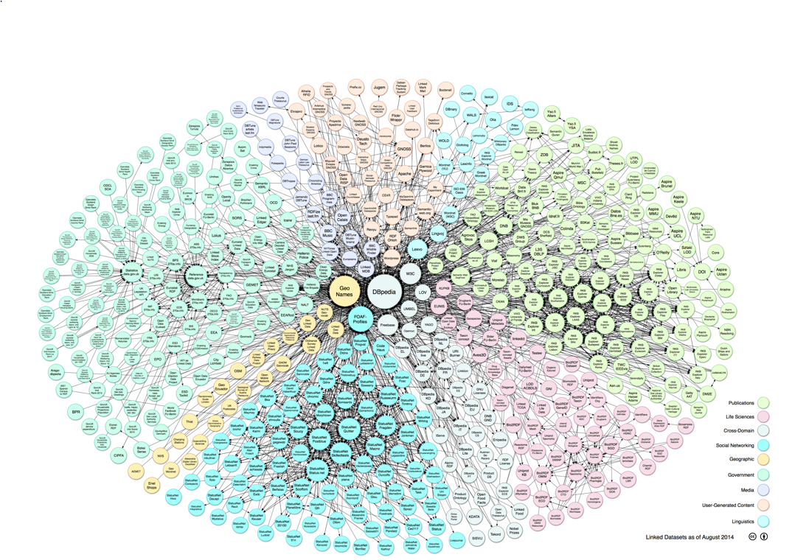
The LOD Cloud

Slide 8
So LOD is Part of Big Data!
  Remember: big data is not only about size, but also about:
  Complexity
  Dynamicity

Slide 9
Decision Making through Reasoning
Make sense of the huge amounts of data:
Turn it into actions
Be able to explain decisions – transparency and increased confidence
Be able to deal with imperfect, missing or conflicting data
All in the remit of KR!
Example: Ambient assisted living
Alert of a possible dangerous situation for an elderly person when certain conditions are met

Slide 10
OK, we are relevant… but can we have impact?
A number of key societal challenges are awaiting our input:
Smart cities
Intelligent environments, ambient assisted living
Intelligent healthcare (including remote monitoring)
Disaster detection and management

Slide 11
OK, we are relevant and can have impact… but can we deliver?
The problem:
Traditional approaches work in centralized memory
But we cannot load big data (or the Web) on a centralized memory, nor are we expected to do so in the future
To the rescue: New computational paradigms
Developed in the past decade as part of high-performance computing, cloud computing etc.
Developed independently of SW and KR, but we can use them

Slide 12
What Follows
Basic RDFS reasoning on Map Reduce
Computationally simple nonmonotonic reasoning on Map Reduce
Computationally complex ontology repair approach using Signal/Collect

Slide 13
Presentation Overview
Motivation
RDFS Reasoning
Reasoning with Imperfect Data and Knowledge
Ontology Repair
Future Work

Slide 14
Problems and Challenges
One machine is not enough to store and process the Web
We must distribute data and computation
What architecture?
  Several architectures of supercomputers
    SIMD (single instruction/multiple data) processors, like graphic cards
    Multiprocessing computers (many CPU shared memory)
    Clusters (shared nothing architecture)
  Algorithms depend on the architecture
Clusters are becoming the reference architecture for High Performance Computing

Slide 15
Problems and Challenges
In a distributed environment the increase of performance comes at the price of new problems that we must face:
  Load balancing
  High I/O cost
  Programming complexity

Slide 16

Problems and Challenges: Load Balancing
Cause: In many cases (like reasoning) some data is needed much more than other (e.g. schema triples)
Effect: Some nodes must work more to serve the others. This hurts scalability

Slide 17
Problems and Challenges: Load Balancing
Cause: In many cases (like reasoning) data distribution is highly skewed (e.g few RDF resources are present in most triples, while the majority of RDF resources are found in only few triples)
Effect: Some nodes must work more while others remain idle. This hurts scalability

Slide 18

Problems and Challenges: High I/O Cost
Cause: data is distributed on several nodes and during reasoning the peers need to heavily exchange it
Effect: hard drive or network speed become the performance bottleneck

Slide 19
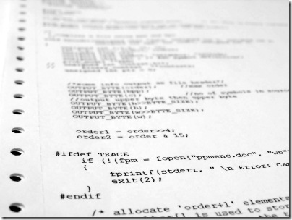
Problems and Challenges: Programming Complexity
Cause: in a parallel setting there are many technical issues to handle
  Fault tolerance
  Data communication
  Execution control
  Etc.
Effect: Programmers need to
write much more code in order
to execute an application on a
distributed architecture

Slide 20
MapReduce
Analytical tasks over very large data (logs, web) are always the same
  Iterate over large number of records
  Extract something interesting from each
  Shuffle and sort intermediate results
  Aggregate intermediate results
  Generate final output
Idea: provide functional abstraction of these two functions
map
reduce

Slide 21
MapReduce
In 2004 Google introduced the idea of MapReduce
  Computation is expressed only with Maps and Reduce
  Hadoop is a very popular open source MapReduce implementation
A MapReduce framework provides
  Automatic parallelization and distribution
  Fault tolerance
  I/O scheduling
  Monitoring and status updates
Users write MapReduce programs -> framework executes them
http://hadoop.apache.org/

Slide 22

MapReduce
A MapReduce program is a sequence of one (or more) map and a reduce function
All the information is expressed as a set of key/value pairs
The execution of a MapReduce program is the follow:
  map function transforms input records in intermediate key/value pairs
  MapReduce framework automatically groups the pairs
  reduce function processes each group and returns output
map(null, file) {
for (word in file) output(word, 1)
}
reduce(word, set<numbers>) {
int count = 0;
for (int value : numbers)
count += value;
output(word, count)
}
Example: suppose we want to calculate the occurrences of words in a set of documents.

Slide 23
MapReduce
“How can MapReduce help us solving the three problems of above?”
High communication cost
  The map functions are executed on local data. This reduces the volume of data that nodes need to exchange
Programming complexity
  In MapReduce the user needs to write only the map and reduce functions. The framework takes care of everything else.
Load balancing
  This problem is still not solved. ☹ Further research is necessary…

Slide 24
WebPIE
WebPIE is a forward reasoner that uses MapReduce to execute the reasoning rules
All code, documentation, tutorial etc. is available online.
WebPIE algorithm:
  Input: triples in N-Triples format
  1) Compress the data with dictionary encoding
  2) Launch reasoning
  3) Decompress derived triples
  Output: triples in N-Triples format
http://cs.vu.nl/webpie/
1st step: compression
2nd step: reasoning

Slide 25
WebPIE 2nd Step: Reasoning
Reasoning means applying a set of rules on the entire input until no new derivation is possible
The difficulty of reasoning depends on the logic considered
RDFS reasoning
  Set of 13 rules
  All rules require at most one join between a “schema” triple and an “instance” triple
OWL reasoning
  Logic more complex => rules more difficult
  The ter Horst fragment provides a set of 23 new rules
  Some rules require a join between instance triples
  Some rules require multiple joins

Slide 26
WebPIE 2nd Step: Reasoning
Reasoning means applying a set of rules on the entire input until no new derivation is possible
The difficulty of reasoning depends on the logic considered
RDFS reasoning
  Set of 13 rules
  All rules require at most one join between a “schema” triple and an “instance” triple
OWL reasoning
  Logic more complex => rules more difficult
  The ter Horst fragment provides a set of 23 new rules
  Some rules require a join between instance triples
  Some rules require multiple joins

Slide 27

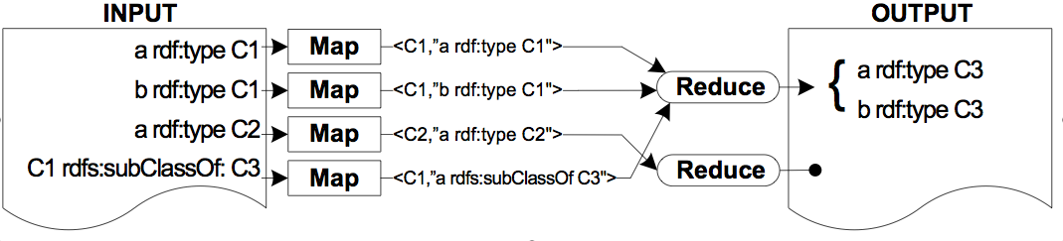
WebPIE 2nd Step: RDFS Reasoning
Q: How can we apply a reasoning rule with MapReduce?
A: During the map we write in the intermediate key matching point of the rule and in the reduce we derive the new triples
Example:
if a rdf:type B
and B rdfs:subClassOf C
then a rdf:type C

Slide 28
WebPIE 2nd Step: RDFS Reasoning
However, such straightforward way does not work because of several reasons
  Load balancing
  Duplicates derivation
  Etc.
In WebPIE we applied three main optimizations to apply the RDFS rules
  We apply the rules in a specific order to avoid loops
  We execute the joins replicating and loading the schema triples in memory
  We perform the joins in the reduce function and use the map function to generate less duplicates

Slide 29
WebPIE: Performance
We tested the performance on LUBM, LDSR, Uniprot
Tests were conducted at the DAS-3 cluster (http://www.cs.vu.nl/das)
Performance depends not only on input size but also the complexity of the input
Execution time using 32 nodes:
Dataset
Input
Output
Exec. time
LUBM
1 Billion
0.5 Billion
1 Hour
LDSR
0.9 Billion
0.9 Billion
3.5 Hours
Uniprot
1.5 Billion
2 Billions
6 Hours

Slide 30
WebPIE: Performance
Scalability (on the input size, using LUBM to 100 Billion triples)

Slide 31
WebPIE: Performance
Scalability (on the number of nodes, up to 64 nodes)

Slide 32
Presentation Overview
Motivation
RDFS Reasoning
Reasoning with Imperfect Data and Knowledge
Ontology Repair
Future Work

Slide 33
Approach
Well-Founded Semantics
Can handle the absence of information (incomplete information)
A standard logic programming semantics
Polynomial computational complexity
Other approaches that have been studied in terms of large-scale reasoning:
Defeasible reasoning (KR 2012, ECAI 2012)
Systems of argumentation (AAAI 2015)

Slide 34
Well-Founded Semantics
Each program has one well-founded model
Three-valued Herbrand model
Herbrand base
Non-false atoms
true
undefined
false
True atoms

Slide 35
Well-Founded Semantics
Alternating Fixpoint Procedure is suitable for MapReduce
Computing and storing true and undefined literals is feasible for Big Data

Slide 36
Well-Founded Semantics
Monotonicity formally
K_{i} ⊆ K_{i+1}, U_{i} ⊇ U_{i+1}, K_{i} ⊆ U_{i}
Monotonicity visually
K_{i}
K_{i+1}
U_{i+1}
U_{i}
K_{i}
U_{i}

Slide 37
Well-Founded Semantics
Inference procedure visually
K₀
U₀
K₁
U₁
K₂
U₂
K₃
U₃
(K₂,U₂)=(K₃,U₃) Fixpoint!

Slide 38
Well-Founded Semantics
WFS fixpoint reached at step i:
  true literals, denoted by K_{i}
  undefined literals, denoted by U_{i} - K_{i}
  false literals, BASE(P) - U_{i}

Slide 39
T_{P,J}(I) Calculation
T_{P,J} (I) models both “join” and “anti-join” operations from database
Example:
I ={parent(John, Alice), parent(John, Jill), sibling(Alice, Edward), sibling(Jill, Mary)}
J = {female(Mary)}
and a program P:
son(X,Y) ← parent(Y,Z), sibling(Z,X), not female(X)
Join
parentOfSiblings(Y,X,Z)

Slide 40
T_{P,J}(I) Calculation
“Join”
MAP phase Input
Key: position in file (ignored)
Value: literal
Set I
parent(John, Alice)
key
value
parent(John, Jill)
< , >
sibling(Alice, Edward)
key
value
< , >
sibling(Jill, Mary)
key
value
< , >
Set J
key
value
< , >
female(Mary)

Slide 41
T_{P,J}(I) calculation
“Join”
MAP phase Input
Key: position in file (ignored)
Value: fact
MAP phase Output
<key, >
< , ( , ) >
parent
(
John
,
Alice
)
<key, >
< , ( , ) >
parent
(
John
,
Jill
)
<key, >
< , ( , )>
sibling
(
Alice
,
Edward
)
<key, >
sibling
(
Jill
,
Mary
)
< , ( , )>

Slide 42
T_{P,J}(I) calculation
“Join”
MAP phase Output
Reduce phase Input
< , >
Alice
(parent, John)
< , < ,
>>
< , >
Jill
(parent, John)
Grouping/Sorting
< , >
Alice
(sibling, Edward)
< , < ,
>>
< , >
Jill
(sibling, Mary)

Slide 43
T_{P,J}(I) calculation
“Join”
Reduce phase Input
Reduce phase Output Output: new conclusion
( ,
, )
< , <( , ),
( , )>>
parentOfSiblings
Alice
parent
John
sibling
Edward
John
( ,
, )
< , <( , ),
( , )>>
parentOfSiblings
Jill
parent
sibling
Mary

Slide 44
T_{P,J}(I) calculation
Rule:
son(X,Y) ← parent(Y,Z), sibling(Z,X), not female(X)
Join
parentOfSiblings(Y,X,Z)
female(Mary)
parentOfSiblings(John, Edward, Alice)
parentOfSiblings(John, Mary, Jill)
Anti-join
son(Edward, John)

Slide 45
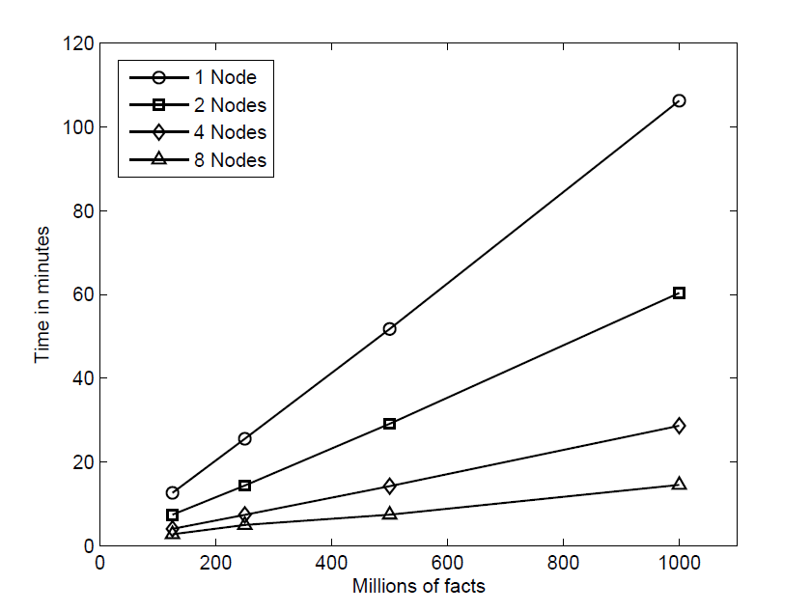
Performance: No Recursion parallelization factor of 8: linear performance

Slide 46
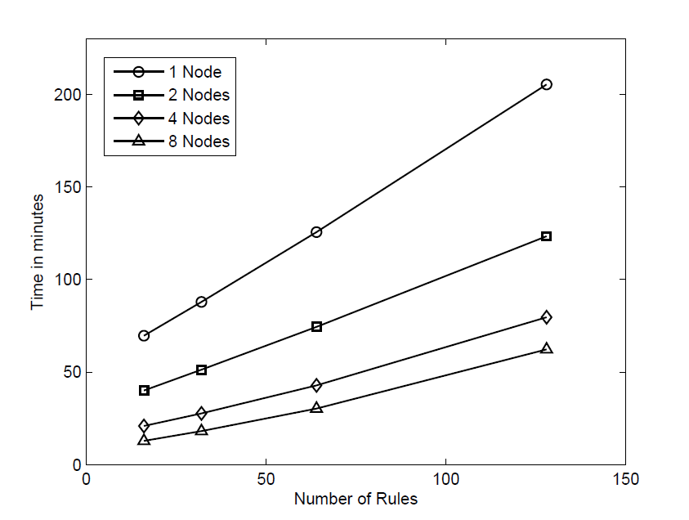
Performance: No Recursion parallelization factor of 8: linear performance up to 64 rules
Notes:
pDF reasoning over 10 rules
RDFS reasoning over 14 rules
OWL-Horst reasoning over 23 rules
RDFS and OWL-Horst reasoning over 27 rules

Slide 47
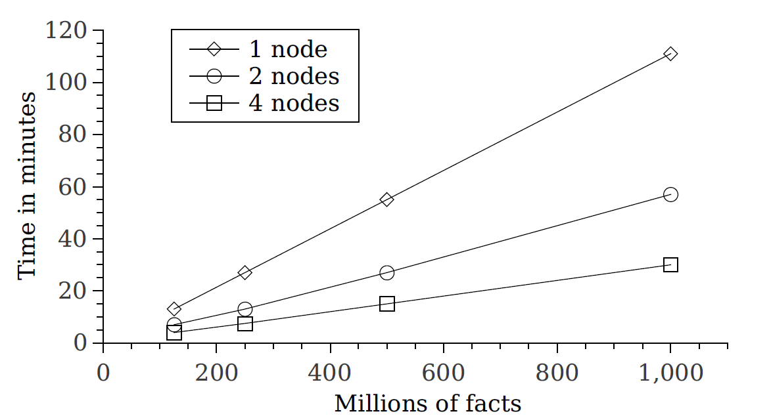
Performance: Full WFS parallelization factor of 4: linear performance (cycle)

Slide 48
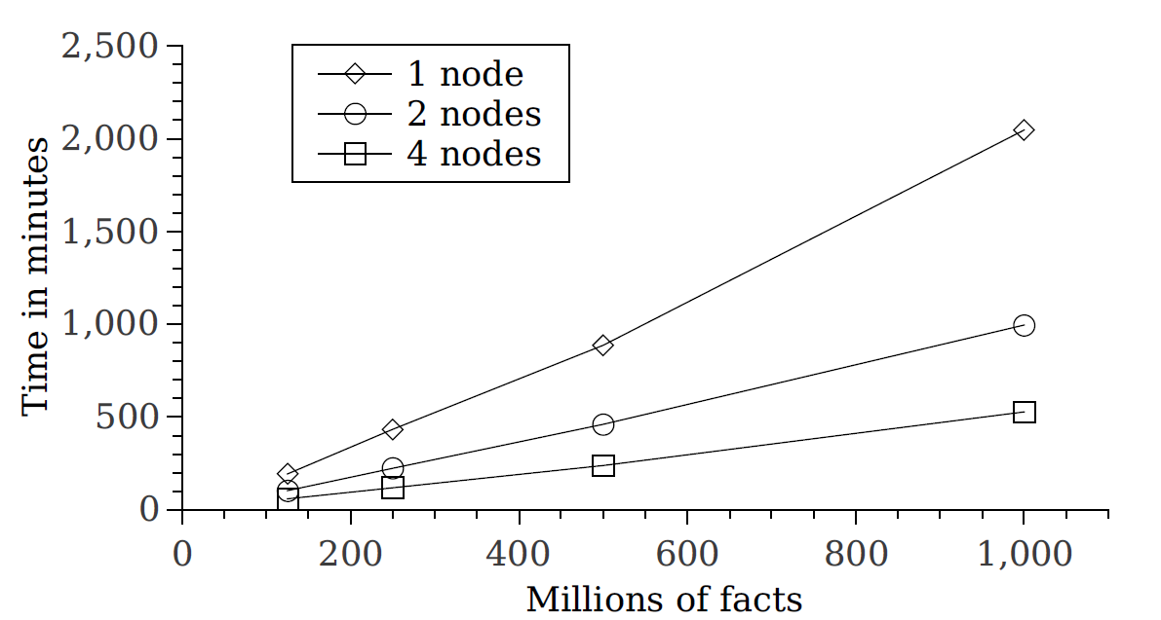
Performance: Full WFS parallelization factor of 4: linear performance (tree)

Slide 49
Presentation Overview
Motivation
RDFS Reasoning
Reasoning with Imperfect Data and Knowledge
Ontology Repair
Future Work

Slide 50
Motivation: LOD Explosion of Uptake
Contains billions of triples and is growing rapidly
Notes:
Cite:
Linked Data - The Story So Far
http://www.w3.org/wiki/SweoIG/TaskForces/CommunityProjects/LinkingOpenData
Programmable Analytics for Linked Open Data
Linked Open Data is a way of publishing structured data that allows metadata to be
connected and enriched, so that different representations of the same content can be
found, and links made between related resources.

Slide 51
But what about Quality?
Quality problems
Obsolete links
Invalidities that occur easily when one combines many data sets (e.g. in terms of disjointness, range, functional properties etc)
Current remedies
Manual curation
  Time consuming, error prone
Automated diagnosis and repair
  Based on integrity constraints
  At present insufficient efficiency (e.g. hours for DBPedia)
Notes:
Cite: http://www.w3.org/wiki/SweoIG/TaskForces/CommunityProjects/LinkingOpenData

Slide 52
Ontology Diagnosis and Repair
Parallel and automatic diagnosis and repairing framework
Diagnosis: detecting invalidities
Repair: automatically resolving detected invalidities
Supporting large-scale through mass parallelization
Over DL-Lite_{A} KBs, which balances
  expressive power of the semantics
  computational complexity

Slide 53
Diagnosis
Integrity constraints expressed as SPARQL queries
SPARQL queries translated into MapReduce algorithm
Form a graph of invalidities

Slide 54
Example: Concept with Domain Disjointness (CwD)
Input: | [A₁ owl:disjointWith A₂] ∈ cln(T) [P₁ rdfs:domain A₂] ∈ T [S rdf:type A₁] ∈ A [S P₁ O] ∈ A
Query: | SELECT ?s ?o WHERE { ?s rdf:type A . ?s P1 ?o . }
Invalidity: | <t1, t2>, where t1 = [S rdf:type A1] t2 = [S P1 O]

Slide 55
Repair
Signal/Collect is a framework for large-scale graph processing
Resolve invalidities in greedy manner
Compute an acceptable approximation of invalid data assertions to be removed

Slide 56
Signal/Collect
Programming model for large-scale graph processing
Models a graph where:
  Vertices, have a state and update their neighbors about state changes
  Edges, transfer messages from source to target vertex
Two core functions:
  Signal(): messages passing over edges
  Collect(): vertices collect incoming signals and update their states

Slide 57
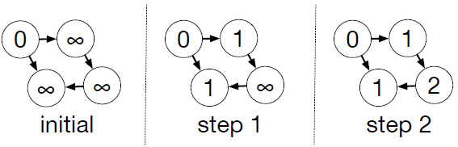
Signal/Collect: Single Source Shortest Path
initialState | if (isSource) 0 else infinity
signal() | return source.state + edge.weight
collect() | return min(oldState, min(signals))

Slide 58
Repair: Greedy Vertex Cover
t2
t6
t6
[2]
[2->{5,3}]
[1]
[1->{2}]
[3]
[3->{5,2,2}]
[2]
[2->{1,1}]
[2->{1,1}]
t3
t1
t1
t5
[1]
[1->{5}]
[0]
[5]
[5->{2,1,1,2,3}]
[5->{2,1,1,2,3}]
[2]
[2->{5,3}]
[1->{2}]
[1]
t4
[0]
[1]
[1->{5}]

Slide 59
Ontology Diagnosis and Repair: Experimental Results
Dbpedia 3.6 containing 700 million triples in 800 files with skewed file sizes
Skewed file sizes affecting severely the performance
9024 invalidities detected

Slide 60
Ontology Diagnosis and Repair: Experimental Results
Results for skewed file sizes
  Total runtime: 45 minutes and 8 seconds (only 42 seconds for reduce phase)
  Runtime of 3 longest map tasks:
    20 minutes and 6 seconds (45% of total runtime)
    6 minutes and 15 seconds
    5 minutes and 9 seconds
  Runtime of 730 (over 90%) map tasks required less than 1 minute

Slide 61
Ontology Diagnosis and Repair: Experimental Results
Results for even file sizes (21 map tasks)
  Total runtime: 13 minutes and 27 seconds, namely x3 time faster (only 42 seconds for reduce phase)
  Runtime map tasks fairly even, between
    11 minutes and 6 seconds, and
    11 minutes and 37 seconds

Slide 62
Ontology Diagnosis and Repair: Experimental Results
Results for even file sizes (210 map tasks on a cluster of capacity for 21 map tasks)
  Runtime map tasks fairly even, between
    1 minute and 34 seconds, and
    1 minute and 45 seconds
Dbpedia 3.6 can be processed within 3 minutes on a cluster of capacity for 210 map tasks

Slide 63
Ontology Diagnosis and Repair: Experimental Results
Asynchronous execution compared to synchronous execution:
  2x time faster
  comes at a lower error rate
 | Expected (ideal) | Synchronous execution | Asynchronous execution
Average Error rate | 1% | 5.16% | 1.6%

Slide 64
Presentation Overview
Motivation
RDFS Reasoning
Reasoning with Imperfect Data and Knowledge
Ontology Repair
Future Work

Slide 65
Future Work
Derive generic lessons
Benchmarks
More complex reasoning
Stream reasoning

Slide 66
Derive Generic Lessons
Desirable:
  Which computing architecture and parallelization approach is most appropriate in which cases?
  When do we need to resort to approximation as well?
Our understanding is emerging, but in terms of generic lessons it is still quite embryonic

Slide 67
Benchmarks
There are no agreed benchmarks for large-scale reasoning
Consider both real data and synthetic data!

Slide 68
More Complex Reasoning
Spatiotemporal reasoning over quantitative, but possibly also qualitative data, is a natural next step
Exponential reasoning approaches pose challenges that need to be addressed on a case-by-case basis
  Best non-parallel solutions are usually based on elaborate heuristics that often will not be compatible with massive parallelization
  Ontology repair was a first instance of such reasoning

Slide 69
Stream Reasoning
Make reasoning with big data work in real time!
A developing area in its own right
Map Reduce cannot work
… but there are newer tools like Apache Storm
  Similar ideas on parallelizing joins can be used
  But recursion poses challenges

Slide 70
Thank you!
… and get involved!!

Slide 71
References
Jacopo Urbani, Spyros Kotoulas, Jason Maassen, Frank van Harmelen, Henri E. Bal: WebPIE: A Web-scale Parallel Inference Engine using MapReduce. J. Web Sem. 10: 59-75 (2012)
Ilias Tachmazidis, Grigoris Antoniou: Computing the Stratified Semantics of Logic Programs over Big Data through Mass Parallelization. RuleML 2013: 188-202
Ilias Tachmazidis, Grigoris Antoniou, Wolfgang Faber: Efficient Computation of the Well-Founded Semantics over Big Data. TPLP 14(4-5): 445-459 (2014)
Federico Cerutti, Ilias Tachmazidis, Mauro Vallati, Sotirios Batsakis, Massimiliano Giacomin, Grigoris Antoniou: Exploiting Parallelism for Hard Problems in Abstract Argumentation. AAAI 2015: 1475-1481

